Slide 1
FOOD OPERATIONS II
FE 384
Dr. Sevim KAYA

Slide 2
Grading
Midterms- each 30%
Final 40%
Books
Geankoplis, J. C. Transport Processes and Unit Operations
Brennan et al., Food Eng. Operations,
Lecture notes from my web site, and some other web sites from other universities, ex:
(https://nzifst.org.nz/resources/unitoperations)

Slide 3
COURSE OUTLINE
Introduction
Separations (settling, sedimentation, sieving, centrifugation, UF, RO, SCFE)
Mechanical Filtration
Mechanical size reduction
MT 1
Evaporation
SEE & MEE
Mixing
Packaging
MT 2

Slide 4
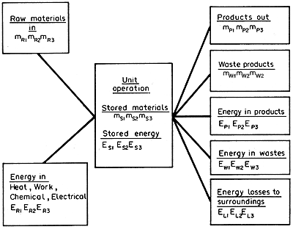
Basic principles of material (mass) and energy balances

Slide 5
MATERIAL AND ENERGY BALANCES
Material quantities, as they pass through food processing operations, can be described by material balances.
Such balances are statements on the conservation of mass.
Similarly, energy quantities can be described by energy balances, which are statements on the conservation of energy.
If there is no accumulation, what goes into a process must come out.

Slide 6
This is true for batch operation. It is equally true for continuous operation over any chosen time interval.
Material and energy balances are very important in the food industry.
Material balances are fundamental to the control of processing, particularly in the control of yields of the products and needs to be reviewed periodically

