Slide 1
ME110 FIRST APPLICATION

Slide 2
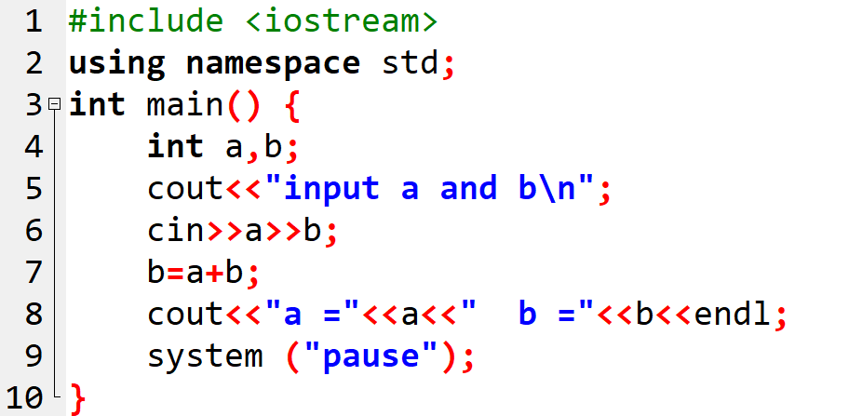
Question 1

Slide 3
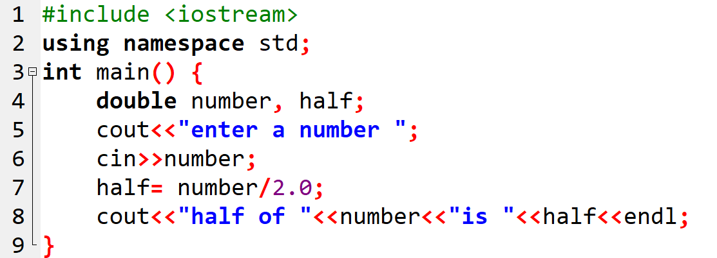
Question 2

Slide 4
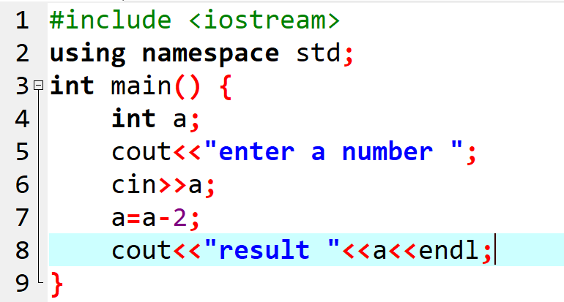
Question 3

Slide 5

Question 4

Slide 6

Question 6

Slide 7
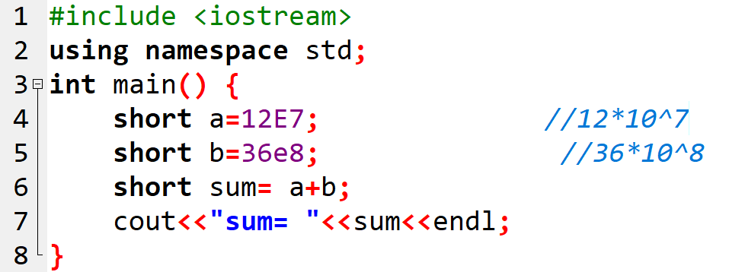
Question 7

Slide 8

Question 7

Slide 9
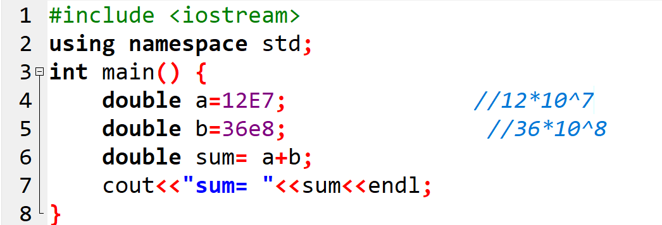
Question 7

Slide 10

Question 7

Slide 11

Question 8

Slide 12

Question 9

Slide 13
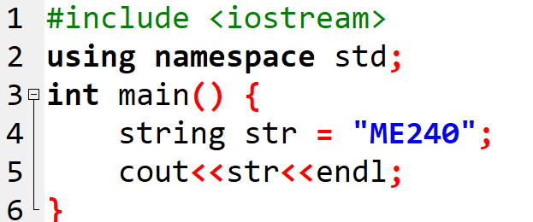
Question 10

