Slide 1
ME110 FIRST APPLICATION

Slide 2
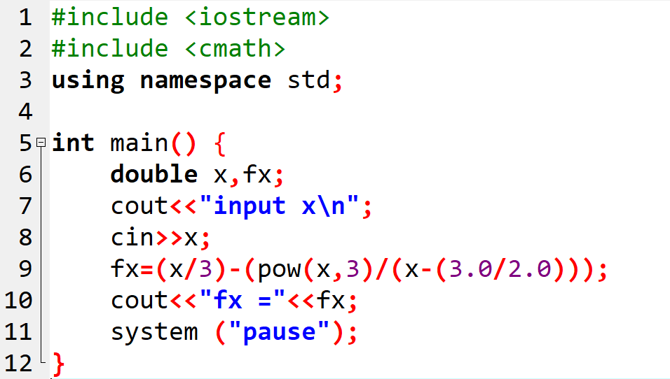
Question 1

Slide 3
Question 2
a) z=(a+b)/(c+d)
b) z=a+((b/(c+d))
c) z=((a+b)/c)+d
d) z=(a+b)/(c+(d/(e+f)))

Slide 4
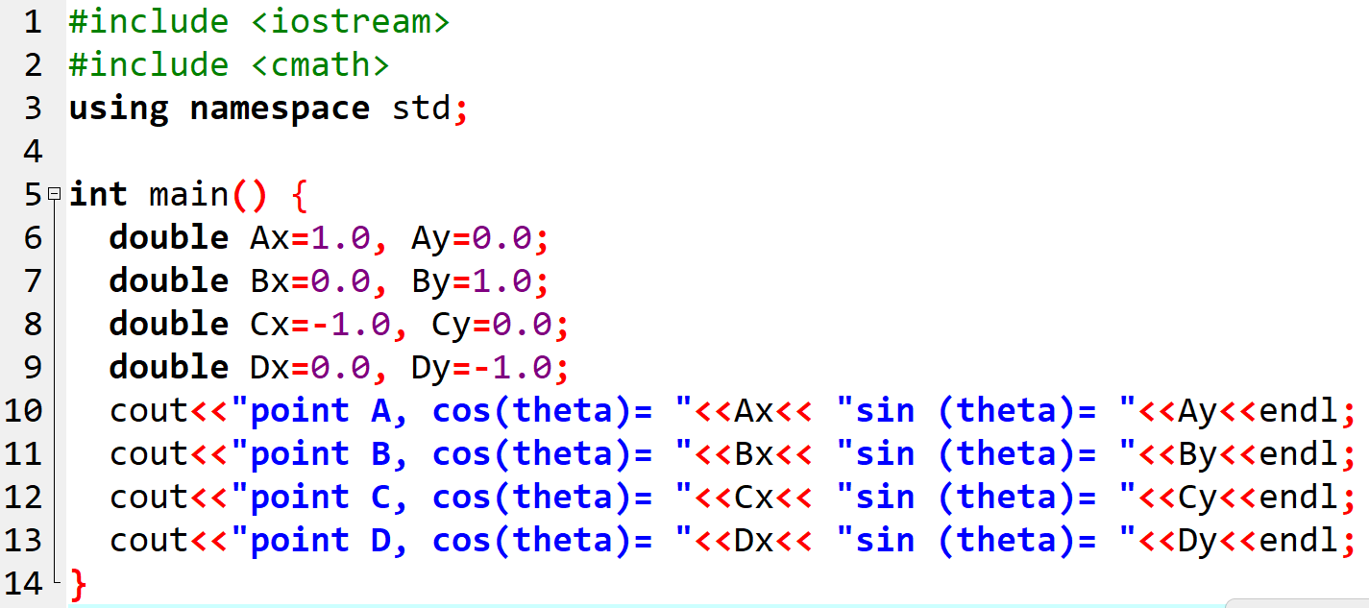
Question 3

Slide 5
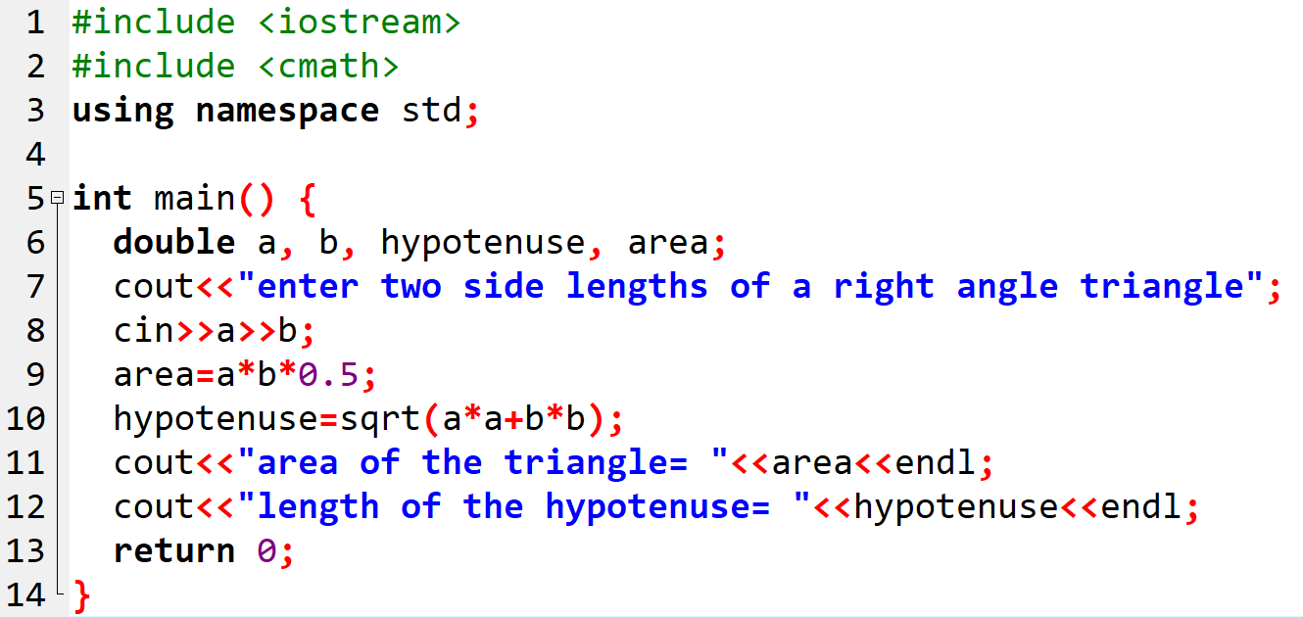
Question 4

Slide 6
Question 5
double(5/(-2))+1
=-2.5+1
=-1.5

Slide 7
Question 6
abs(-2.3)/2+1.3*sqrt(4.)/double(5/2)
=2.3/2+1.3*2/2.5
=2.45

Slide 8
Question 7
double x=10.0, y=0.01, z=0.5 ;
int i=10, j=25, k=3 ;
cout << ceil(j/x)+floor(x+j/2) ; 3.0+22.0=25
cout << z * x / 10 + k ; 0.5*10.0/10+3=3.5
cout << z * k + z * j + z * i ; 0.5*3+0.5*25+0.5*10=19
cout << i * y - k / x + j ; 10*0.01-3/10.0+25=24.8

Slide 9
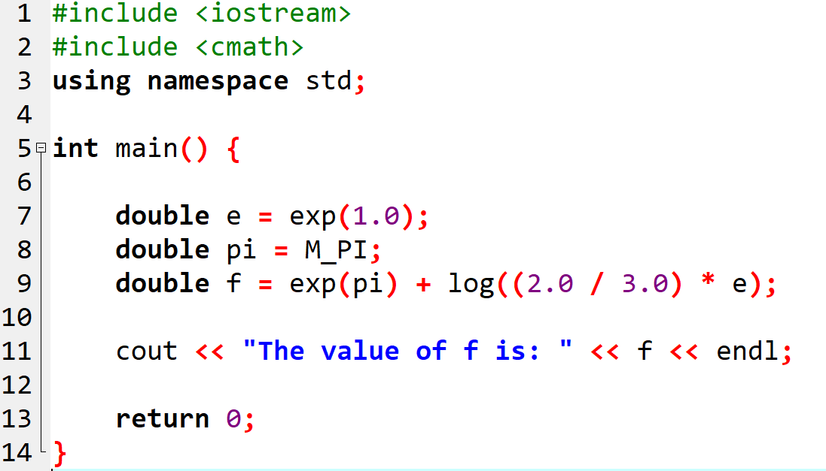
Question 8

