Slide 1
ENZYMES
Key definitions:
Enzymes are proteins that accelerate chemical reactions.
Substrates: The molecules present at the beginning of the reaction are called substrates. Reactant which binds to enzyme
Product: Enzymes convert substrates into different molecule
Active site: A restricted region of an enzyme molecule which binds to the substrate. It is formed from amino acids sequences in the polypeptide chain .

Slide 2
FACTORS AFFECTING ENZYME ACTIVITY
Several factors affect the rate at which reactions proceed, such as
  temperature,
  pH,
  enzyme concentration,
  time,
  substrate concentration and
  the presence of any inhibitors or activators.

Slide 3
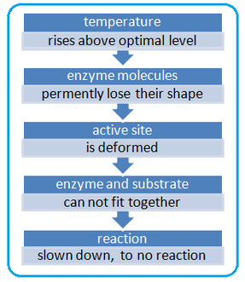
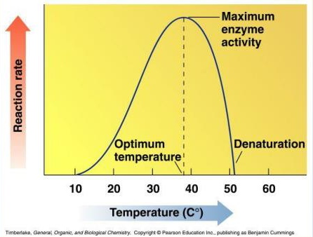
FACTORS AFFECTING ENZYME ACTIVITY (Continued)
Effect of Temperature
The rate of an enzyme-catalyzed reaction increases as the temperature is raised.
However, very high temperatures denature enzymes.
Most animal enzymes rapidly become denatured at temperatures above 40°C.
Enzymes are most active at on optimum temperature

Slide 4
The effect of temperature on reaction rate is due to:
1- Increase of temperature increase the initial energy of substrate and thus decrease the activation energy
2- Increase of collision of molecules: more molecules become in the bond forming or bond breaking distance.

Slide 5
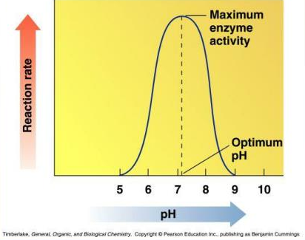
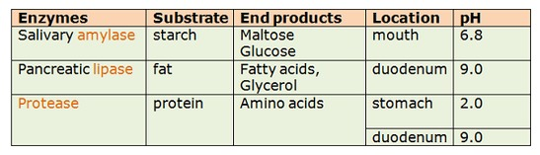
FACTORS AFFECTING ENZYME ACTIVITY (Continued)
Effect of pH
The most favorable pH value - the point where the enzyme is most active - is known as the optimum pH.
Extremely high or low pH values generally result in complete loss of activity for most enzymes.
An extreme pH can denature enzymes – the active site is deformed permanently.

Slide 6
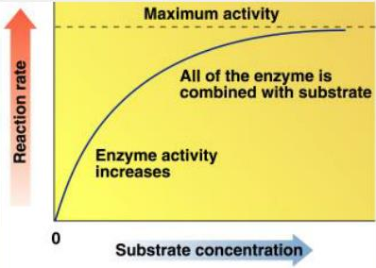
FACTORS AFFECTING ENZYME ACTIVITY (Continued)
Effect of Substrate Concentration
If the amount of the enzyme is kept constant and the substrate concentration is then gradually increased, the reaction velocity will increase until it reaches a maximum. After this point, increases in substrate concentration will not increase the velocity

Slide 7
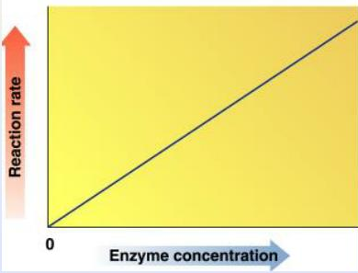
FACTORS AFFECTING ENZYME ACTIVITY (Continued)
Enzyme Concentration
As the concentration of enzyme increases, rate of reaction will also increase (at constant substrate concentration)

Slide 8
FACTORS AFFECTING ENZYME ACTIVITY (Continued)
Effect of time
In an enzymatic reaction, the rate of reaction is decreased by time.
Because of the reasons
1. The decrease in substrate concentration.
2. The accumulation of the end products.
3. The change in PH than optimum PH.

Slide 9
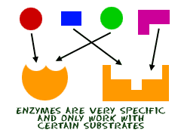
Specificity of Enzymes
What is enzyme specificity?
  Ability of an enzyme to choose exact substrate
  It is a molecular recognition mechanism
  Recogntion and specificity is based on structural complemetarity
The specificity of enzymes is determined by complementary shape, charge, hydrophilic/ hydrophobic characteristics of the substrates and their three-dimensional organization.

Slide 10
Specificity of enzymes
The specificity of enzymes is one of their unique properties.
They are specific not only to the reactions they catalyze, but also to the substrates they utilize.
Therefore, they may be categorized based on their different exhibited specificities, as absolute specificity, group specificity, linkage specificity, and stereospecificity.

Slide 11
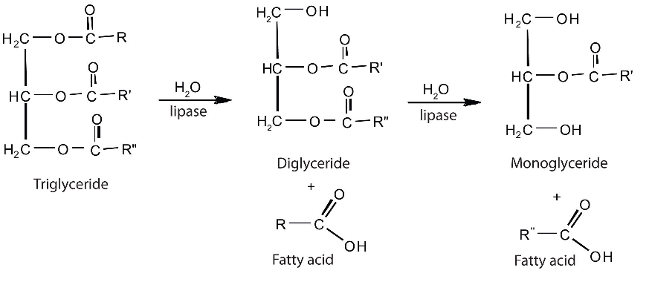
Specificity of Enzymes (Continued)
Absolute specificity: Enzymes exhibit absolute specificity act only on one substrate or one reaction

Slide 12
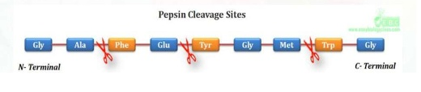
Specificity of Enzymes (Continued)
(2) Group specificity: group specific enzymes act only on molecules that have specific functional groups, such as amino, phosphate or methyl groups.

Slide 13
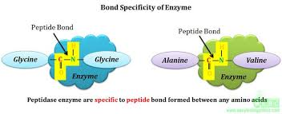
Specificity of Enzymes (Continued)
(3) Linkage specificity: such enzymes act on chemical bonds of certain nature, regardless of the rest of the molecular structure.

Slide 14
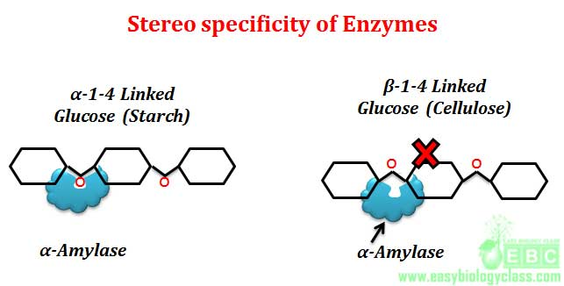
Specificity of Enzymes (Continued)
(4) Stereochemical specificity: stereospecific enzymes act only on a particular steric or optical isomer and not on their isomeric counterparts.

Slide 15
INDUSTRIAL ENZYMES
Enzymes are highly efficient biocatalysts researched for industrial-scale catalysis because of their several distinct advantages in comparison with chemicals catalysts
  The ability to work under milder reaction conditions
  Product selectivity
  Catalysts
  Lower environmental and physiological toxicity.
Industrial enzymes may be derived from a wide variety of plant, animal or microbial sources, although most production processes rely on microbial sources. However, over the years, advancements in biotechnology have resulted in newer and more highly efficient varieties of enzymes.

Slide 16
INDUSTRIAL ENZYMES (Continued)
Microbes are preferred to plants and animal as industrial enzyme source for the following reasons:
1. Higher expression levels.
2. Higher purity (% enzyme protein vs. % other components).
3. Cheaper production due to the above.
4. Their enzyme contents are more predictable and controllable
5. Plant and animal tissues contain more potentially harmful materials than microbes

Slide 17
Industrial Enzymes
Commodity enzymes
  High volume (tonnes p.a)
  Low purity (but not necessarily so)
  Low cost (e.g. $5-40 per kg)
  Low profit margins
Speciality enzymes
  Low volume (g – kg)
  High purity
  High cost ($5 – 10,000 per g)
  High profit margins

Slide 18
INDUSTRIAL ENZYMES (Continued)
Industrial applications of enzyme catalysis

Slide 19
INDUSTRIAL ENZYMES (Continued)
In industry, generally immobilized enzymes are used.
Immobilized enzyme is either physically entrapped or covalently bonded by chemical means to an inert insoluble matrix or carrier. This matrix or carrier protects enzyme from degradation and deactivation.
Enzyme immobilization is a process of confining the enzyme to a solid support over which a substrate is passed and converted to products.

Slide 20
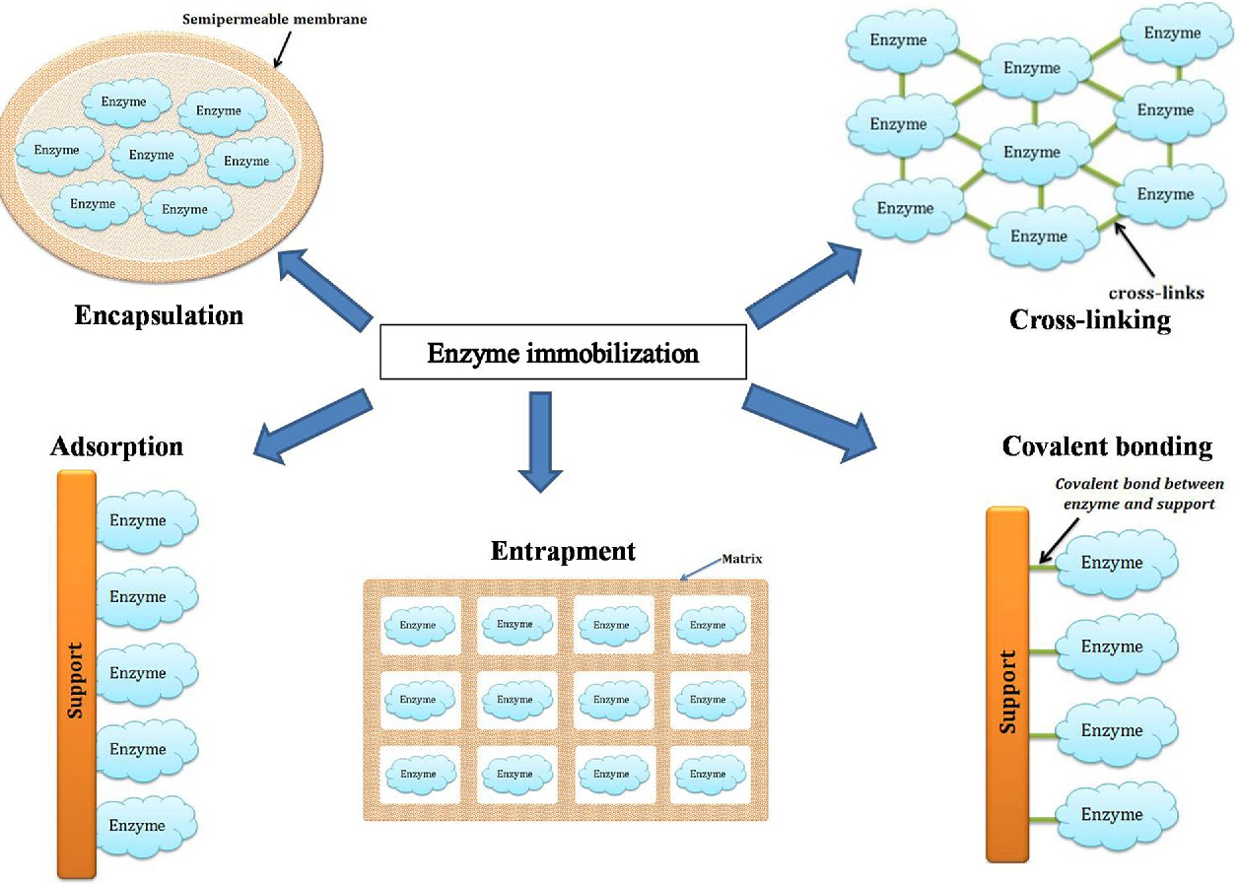
INDUSTRIAL ENZYMES (Continued)

Slide 21
INDUSTRIAL ENZYMES (Continued)
Advantages of Immobilized Enzymes:
  Attachment to polymers/ matrix causes repetitive use of enzyme
  Immobilized enzymes are usually more stable compared to free enzyme (e.g. pH, temperature..)
  Easy separation of the enzyme from the product
  Ability to stop the reaction rapidly by removing the enzyme from the product
  Product is not contaminated with the enzyme
  Reduces the effluent disposal problems
  Cost effective

Slide 22
INDUSTRIAL ENZYMES (Continued)
Disadvantages of Immobilized Enzymes:
  Additional cost
  Loss or reduction in activity
  Diffusional limitation problems (Diffusion of substrate to enzyme)
Determining the appropriateness of implementing immobilized biocatalysis on an industrial scale requires a critical evaluation of both technical and economic factors as well as of the process in consideration.

Slide 23
ENZYMES IN FOOD INDUSTRY
Food processing combines raw food ingredients to produce marketable food products that can be easily prepared and served to consumer.
Traditional chemical synthesis routes are not viable for food products due to reagent toxicity and complex reaction chemistries that result in unfavorable process economics.
Their high substrate specificity, rapid reaction rates, and ability to work effectively at relatively low temperatures make them ideal for food processing.

Slide 24
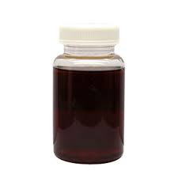
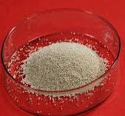
Sources of Enzymes in Food Industry
Enzyme preparations used in food industries are obtained from animal, plant, or microbial sources and may consist of whole cells, parts of cells, or cell-free extracts of the source used.
They may be available in liquid, semiliquid, dry, or an immobilized form.

Slide 25
Enzyme Applications in Food Industry
In food production, enzymes have a number of advantages.
Enzymes are alternatives to traditional chemical-based technology. Enzymes can thus replace synthetic chemical-based technology.
(2) Enviromental performance of processes by lowering energy consumption
(3) Enzymatic processes have fewer side reactions and by-products (waste-products) since they are more specific.
The result is higher quality products and less pollution.
(4) Enzymes can catalyze reactions under very mild conditions, allowing mild processing conditions which do not
destroy valuable attributes of foods and food components.

Slide 26
Enzyme Applications in Food Industry (Continued)
The use of enzymes in industrial processes is often associated with reduced consumption of energy, chemical inputs, and waste streams.
For example, using phospholipase to degum vegetable oil led to a decrease of 44 tons of equivalent CO2 generation per 1000 tons of oil produced, due to improvement in oil yield and a subsequent decrease in feedstock requirements.

Slide 27
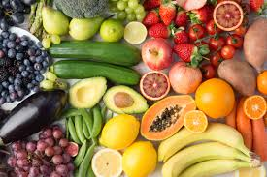
Enzyme Applications in Food Industry (Continued)
ENZYMES USED IN FRUIT JUICE EXTRACTION
To increase the juice yield
To clarify the juice
To break down all insoluble carbohydrates (pectins, hemicelluloses and starch)
Enzymes | Benefits
Pectinase used for maceration of fruits/vegetables prior to extraction | Increases yield, Faster extraction, Increases sugar extraction, Increasinfg process capacity
Carbohydrase used in the maceration prior to extraction
Pectinase | Produces clear juice and concentrate

Slide 28
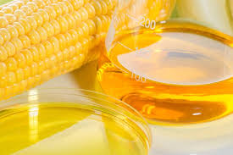
Enzyme Applications in Food Industry (Continued)
ENZYMES USED IN STARCH INDUSTRY
Production of high fructose corn syrup and sweeteners
FEEDSTOCK | PRODUCT | ENZYME(S)
STARCH | CORN SYRUPS | α-AMYLASES,PULLULANASE
 | GLUCOSE | α-AMYLASE,GLUCOAMYLASE
 | FRUCTOSE | α- AMYLASE,GLUCOAMYLASE, GLUCOISOMERASE

Slide 29
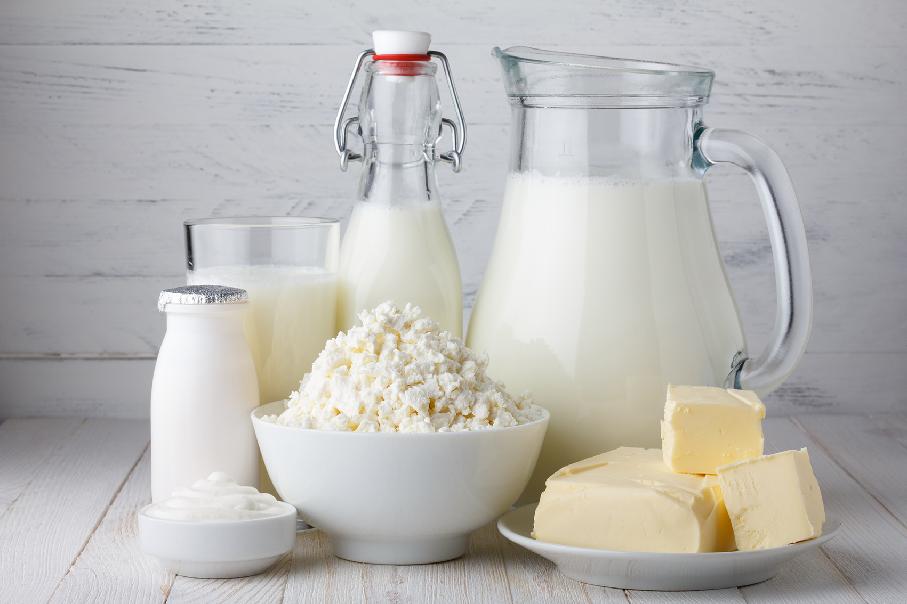
Enzyme Applications in Food Industry (Continued)
ENZYMES IN MILK AND DAIRY PRODUCTS
Milk is processed and converted into yoghurt, buttermilk, cheese, butter, cream via fermentation.
ENZYMES | FUNCTIONS
Chymosin | Milk coagulation
Proteases | Flavour improvement, decrease ripening time of cheeses
Lipases | Flavour improvement, decrease ripening time of cheeses
Sulphydryl oxidase | Remove cooked flavour
β-Galactosidase | Lactose removal
Proteases | Soyabean milk coagulation

Slide 30
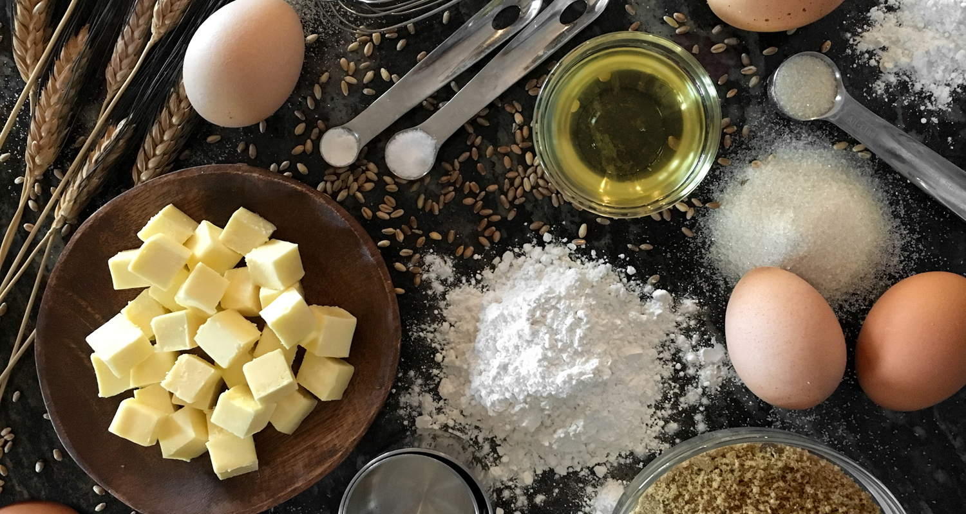
Enzyme Applications in Food Industry (Continued)
ENZYMES IN BAKING
They improve the dough and bread quality, leading to improved dough flexibility, stability, loaf volume and crumb structure
 | PURPOSE
Amylase | Maximise fermentation purpose;prevent staling
Protease | Improve handling and rheological properties
Glutamyl transferase | Improve dough elasticity;retention of bread softness on storage

Slide 31
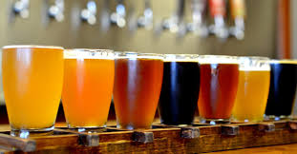
Enzyme Applications in Food Industry (Continued)
ENZYMES IN BREWING
Employs the fermantation process to produce the wine, beer and sake
ENZYME | PURPOSE
amylase(α and β) | Convert starch to maltose and dextrins
Proteases | Hydrolyze proteins to amino acids;used by yeast to grow
Papain | Chill proofing beer

Slide 32
References
Sirisha, V. L., Jain, A., & Jain, A. (2016). Enzyme immobilization: an overview on methods, support material, and applications of immobilized enzymes. In Advances in food and nutrition research (Vol. 79, pp. 179-211). Academic Press.
Chapman, J., Ismail, A. E., & Dinu, C. Z. (2018). Industrial applications of enzymes: recent advances, techniques, and outlooks. Catalysts, 8(6), 238.
Chandrasekaran, M. (Ed.). (2015). Enzymes in food and beverage processing. CRC Press.

