Slide 1
ME 224
STRENGTH OF MATERIALS
Assoc. Prof. Dr. Nurettin Furkan DOĞAN
Department of Mechanical Engineering
E-mail: nfdogan@gantep.edu.tr
Office: Mechanical Engineering Department Building
4th Floor, No: 303

Slide 2
Course Description
STRENGTH OF MATERIALS ME 224
Credit Structure: (3-1)4
Course Objectives:
The main objective of the course is to develop in the second-year mechanical engineering students a clear understanding of relationship between the loads applied to elastic bodies, and the resultant stresses, strains and deformations.
Prerequisities:
ME 201 Statics
Textbook(s):
F.P. Beer and E.R. Johnston, “Mechanics of Materials”,
McGraw-Hill Int Book Company
Reference:
R.C. Hibbeler, "Mechanics of materials", Prentice Hall Inc, 1997
Instructors: Prof. Dr. Ömer Yavuz BOZKURT, Assoc. Prof. Dr. Nurettin Furkan DOĞAN
Exams: 1. Midterm 30% ;2. Midterm 30% ; Final: 40%
Attendance: The attendance of 70% is mandatory.
E-mails : oybozkurt@gantep.edu.tr
nfdogan@gantep.edu.tr

Slide 3
2024-2025 SPRING SEMESTER ME 224 GENERAL CONTENT
INTRODUCTION | 25.02.2025 | EXAMS First and Second Examination dates will be announced by the department. Textbook Mechanics of Materials By Ferdinand P. Beer and E. R. Johnston Auxiliary Books Mechanics of Materials By R.C. Hibbeler Many books related with the Strength in the Library
Ch 1. Normal, Shear stress | 28.02.2025
Ch 1. Oblique Plane,Factor of Safety | 04.03.2025
Ch 1. Pr.Hr. | 07.03.2025
STRESS AND STRAIN Ch 2. Stress-Strain- Deformation | 11.03.2025
Ch 2. Pr.Hr. | 14.03.2025
Ch 2. Statically Indeterminate Pr. | 18.03.2025
Ch 2. Poissons’ Raito and so on | 21.03.2025
Ch 2. Pr.Hr. | 25.03.2025
TORSION Ch 3. Torsion | 28.03.2025
Ch 3. Pr.Hr. | 04.04.2025
Ch 3. Power Transmission | 08.04.2025
PURE BENDING Ch 4. Pure Bending | 11.04.2025
Ch 4. Pr.Hr. | 15.04.2025
Ch 4. Eccentic Axial Loading | 18.04.2025
Ch 4. Pr.Hr. | 22.04.2025
FIRST EXAM | --.--.----

Slide 4
2023-2024 SPRING SEMESTER ME 224 GENERAL CONTENT
SHEARING STRESS Ch 6. in Beams | 29.04.2025 | EXAMS First and Second Examination dates will be announced by the department. Textbook Mechanics of Materials By Ferdinand P. Beer and E. R. Johnston Auxiliary Books Mechanics of Materials By R.C. Hibbeler Many books related with the Strength in the Library
Ch 6. Pr.Hr. | 02.05.2025
Ch 6. in Thin walled members | 06.05.2025
Ch 6. Pr.Hr. | 09.05.2025
PRINCIPAL STRESSES UNDER A GIVEN LOADING Ch 8. Combined Loadings | 13.05.2025
Ch 8. Pr.Hr. | 16.05.2025
TRANSFORMATION OF STRESS Ch 7. Transformation of Plane Stress and Mohr’s Circle | 20.05.2025
Ch 7. Pressure Vessels and Yield Criteria’s | 23.05.2025
Ch 7. Pr.Hr. | 27.05.2025
DEFLECTION OF BEAMS Ch 9. Integration (Deflection of Beams) | 30.05.2025
Ch 9. Singularity Function(Deflection of Beams) | 03.06.2025
Ch 9. Singularity Function(Deflection of Beams) | --.--.----
Ch 9. Pr. Hr. | --.--.----
SECOND EXAM | --.--.----

Slide 5
Chapter 1- Introduction Concept of Stress

Slide 6
Mechanics In Science
Mechanics is one the essential branch in physics. It can be examining in solid mechanics and fluid mechanics.
Mechanics
Solid Mechanics
Fluid Mechanics
Rigid Bodies
Deformable Bodies
. . . . .
Statics
Dynamics
Elasticity
Plasticity
Fracture
Thermo-elasticity
Advanced Mechanics of Materials
Under Some simplification assumptions
(Geometry; Boundary Conditions; Material model simplifications)
Mechanics of Materials

Slide 7
Main Objective of Mechanics of Materials
The main objective of the study of mechanics of materials is to provide the future engineer with the means of analyzing and designing tips various machines, machine elements and structures.
Both the analysis and design of a given structure involve the determination of stresses and deformations.

Slide 8
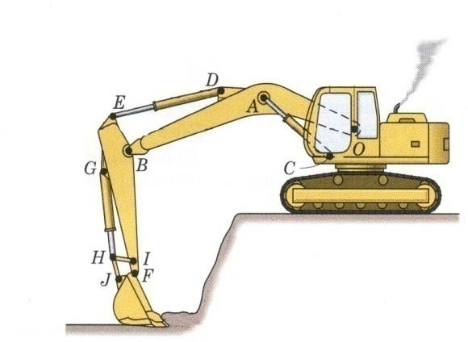
Method of Analysis
APPLIED LOAD
STIFFNESS
EQUILIBRIUM
STRUCTURE
DEFORMATION
STRESS
COMPATIBILITY
CONSTITUTIVE
STRAIN

Slide 9
Review of Statics
Statics has two main goals:
Introduction to basic concepts of force, couples and moments in two and three dimensions structures.
Developments of analytical skills relevant to the areas of mentioned in above.

Slide 10
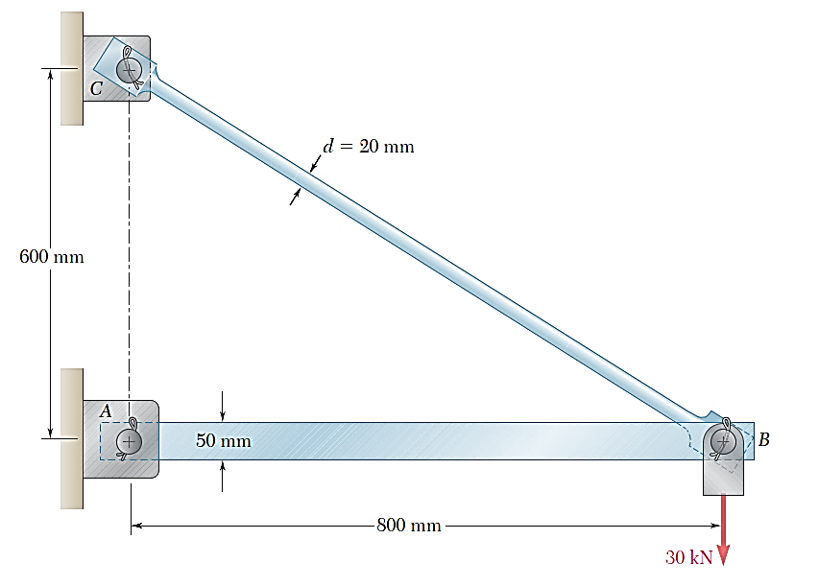
Example in Statics
The structure consists of a boom (50mm x 30 mm) and rod (d=20mm) joined by pins at the junctions and supports
Determine the internal force in each structural member and the reaction forces at the supports

Slide 11
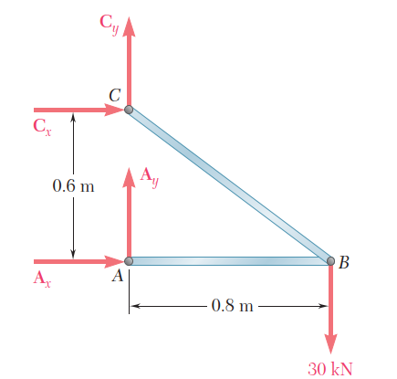
Structure Free-Body Diagram
Structure is detached from supports and the external loads and reaction forces are indicated
Conditions for static equilibrium:
A_{y} and C_{y} can not be determined from these equations

Slide 12
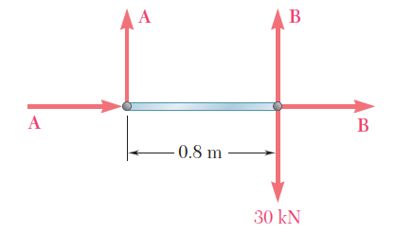
Component Free-Body Diagram
In addition to the complete structure, each component and each point must satisfy the conditions for static equilibrium
Consider a free-body diagram for the boom:
substitute into the structure equilibrium equation
Results:
Reaction forces are directed along boom and rod

Slide 13
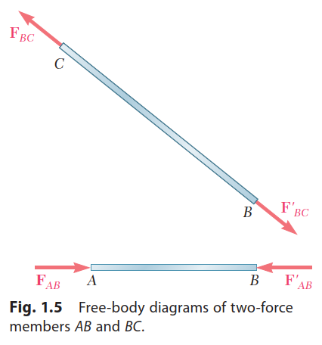
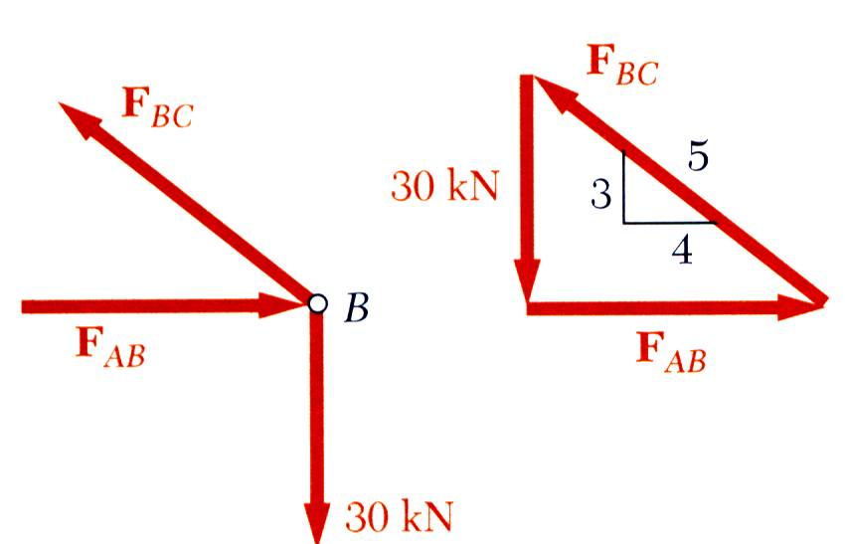
Method of Joints
Alternative Solution Of Using Two Force Members Concept
The boom and rod are 2-force members, i.e., the members are subjected to only two forces which are applied at member ends
For equilibrium, the forces must be parallel to to an axis between the force application points, equal in magnitude, and in opposite directions
Joints (points) must satisfy the conditions for static equilibrium which may be expressed in the form of a force triangle:

Slide 14
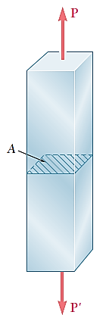
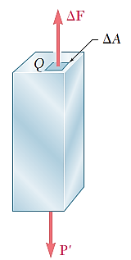
Axial Loading: Normal Stress
Consider an axially loaded member. The resultant of the internal forces for an axially loaded member is normal to a section cut perpendicular to the member axis.
The force intensity (force per unit area) on that section is defined as the normal stress, $σ$ (sigma).
Average Normal stress in a member under axial loading
A positive sign indicates a tensile stress (member in tension), and a negative sign indicates a compressive stress (member in compression).

Slide 15
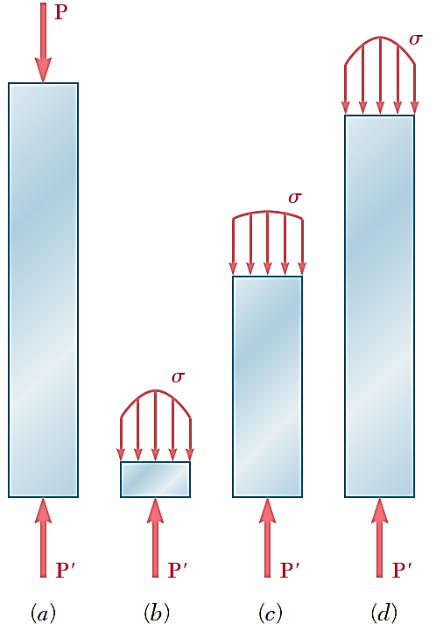
Normal Stress$(σ)$ in Axially Loaded Members
To define the stress at a given point Q of the cross section, consider a small area $∆A$
$$σ =\lim_{ΔA→0}{\frac{ΔF}{ΔA}}$$
The normal stress at a particular point may not be equal to the average stress but the resultant of the stress distribution must satisfy
The detailed distribution of stress is statically indeterminate, i.e., can not be found from statics alone.
Notes:
In a slender rod subjected to equal and opposite concentrated loads P and P’ (Fig. 1.10a), this variation is small in a section away from the points of application of the concentrated loads (Fig. 1.10c), but it is quite noticeable in the neighborhood of these points (Fig. 1.10b and d).

Slide 16
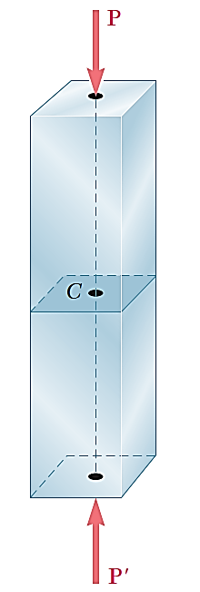
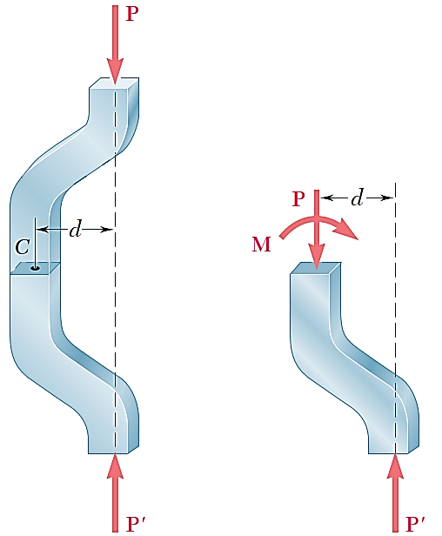
Centric & Eccentric Loading
A uniform distribution of stress in a section infers that the line of action for the resultant of the internal forces passes through the centroid of the section.
A uniform distribution of stress is only possible if the concentrated loads on the end sections of two-force members are applied at the section centroids. This is referred to as centric loading.
If a two-force member is eccentrically loaded, then the resultant of the stress distribution in a section must yield an axial force and a moment.
The stress distributions in eccentrically loaded members cannot be uniform or symmetric.

Slide 17
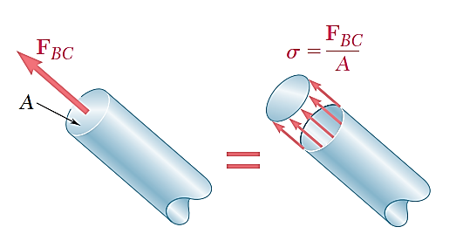
Stress Analysis
1.b. Stress analysis for the BC member (except connection region)
Can this structure safely support the 30 kN load?
From a statics analysis
F_{AB} = 40 kN (compression)
F_{BC} = 50 kN (tension)
At any section through member BC (except connection region), the internal reaction force is 50 kN with a force intensity or stress of
d_{BC} = 20 mm
From the material properties for steel, the allowable stress is
Conclusion: the strength of member BC is adequate

Slide 18
Design
1.c. Design for the BC member (Changing material from steel to aluminum)
For reasons based on cost, weight, availability, etc., the choice is made to construct the rod from aluminum (σ_{all}= 100 MPa). What is an appropriate choice for the rod diameter?
An aluminum rod 26 mm or more in diameter is adequate

Slide 19
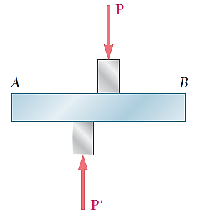
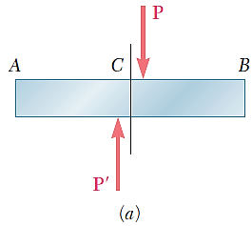
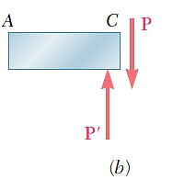
Shearing Stress $(τ)$
Force P is applied transversely to the member .
Corresponding internal forces act in the plane of section A and are called shearing forces.
The resultant of the internal shear force distribution is defined as the shear of the section and is equal to the load P.
The corresponding average shear stress is,

Slide 20
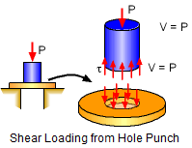
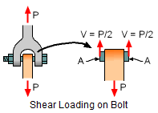
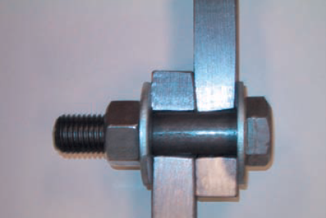
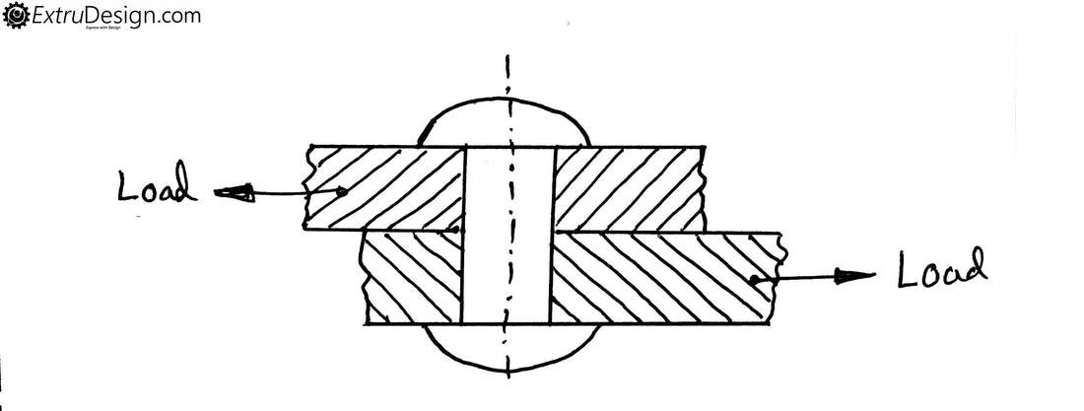
Shearing Stress Examples

Slide 21
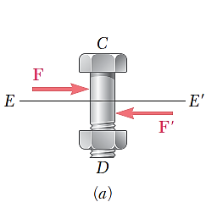
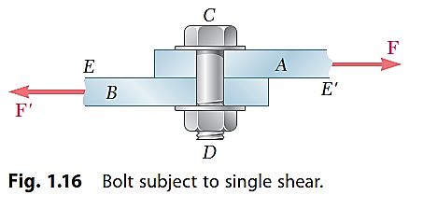
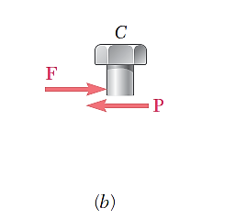
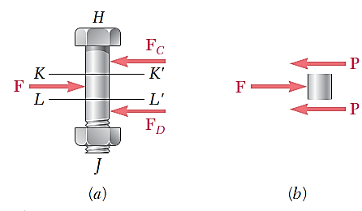
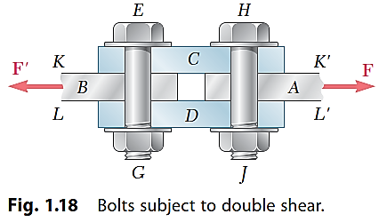
Shearing Stress Examples

Slide 22
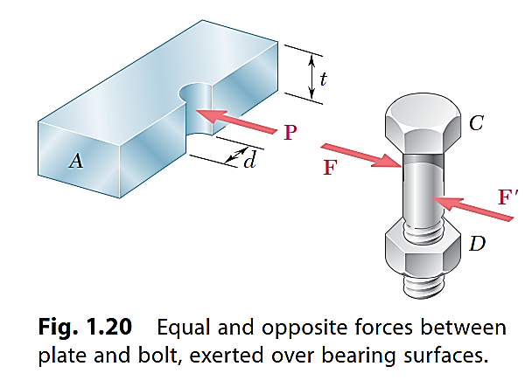
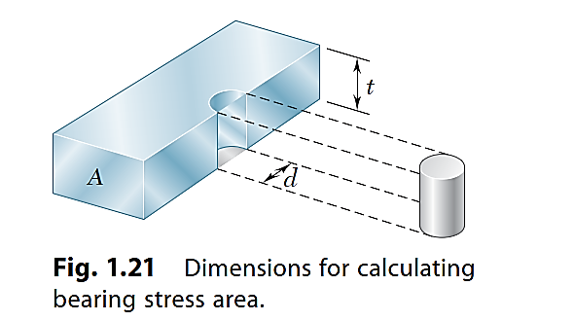
Bearing Stress in Connections
Bolts, rivets, and pins create stresses on the points of contact or bearing surfaces of the members they connect.
The resultant of the force distribution on the surface is equal and opposite to the force exerted on the pin.
Corresponding average force intensity is called the bearing stress,

Slide 23
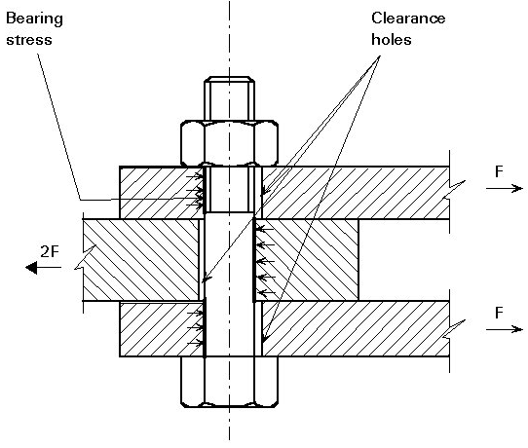
More on Bearing Stress

Slide 24
Linkage in Tension and Compression
Force is affecting the hatched area under tension.
For this case, circular part is also checked.
Force is affecting the hatched area under compression

Slide 25
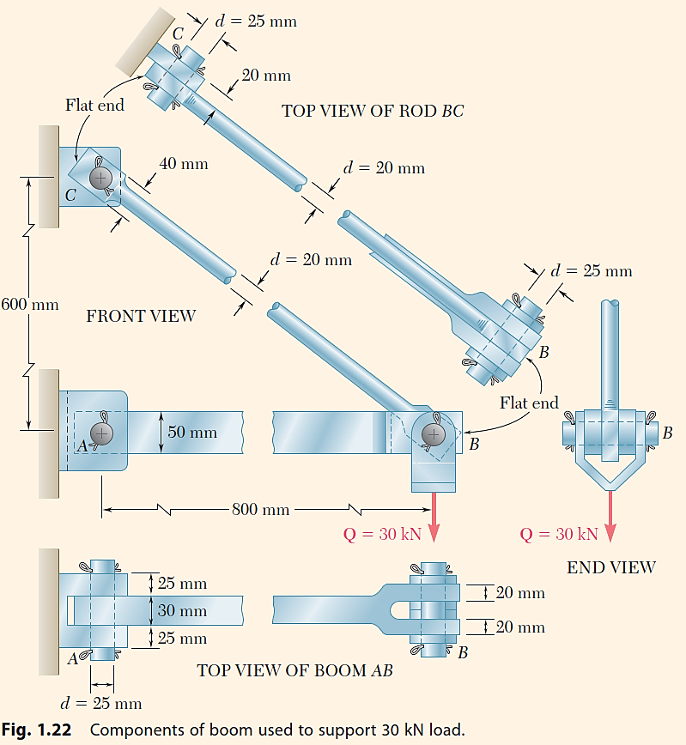
Stress Analysis & Design Example
1.d. A complete Stress analysis for the AC and BC member (including connection region)
Would like to determine the stresses in the members and connections of the structure shown.
From a statics analysis:
F_{AB} = 40 kN (compression)
F_{BC} = 50 kN (tension)
Must consider maximum normal stresses in AB and BC, and the shearing stress and bearing stress at each pinned connection

Slide 26
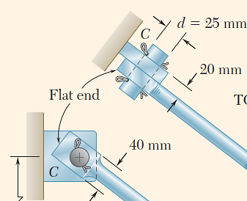
Rod & Boom Normal Stresses
The rod is in tension with an axial force of 50 kN.
At the rod center, the average normal stress in the circular cross-section (A = 314x10⁻⁶m²) is σ_{BC} = +159 MPa.
At the flattened rod ends, the smallest cross-sectional area occurs at the pin centerline,
The boom is in compression with an axial force of 40 kN and average normal stress of –26.7 MPa.
The minimum area sections at the boom ends are unstressed since the boom is in compression.

Slide 27
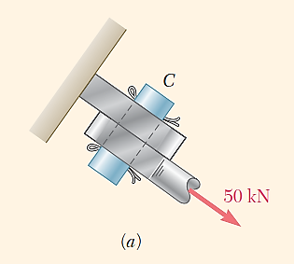
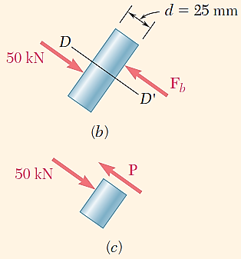
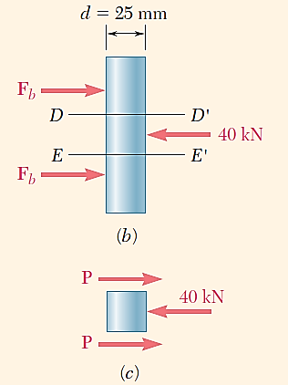
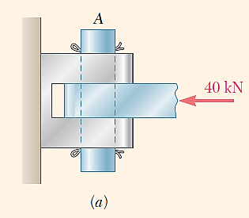
Pin Shearing Stresses
The cross-sectional area for pins at A, B, and C,
The force on the pin at C is equal to the force exerted by the rod BC,
The pin at A is in double shear with a total force equal to the force exerted by the boom AB,

Slide 28
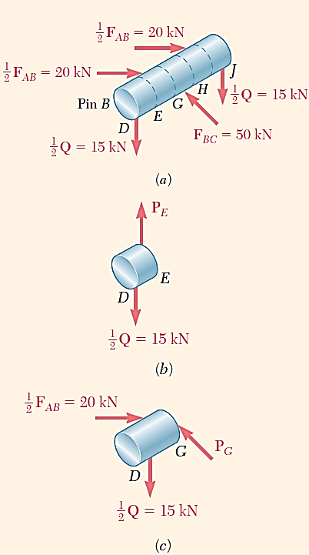
Pin Shearing Stresses
Divide the pin at B into sections to determine the section with the largest shear force,
Evaluate the corresponding average shearing stress,

Slide 29
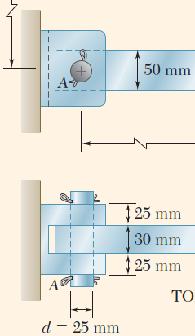
Pin Bearing Stresses
To determine the bearing stress at A in the boom AB, we have t = 30 mm and d = 25 mm,
To determine the bearing stress at A in the bracket, we have t = 2(25 mm) = 50 mm and d = 25 mm,

Slide 30
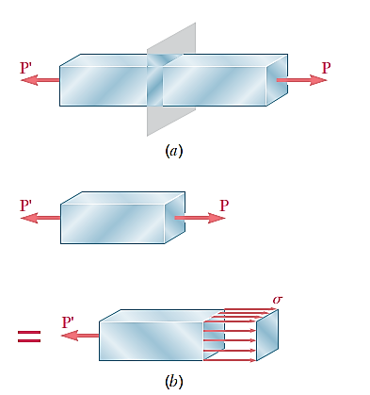
Stress in Two Force Members
Axial forces on a two-force member result in only normal stresses on a plane cut perpendicular to the member axis.
Transverse forces on bolts and pins result in only shear stresses on the plane perpendicular to bolt or pin axis.
We will show that either axial or transverse forces may produce both normal and shear stresses with respect to a plane other than one cut perpendicular to the member axis.

Slide 31
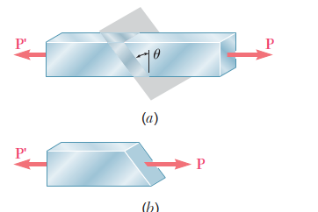
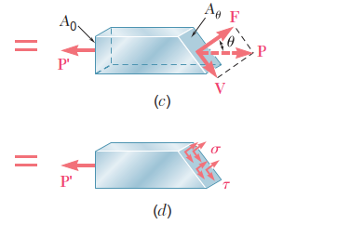
Stress on an Inclined Plane
Pass a section through the member forming an angle θ with the normal plane.
From equilibrium conditions, the distributed forces (stresses) on the plane must be equivalent to the force P.
Resolve P into components normal and tangential to the inclined section,
The average normal and shear stresses on the inclined plane are

Slide 32
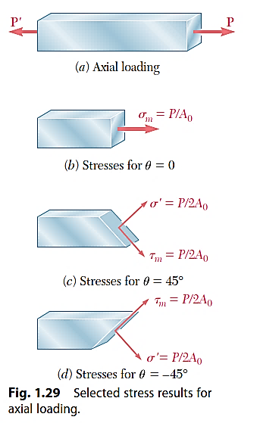
Maximum Stresses
Normal and shearing stresses on an inclined plane
The maximum normal stress occurs when the reference plane is perpendicular to the member axis,
The maximum shear stress occurs for a plane at + 45º with respect to the axis,

Slide 33
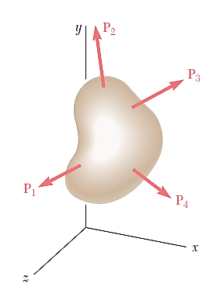
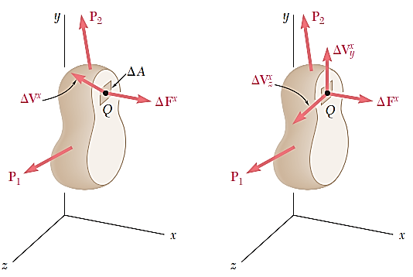
Stress Under General Loadings
A member subjected to a general combination of loads is cut into two segments by a plane passing through Q
The distribution of internal stress components may be defined as,
For equilibrium, an equal and opposite internal force and stress distribution must be exerted on the other segment of the member.

Slide 34
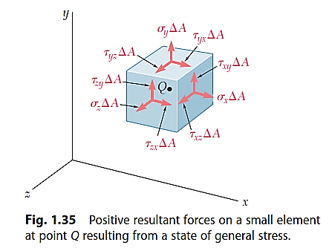
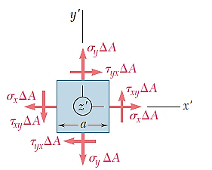
State of Stress
Stress components are defined for the planes cut parallel to the x, y and z axes. For equilibrium, equal and opposite stresses are exerted on the hidden planes.
The combination of forces generated by the stresses must satisfy the conditions for equilibrium:
Consider the moments about the z axis:
It follows that only 6 components of stress are required to define the complete state of stress

Slide 35
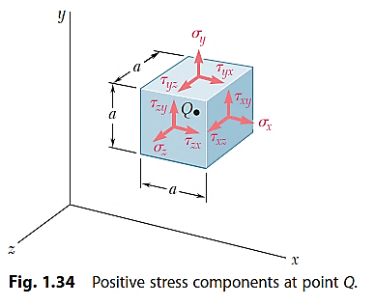
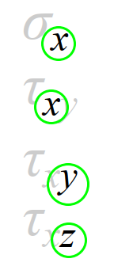
Normal stress is indicated with this symbol
Shearing stress is indicated with this symbol
These indices show the axis parallel to the normal of the surface on which the stress acts.
These indices show the axis to which the stress is parallel.

Slide 36
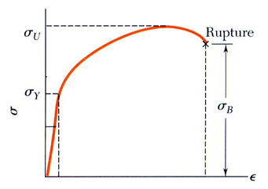
Allowable Load and Allowable Stress: Factor of Safety
The maximum load that a structural member or a machine component will be allowed to carry under normal conditions is considerably smaller than the ultimate load. This smaller load is the allowable load (sometimes called the working or design load).
The ratio of the ultimate load to the allowable load is used to define the factor of safety:
Structural members or machines must be designed such that the working stresses are less than the yield strength of the material.

Slide 37
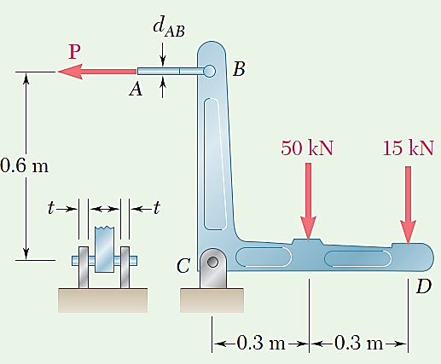
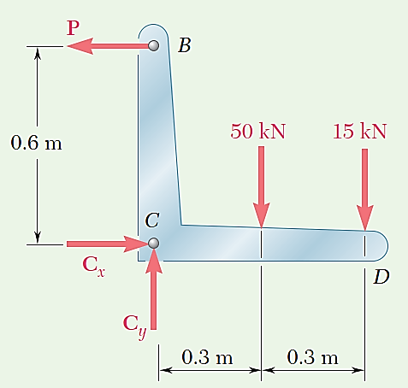
Sample Problem
Two loads are applied to the bracket BCD as shown. (a) Knowing that the control rod AB is to be made of a steel having an ultimate normal stress of 600 MPa, determine the diameter of the rod for which the factor of safety with respect to failure will be 3.3. (b) The pin at C is to be made of a steel having an ultimate shearing stress of 350 MPa. Determine the diameter of the pin C for which the factor of safety with respect to shear will also be 3.3. (c) Determine the required thickness of the bracket supports at C, knowing that the allowable bearing stress of the steel used is 300 MPa.
Using free-body diagram of bracket:
Free-body diagram of bracket.

Slide 38
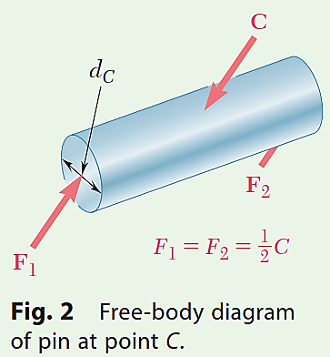
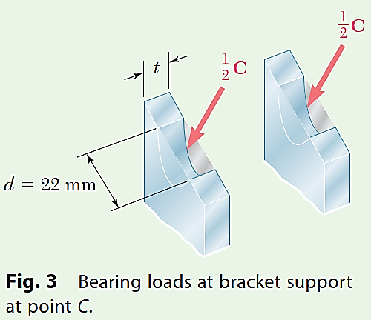

Slide 39
EXERCISE 1.
The 1.4-kip load P is supported by two wooden members of uniform cross section that are joined by the simple glued scarf splice shown. Determine the normal and shearing stresses in the glued splice.
EXERCISE 2.
Two wooden members of uniform cross section are joined by the simple scarf splice shown. Knowing that the maximum allowable tensile stress in the glued splice is 75 psi, determine (a) the largest load P that can be safely supported, (b) the corresponding shearing stress in the splice.

Slide 40
EXERCISE 3.
Link AB is to be made of a steel for which the ultimate normal stress is 65 ksi. Determine the cross-sectional area of AB for which the factor of safety will be 3.20. Assume that the link will be adequately reinforced around the pins at A and B.
EXERCISE 4.
Link BC is 6 mm thick, has a width w = 25 mm, and is made of a steel with a 480-MPa ultimate strength in tension. What is the factor of safety used if the structure shown was designed to support a 16-kN load P?

