Slide 1
Ch.2 Stress and StraIn AxIal LoadIng
Part I

Slide 2
Objectives
Concept of strain.
Relationship between stress and strain in different materials.
Determine the deformation of structural components under axial loading.
Hooke’s Law and the modulus of elasticity.
Concept of lateral strain and Poisson's ratio.
Solve indeterminate problems using axial deformations.
Saint-Venant’s principle and the distribution of stresses.

Slide 3
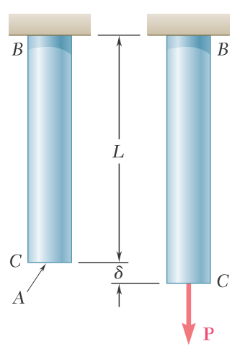
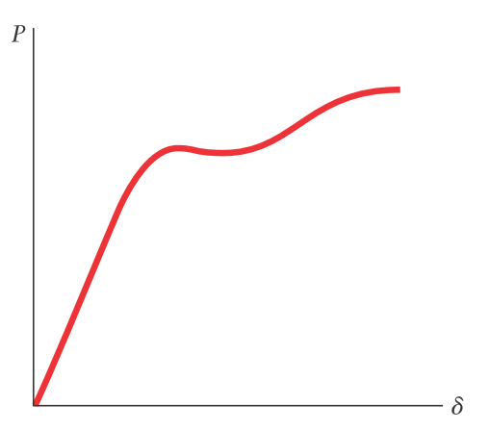
From the load-displacement we can obtain useful informations to the analysis of the rod for the BC rod. But, can it be used to predict the deformation of a rod of the same material but with different dimensions?

Slide 4
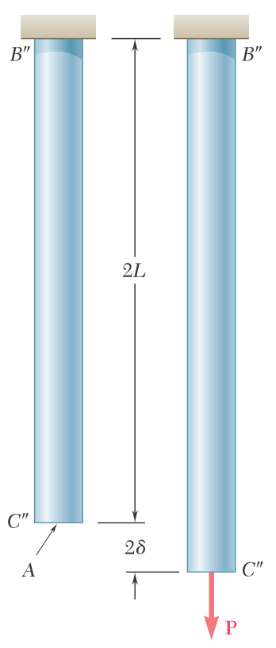
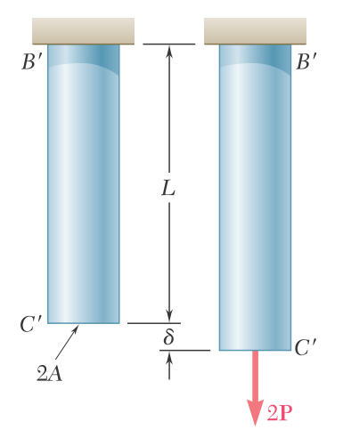
In both cases, the ratio of the deformation over the length of the rod is the same at $δ/L$.

Slide 5
Deformation per unit length in a rod under axial loading is called as normal strain.
The normal strain, $ε$ (Greek letter epsilon), is $ε=\frac{δ}{L}$
Since deformation and length are expressed in the same units, the normal strain $ε$ obtained by dividing $δ$ by L is a dimensionless quantity.
Plotting the stress $σ=\frac{P}{A}$ against the strain $ε=\frac{δ}{L}$ results in a curve that is characteristic of the properties of the material but does not depend upon the dimensions of the specimen used. This curve is called a stress-strain diagram.

Slide 6
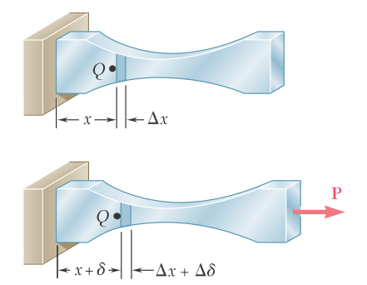
If the rod has a uniform cross section of area A, the normal stress $σ$ is assumed to have a constant value $P/A$ throughout the rod. The strain $ε$ is the ratio of the total deformation $δ$ over the total length L of the rod.
If the rod has a variable cross-sectional area A, the normal stress $σ=P/A$ varies along the member, and it is necessary to define the strain at a given point $Q$ by considering a small element of undeformed length $∆x$. Denoting the deformation of the element under the given loading by $∆δ$, the normal strain at point $Q$ is defined as
$$ε=\lim_{∆x→0}{\frac{∆δ}{∆x}}=\frac{dδ}{dx}$$

Slide 7
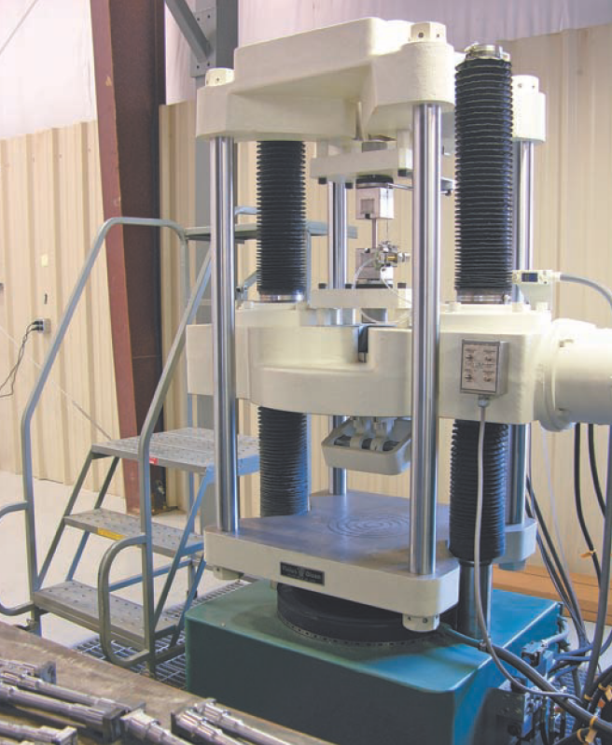
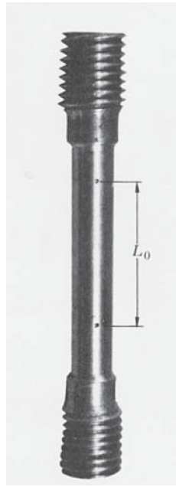
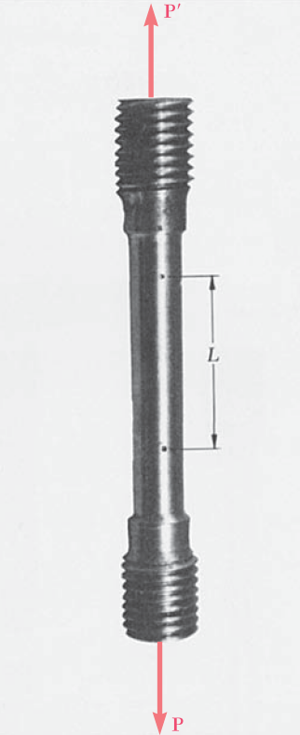
Stress-Strain Diagram
To obtain the stress-strain diagram of a material, a tensile test is conducted on a specimen of the material. The cross-sectional area of the cylindrical central portion of the specimen is accurately determined and two gage marks are inscribed on that portion at a distance $L_{0}$ from each other. The distance $L_{0}$ is known as the gage length of the specimen.
The test specimen is then placed in a testing machine, which is used to apply a centric load P. As load P increases, the distance L between the two gage marks also increases. The distance L is measured with a dial gage, and the elongation $δ=L−L_{0}$ is recorded for each value of P. A second dial gage is often used simultaneously to measure and record the change in diameter of the specimen.
From each pair of readings P and $δ$, the engineering stress $σ$ is
$$σ=\frac{P}{A_{0}}$$
and the engineering strain $ε$ is
$$ε=\frac{δ}{L_{0}}$$

Slide 8
The stress-strain diagram can be obtained by plotting $ε$ as an abscissa and $σ$ as an ordinate.
Stress-strain diagrams of materials vary widely, and different tensile tests conducted on the same material may yield different results, depending upon the temperature of the specimen and the speed of loading. However, some common characteristics can be distinguished from stress-strain diagrams to divide materials into two broad categories: ductile and brittle materials.

Slide 9
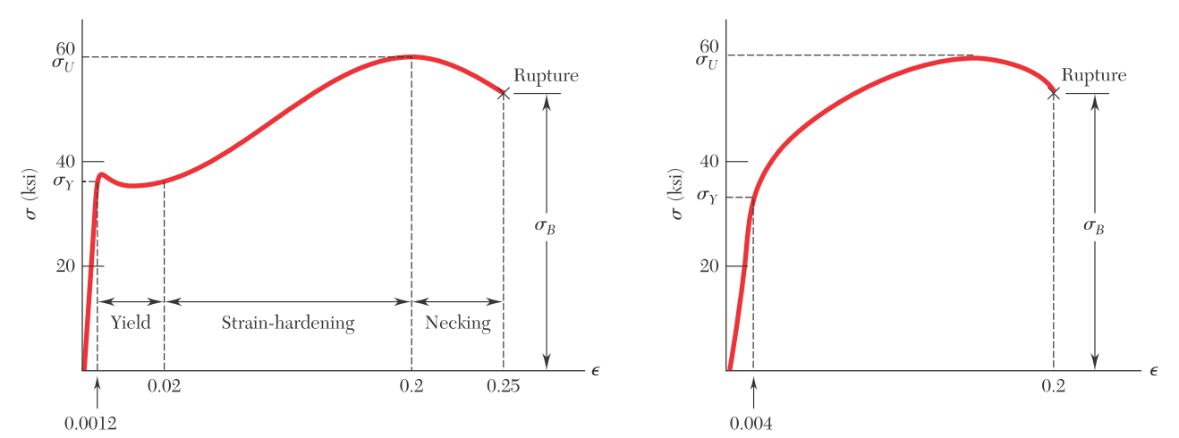
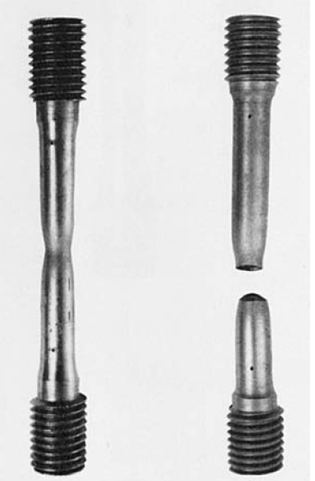
Stress-strain diagrams of two typical ductile materials

Slide 10
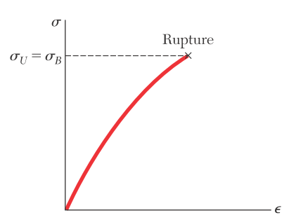
Stress-strain diagram of a typical brittle material

Slide 11
A standard measure of the ductility of a material is its percent elongation:
$$Percent elongation=100\frac{L_{B}−L_{0}}{L_{0}}$$
where $L_{0}$ and $L_{B}$ are the initial length of the tensile test specimen and its final length at rupture, respectively.
Another measure of ductility that is sometimes used is the percent reduction in area:
$$Percent reduction in area=100\frac{A_{0}−A_{B}}{A_{0}}$$
where $A_{0}$ and $A_{B}$ are the initial cross-sectional area of the specimen and its minimum cross-sectional area at rupture, respectively.

Slide 12
Determination of Yield Strength

Slide 13
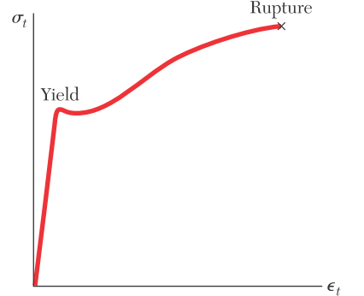
True Stress and True Strain
Engineering stress $σ=\frac{P}{A_{0}}$
True stress $σ_{t}=\frac{P}{A}$
The difference between the engineering stress $σ$ and the true stress $σ_{t}$ becomes apparent in ductile materials after yield has started. While the engineering stress $σ$, which is directly proportional to the load $P$, decreases with $P$ during the necking phase, the true stress $σ_{t}$, which is proportional to $P$ but also inversely proportional to $A$, keeps increasing until rupture of the specimen occurs.

Slide 14
For engineering strain $ε=δ/{L_{0}}$, instead of using the total elongation $δ$ and the original value $L_{0}$ of the gage length, many scientists use all of the values of $L$ that they have recorded. Dividing each increment $∆L$ of the distance between the gage marks by the corresponding value of $L$, the elementary strain $∆ε={∆L}/L$. Adding the successive values of $∆ε$, the true strain $ε_{t}$ is
$$ε_{t}=\sum{∆ε}=\sum{({∆L}/L)}$$
With the summation replaced by an integral, the true strain can be expressed as:
$$ε_{t}=\int_{L_{0}}^{L}{\frac{dL}{L}}=\ln{\frac{L}{L_{0}}}$$

Slide 15
Hooke’s Law; Modulus of Elasticity
Most engineering structures are designed to undergo relatively small deformations, involving only the straight-line portion of the corresponding stress-strain diagram. For that initial portion of the diagram, the stress $σ$ is directly proportional to the strain $ε$:
$$σ=Eε$$
This is known as Hooke’s law.
The coefficient $E$ of the material is the modulus of elasticity or Young’s modulus

Slide 16
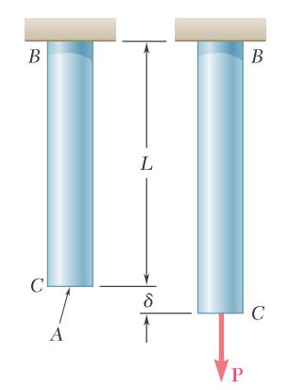
Deformations of Members Under Axial Loading
If the resulting axial stress $σ=P/A$ does not exceed the proportional limit of the material, Hooke’s law applies and
$$σ=Eε$$
from which
$$ε=\frac{σ}{E}=\frac{P}{AE}$$
Recalling that the strain $ε=\frac{δ}{L}$ and substituting $ε=\frac{P}{AE}$ into $δ=εL$ gives
$$δ=\frac{PL}{AE}$$

Slide 17
Equation $δ=\frac{PL}{AE}$ can be used only if the rod is homogeneous (constant $E$), has a uniform cross section of area $A$, and is loaded at its ends. If the rod is loaded at other points, or consists of several portions of various cross sections and possibly of different materials, it must be divided into component parts that satisfy the required conditions.
Using the internal force $P_{i}$, length $L_{i}$, cross-sectional area $A_{i}$, and modulus of elasticity $E_{i}$, corresponding to part i, the deformation of the entire rod is
$$δ=\sum_{i}{\frac{P_{i}L_{i}}{A_{i}E_{i}}}$$

Slide 18
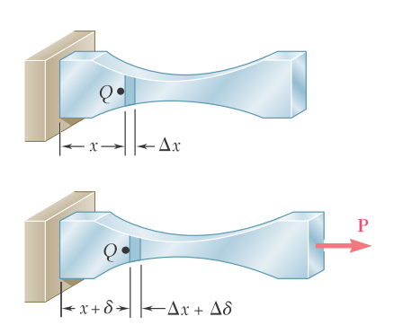
In the case of a member of variable cross section, the strain $ε$ depends upon the position of the point $Q$, where it is computed as $ε={dδ}/{dx}$. Solving for $dδ$ and substituting for $ε$ from $ε=P/{AE}$, the deformation of an element of length $dx$ is
$$dδ=εdx=\frac{Pdx}{AE}$$
The total deformation $δ$ of the member is obtained by integrating this expression over the length $L$ of the member:
$$δ=\int_{0}^{L}{\frac{Pdx}{AE}}$$

Slide 19
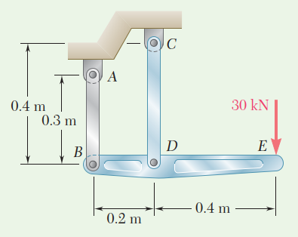
Example 2.1
The rigid bar BDE is supported by two links AB and CD. Link AB is made of aluminum (E=70 GPa) and has a cross-sectional area of 500 mm². Link CD is made of steel (E= 200 GPa) and has a cross-sectional area of 600 mm². For the 30-kN force shown, determine the deflection (a) of B, (b) of D, and (c) of E.

Slide 20
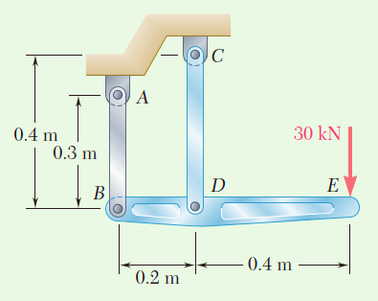
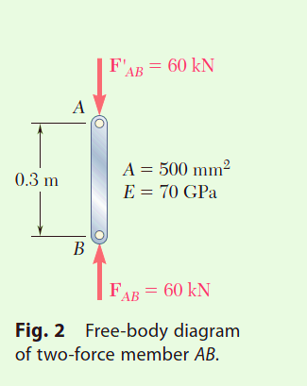
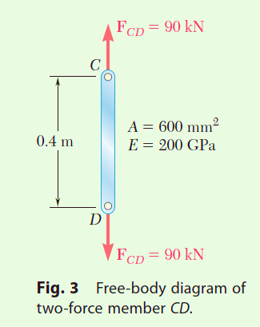
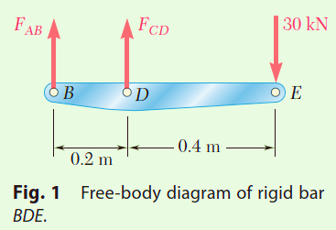
Example 2.1
STRATEGY: Consider the free body of the rigid bar to determine the internal force of each link. Knowing these forces and the properties of the links, their deformations can be evaluated. You can then use simple geometry to determine the deflection of E.
MODELING: Draw the free body diagrams of the rigid bar and the two links
ANALYSIS:

Slide 21
Example 2.1
ANALYSIS:
Free Body: Bar BDE (Fig. 1)
a. Deflection of B. Since the internal force in link AB is compressive (Fig. 2), P = 260 kN and
The negative sign indicates a contraction of member AB. Thus, the deflection of end B is upward:

Slide 22
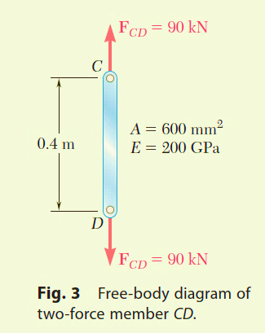
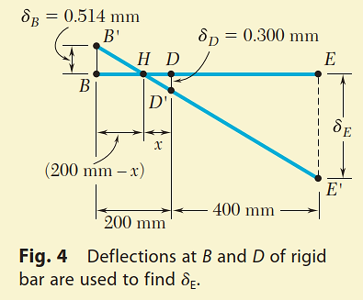
Example 2.1
ANALYSIS:
b. Deflection of D. Since in rod CD (Fig. 3), P = 90 kN, write
c. Deflection of E. Referring to Fig. 4, we denote by B’ and D’ the displaced positions of points B and D. Since the bar BDE is rigid, points B’, D’, and E’ lie in a straight line. Therefore,

