Slide 1
Stress and Strain Axial Loading
Part II

Slide 2
Statically Indeterminate Problems
In the problems considered in the preceding section, we could always use free-body diagrams and equilibrium equations to determine the internal forces produced in the various portions of a member under given loading conditions. There are many problems, however, where the internal forces cannot be determined from statics alone. In most of these problems, the reactions themselves—the external forces— cannot be determined by simply drawing a free-body diagram of the member and writing the corresponding equilibrium equations. The equilibrium equations must be complemented by relationships involving deformations obtained by considering the geometry of the problem. Because statics is not sufficient to determine either the reactions or the internal forces, problems of this type are called statically indeterminate.

Slide 3
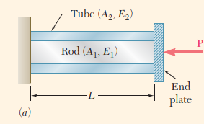
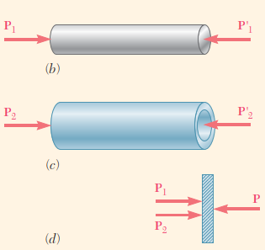
Concept Application 2.2
A rod of length L, cross-sectional area A₁, and modulus of elasticity E₁, has been placed inside a tube of the same length L, but of cross-sectional area A₂ and modulus of elasticity E₂ (Fig. 2.21a).
What is the deformation of the rod and tube when a force P is exerted on a rigid end plate as shown?
The axial forces in the rod and in the tube are P₁ and P₂, respectively. From, Figure 2.21d.
Clearly, one equation is not sufficient to determine the two unknown internal forces P₁ and P₂. The problem is statically indeterminate.
However, the geometry of the problem shows that the deformations δ₁ and δ₂ of the rod and tube must be equal.
Either of deformation equations can be used to determine the common deformation of the rod and tube.

Slide 4
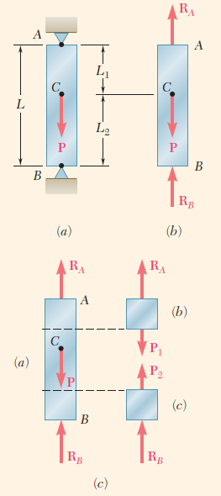
Concept Application 2.3
A bar AB of length L and uniform cross section is attached to rigid supports at A and B before being loaded. What are the stresses in portions AC and BC due to the application of a load P at point C (Fig. 2.22a)?
Drawing the free-body diagram of the bar (Fig. 2.22b), the equilibrium equation is
Since this equation is not sufficient to determine the two unknown reactions R_{A} and R_{B}, the problem is statically indeterminate.
However, the reactions can be determined if observed from the geometry that the total elongation d of the bar must be zero. The elongations of the portions AC and BC are respectively δ₁ and δ₂, so
Note from the free-body diagrams shown in parts b and c of Figure that P₁ = R_{A} and P₂ = 2R_{B}. Carrying these values into deformation equation above,

Slide 5
Superposition Method
A structure is statically indeterminate whenever it is held by more supports than are required to maintain its equilibrium.
This results in more unknown reactions than available equilibrium equations. It is often convenient to designate one of the reactions as redundant and to eliminate the corresponding support. Since the stated conditions of the problem cannot be changed, the redundant reaction must be maintained in the solution. It will be treated as an unknown load that, together with the other loads, must produce deformations compatible with the original constraints. The actual solution of the problem considers separately the deformations caused by the given loads and the redundant reaction, and by adding—or superposing—the results obtained.

Slide 6
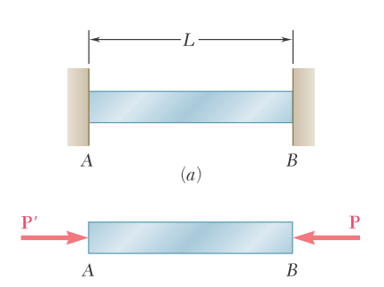
$$δ_{T}=0$$
$$δ_{T}=0$$
R_{A}
R_{B}
100 kN
100 kN
$\sum{F}=R_{A}+100−R_{B}=0$
$R_{B}−R_{A}=100 kN$
$$δ_{R_{B}}$$
R_{B}

Slide 7
The following two conditions must be satisfied if the principle of superposition is to be applied.
The loading P must be linearly related to the stress $σ$ or displacement $δ$ that is to be determined.
The loading must not significantly change the original geometry or configuration of the member.

Slide 8
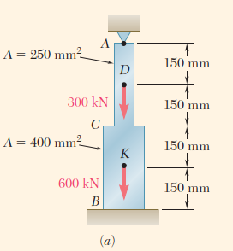
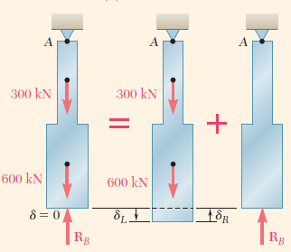
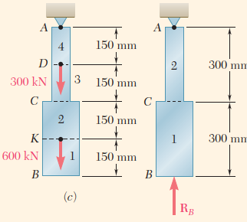
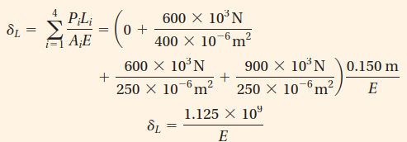
Concept Application 2.4
Determine the reactions at A and B for the steel bar and loading shown in Fig. 2.23a, assuming a close fit at both supports before the loads are applied.
We consider the reaction at B as redundant and release the bar from that support. The reaction R_{B} is considered to be an unknown load and is determined from the condition that the deformation δ of the bar equals zero.
The solution is carried out by considering the deformation δ_{L} caused by the given loads and the deformation δ_{R} due to the redundant reaction R_{B} (Fig. 2.23b). Dividing the bar into four portions:
Substituting these values into deformation equation

Slide 9
Concept Application 2.4
Considering now the deformation δ_{R} due to the redundant reaction R_{B}, the bar is divided into two portions,
Substituting these values into deformation equation
Express the total deformation δ of the bar is zero

Slide 10
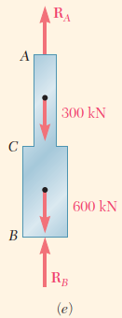
Concept Application 2.4
Solving for R_{B},
The reaction R_{A} at the upper support is obtained from the free-body diagram of the bar

Slide 11
Problems Involving Temperature Changes
Consider a homogeneous rod AB of uniform cross section that rests freely on a smooth horizontal surface. If the temperature of the rod is raised by $∆T$, the rod elongates by an amount $δ_{T}$ that is proportional to both the temperature change $∆T$ and the length $L$ of the rod. Here
$$δ_{T}=α\left(∆T\right)L$$
where $α$ is a constant characteristic of the material called the coefficient of thermal expansion.
Since $δ_{T}$ and $L$ are both expressed in units of length, a represents a quantity per degree C or per degree F, depending whether the temperature change is expressed in degrees Celsius or Fahrenheit.

Slide 12
Associated with deformation $δ_{T}$ there must be a strain $ε_{T}={δ_{T}}/L$.
The strain $ε_{T}$ is called a thermal strain, as it is caused by the change in temperature of the rod. However, there is no stress associated with the strain $ε_{T}$.
$$ε_{T}=α∆T$$

Slide 13
Assume the same rod AB of length $L$ is placed between two fixed supports at a distance $L$ from each other. Again, there is neither stress nor strain in this initial condition.
If we raise the temperature by $∆T$, the rod cannot elongate because of the restraints imposed on its ends; the elongation $δ_{T}$ of the rod is zero. Since the rod is homogeneous and of uniform cross section, the strain $ε_{T}$ at any point is $ε_{T}={δ_{T}}/L$ and thus is also zero.

Slide 14
However, the supports will exert equal and opposite forces $P$ and $P′$ on the rod after the temperature has been raised, to keep it from elongating. It follows that a state of stress (with no corresponding strain) is created in the rod.
The problem created by the temperature change $∆T$ is statically indeterminate. Therefore, the magnitude $P$ of the reactions at the supports is determined from the condition that the elongation of the rod is zero. no corresponding strain) is created in the rod.

Slide 15
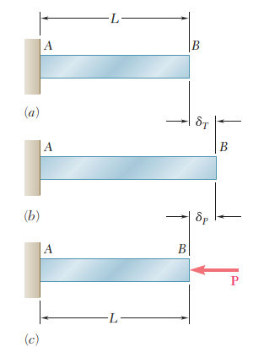
The problem created by the temperature change $∆T$ is statically indeterminate. Therefore, the magnitude $P$ of the reactions at the supports is determined from the condition that the elongation of the rod is zero.
Using the superposition method, the rod is detached from its support B and elongates freely as it undergoes the temperature change $∆T$. The corresponding elongation is
$$δ_{T}=α\left(∆T\right)L$$
Applying now to end B the force P representing the redundant reaction, a second deformation is
$$δ_{P}=\frac{PL}{AE}$$

Slide 16
Expressing that the total deformation d must be zero,
$$δ=δ_{T}+δ_{P}=α\left(∆T\right)L+\frac{PL}{AE}$$
from which
$$P=−AEα\left(∆T\right)$$
The stress in the rod due to the temperature change $∆T$ is
$$σ=\frac{P}{A}=−Eα\left(∆T\right)$$

Slide 17
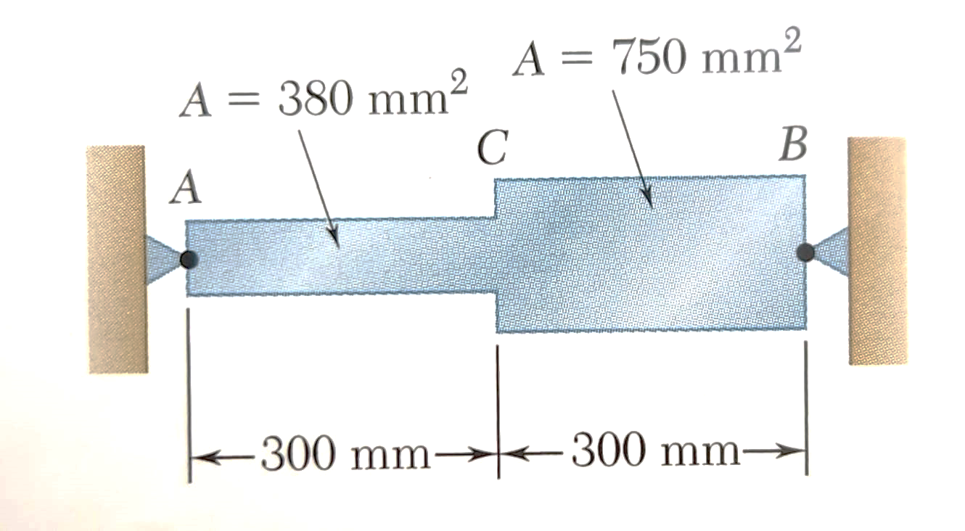
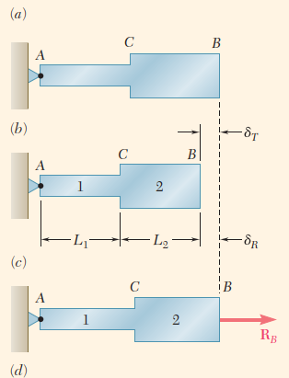
Concept Application 2.5
A = 800 mm²
Determine the values of the stress in portions AC and CB of the steel bar shown (Fig. 2.28a) when the temperature of the bar is -50°C, knowing that a close fit exists at both of the rigid supports when the temperature is +25°C . Use the values E = 200 GPa and α=12*10⁻⁶ /°C for steel.
A = 400 mm²

Slide 18
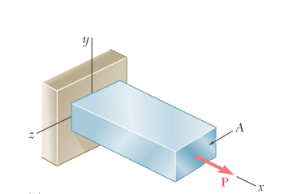
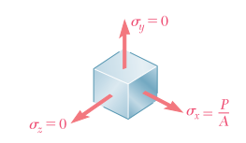
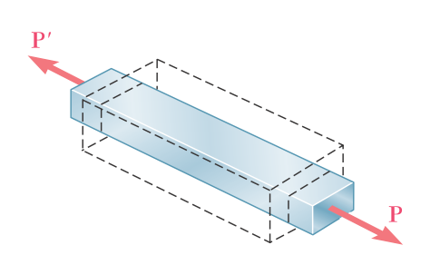
Poisson’s Ratio
$$σ_{x}=\frac{P}{A} and ε_{x}=\frac{σ_{x}}{E}$$
The normal stresses on faces perpendicular to the y and z axes are zero: $σ_{y}=σ_{z}=0$.
It would be tempting to conclude that the corresponding strains $ε_{y}$ and $ε_{z}$ are also zero. This is not the case.
In all engineering materials, the elongation produced by an axial tensile force P in the direction of the force is accompanied by a contraction in any transverse direction.

Slide 19
In this section and the following sections, all materials are assumed to be both homogeneous and isotropic (i.e., their mechanical properties are independent of both position and direction). It follows that the strain must have the same value for any transverse direction. Therefore,
$$ε_{y}=ε_{z}$$
This common value is the lateral strain. An important constant for a given material is its Poisson’s ratio, named after the French mathematician Siméon Denis Poisson (1781–1840) and denoted by the Greek letter $ν$ (nu).

Slide 20
Note the use of a minus sign in these equations to obtain a positive value for $ν$, as the axial and lateral strains have opposite signs for all engineering materials.
* It also would be tempting, but equally wrong, to assume that the volume of the rod remains unchanged as a result of the combined effect of the axial elongation and transverse contraction (see Sec. 2.6).
** However, some experimental materials, such as polymer foams, expand laterally when stretched. Since the axial and lateral strains have then the same sign, Poisson’s ratio of these materials is negative. (See Roderic Lakes, “Foam Structures with a Negative Poisson’s Ratio,” Science, 27 February 1987, Volume 235, pp. 1038–1040.)

Slide 21
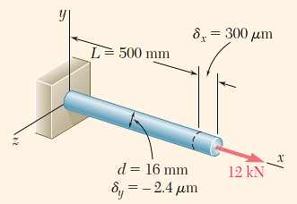
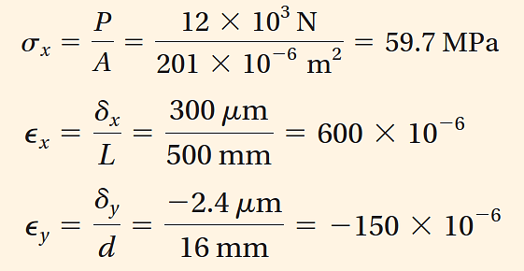
Concept Application 2.7
A 500-mm-long, 16-mm-diameter rod made of a homogenous, isotropic material is observed to increase in length by 300 μm, and to decrease in diameter by 2.4 μm when subjected to an axial 12-kN load. Determine the modulus of elasticity and Poisson’s ratio of the material.
The cross-sectional area of the rod is
Choosing the x axis along the axis of the rod (Fig. 2.31), write
From Poisson’s ratio equation:
From Hooke’s law, modulus of elasticty (E) is:

Slide 22
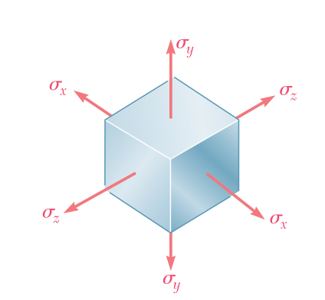
Multiaxial Loading: Generalized Hooke’s Law
All the examples considered so far in this chapter have dealt with slender members subjected to axial loads, i.e., to forces directed along a single axis.
Consider now structural elements subjected to loads acting in the directions of the three coordinate axes and producing normal stresses $σ_{x}$, $σ_{y}$, and $σ_{z}$ that are all different from zero. This condition is a multiaxial loading.
Note that this is not the general stress condition, since no shearing stresses are included among the stresses.

Slide 23
Consider an element of an isotropic material in the shape of a cube. Assume the side of the cube to be equal to unity, since it is always possible to select the side of the cube as a unit of length.
Under the given multiaxial loading, the element will deform into a rectangular parallelepiped of sides equal to $1+ε_{x}$, $1+ε_{y}$, and $1+ε_{z}$, where $ε_{x}$, $ε_{y}$, and $ε_{z}$ denote the values of the normal strain in the directions of the three coordinate axes.

Slide 24
In order to express the strain components $ε_{x}$, $ε_{y}$, $ε_{z}$ in terms of the stress components $σ_{x}$, $σ_{y}$, $σ_{z}$, consider the effect of each stress component and combine the results. This approach will be used repeatedly in this text, and is based on the principle of superposition.
This principle states that the effect of a given combined loading on a structure can be obtained by determining the effects of the various loads separately and combining the results, provided that the following conditions are satisfied:
Each effect is linearly related to the load that produces it.
The deformation resulting from any given load is small and does not affect the conditions of application of the other loads.
For multiaxial loading, the first condition is satisfied if the stresses do not exceed the proportional limit of the material, and the second condition is also satisfied if the stress on any given face does not cause deformations of the other faces that are large enough to affect the computation of the stresses on those faces.

Slide 25
Considering the effect of the stress component $σ_{x}$,
Similarly, the stress component $σ_{y}$,
and the stress component $σ_{z}$,
Combining the results, the components of strain corresponding to the given multiaxial loading are
$$ε_{x}=\frac{σ_{x}}{E} and ε_{y}=−ν\frac{σ_{x}}{E} and ε_{z}=−ν\frac{σ_{x}}{E}$$
$$ε_{x}=\frac{σ_{x}}{E}−ν\frac{σ_{y}}{E}−ν\frac{σ_{z}}{E}$$
$$ε_{y}=\frac{σ_{y}}{E}−ν\frac{σ_{x}}{E}−ν\frac{σ_{z}}{E}$$
$$ε_{z}=\frac{σ_{z}}{E}−ν\frac{σ_{x}}{E}−ν\frac{σ_{y}}{E}$$
$$ε_{y}=\frac{σ_{y}}{E} and ε_{x}=−ν\frac{σ_{y}}{E} and ε_{z}=−ν\frac{σ_{y}}{E}$$
$$ε_{z}=\frac{σ_{z}}{E} and ε_{x}=−ν\frac{σ_{z}}{E} and ε_{y}=−ν\frac{σ_{z}}{E}$$
Generalized Hooke’s law for the multiaxial loading of a homogeneous isotropic material
a positive value for a stress component signifies tension and a negative value compression
a positive value for a strain component indicates expansion in the corresponding direction and a negative value contraction

Slide 26
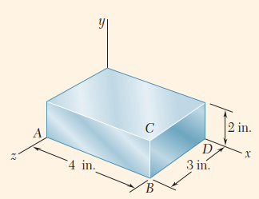
Concept Application 2.8
The steel block shown (Fig. 2.34) is subjected to a uniform pressure on all its faces. Knowing that the change in length of edge AB is -1.2 * 10⁻³ in., determine (a) the change in length of the other two edges and (b) the pressure p applied to the faces of the block. Assume E = 29*10⁶ psi and ν=0.29.
a. Change in Length of Other Edges. Substituting σ_{x}= σ _{y}=σ _{z}=-p into strain equantions in multi-axial loading case, the three strain components have the common value
(1)
b. Pressure. Solving Eq. (1) for p,

Slide 27
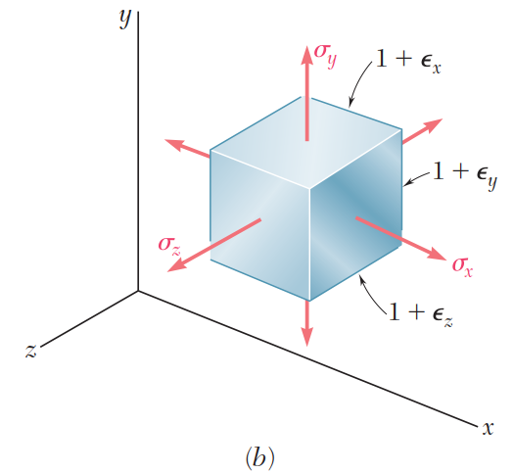
DILATATION AND BULK MODULUS
undeformed
deformed

Slide 28
Volume of deformed unity cube
Since the strains are much smaller than unity, their products can be omitted
The change in volume e of the element is
or
e represents the change in volume per unit volume and is called the dilatation of the material.

Slide 29
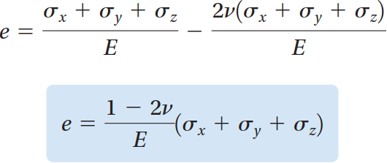
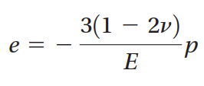
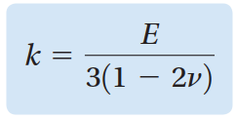
Substitute strains to the e equation
When a body is subjected to a uniform hydrostatic pressure p, each of the stress components is equal to -p
or
The constant k is known as the bulk modulus or modulus of compression of the material

Slide 30
Because a stable material subjected to a hydrostatic pressure can only decrease in volume, the dilatation e is negative, and the bulk modulus k is a positive quantity. Referring from bulk modulus that
or
Poisson’s ratio (ν) is positive for all engineering materials. Thus, for any engineering material,

Slide 31
Concept Application 2.9
Determine the change in volume DV of the steel block shown in Figure, when it is subjected to the hydrostatic pressure p=180 MPa. Use E = 200 GPa and ν=0.29.
From the bulk modulus of steel is
^{40 mm}
^{80 mm}
^{60 mm}
And the dilatation is
Since the volume V of the block in its unstressed state is
and e represents the change in volume per unit volume,

Slide 32
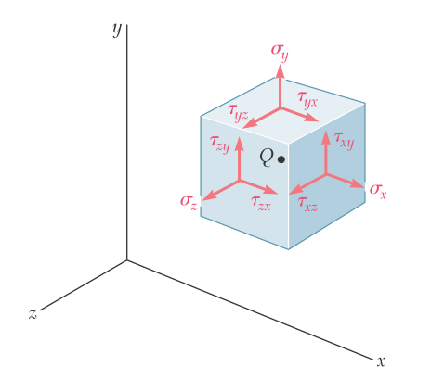
SHEARING STRAIN
In a general stress situation, shown in figure, shearing stresses $τ_{xy}$, $τ_{yz}$, and $τ_{zx}$ are present (as well as the corresponding shearing stresses $τ_{yx}$, $τ_{zy}$, and $τ_{xz}$).
These stresses have no direct effect on the normal strains and, as long as all the deformations involved remain small, they will not affect the derivation nor the validity of Generalized Hooke’s law for the multiaxial loading.

Slide 33
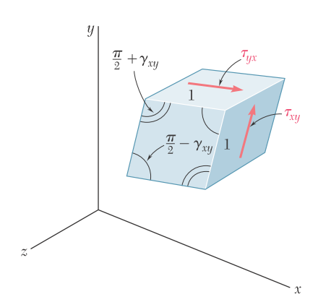
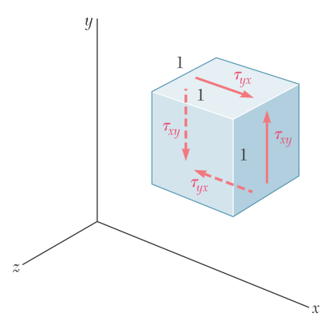
The shearing stresses, however, tend to deform a cubic element of material into an oblique parallelepiped.
Consider a cubic element subjected to only the shearing stresses $τ_{xy}$ and $τ_{yx}$ applied to faces of the element respectively perpendicular to the x and y axes. (Recall that $τ_{xy}=τ_{yx}$) The cube is observed to deform into a rhomboid of sides equal to one
Unit cubic element subjected to
shearing stress.
Deformation of unit cubic
element due to shearing stress.

Slide 34
Two of the angles formed by the four faces under stress are reduced from $(π/2)$ to $(π/2−γ_{xy})$, while the other two are increased from $(π/2)$ to $(π/2+γ_{xy})$.
The small angle $γ_{xy}$ (expressed in radians) defines the shearing strain corresponding to the x and y directions.
When the deformation involves a reduction of the angle formed by the two faces oriented toward the positive x and y axes, the shearing strain $γ_{xy}$ is positive; otherwise, it is negative.

Slide 35
Plotting successive values of $τ_{xy}$ against the corresponding values of $γ_{xy}$, the shearing stress-strain diagram is obtained for the material. This diagram is similar to the normal stress-strain diagram from the tensile test described earlier; however, the values for the yield strength, ultimate strength, etc., are about half as large in shear as they are in tension. As for normal stresses and strains, the initial portion of the shearing stress-strain diagram is a straight line. For values of the shearing stress that do not exceed the proportional limit in shear, it can be written for any homogeneous isotropic material that
$$τ_{xy}=Gγ_{xy}$$
This relationship is Hooke’s law for shearing stress and strain, and the constant G is called the modulus of rigidity or shear modulus of the material.

Slide 36
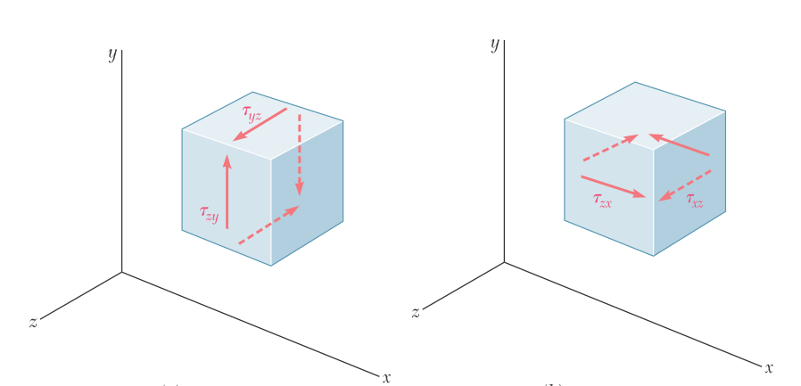
For values of the stress that do not exceed the proportional limit, you can write two additional relationships:
$$τ_{yz}=Gγ_{yz} and τ_{xz}=Gγ_{xz}$$

Slide 37
For the general stress condition, as long as none of the stresses involved exceeds the corresponding proportional limit, you can apply the principle of superposition and combine the results.
The generalized Hooke’s law for a homogeneous isotropic material under the most general stress condition is
$$ε_{x}=\frac{σ_{x}}{E}−ν\frac{σ_{y}}{E}−ν\frac{σ_{z}}{E}$$
$$ε_{y}=\frac{σ_{y}}{E}−ν\frac{σ_{x}}{E}−ν\frac{σ_{z}}{E}$$
$$ε_{z}=\frac{σ_{z}}{E}−ν\frac{σ_{x}}{E}−ν\frac{σ_{y}}{E}$$
$$τ_{xy}=Gγ_{xy} τ_{xy}=Gγ_{xy} τ_{xy}=Gγ_{xy}$$

Slide 38
Deformations Under Axial Loading — Relation Between $E$, $ν$, And $G$
For an isotropic homogenous material, two of the material constant must be determined by conducting mechanic tests, and the third one can be calculated by using the relationship :
$$G=\frac{E}{2(1+ν)}$$

