Slide 1
FE382 Food Operations - I
Prof.Dr. Medeni MASKAN
Gaziantep University
Food Engineering Department

Slide 2
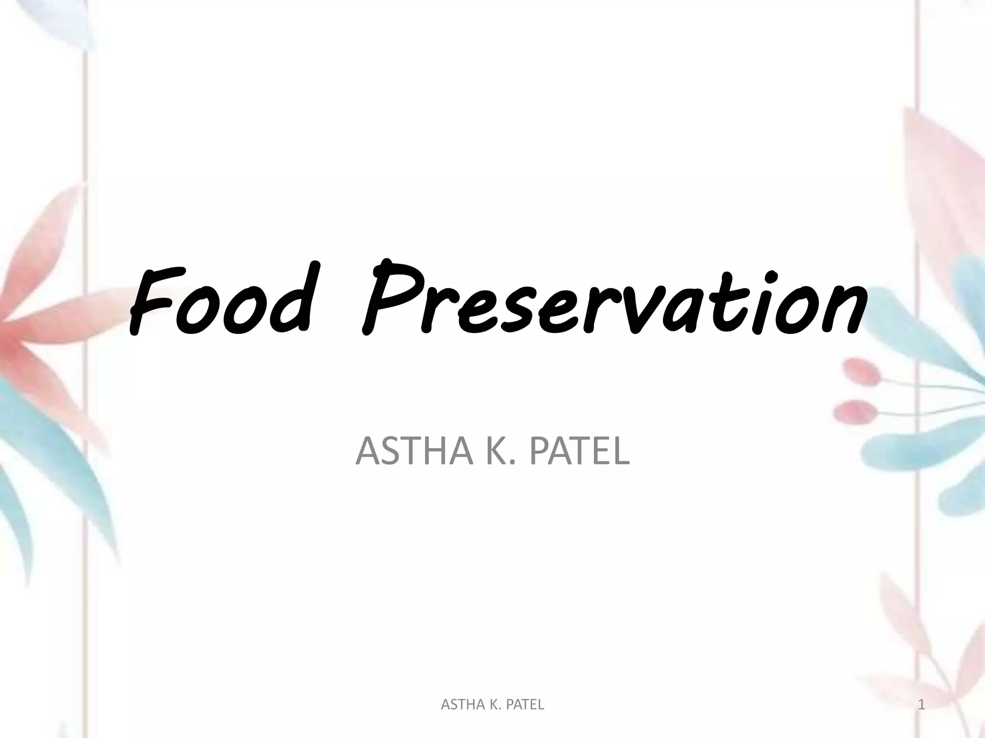

Slide 3
Preservation methods start with the complete analysis and understanding of the whole food chain including; growing, harvesting, processing, packaging, and distribution; thus an integrated approach needs to be applied.
Food preservation is the process of treating and handling food to stop or slow down spoilage of foods, loss of quality, edibility or nutritional value and thus allow for longer food storage for future use.

Slide 4
Preservation usually involves stopping the enzymatic activity, preventing the growth of bacteria, fungi and mold to prevent foodborne illness and extend its shelf-life while keeping as much of its nutritional quality.
Advantages of Food Preservations:
1) Food preservation prevents the food from being spoiled by the action of enzymes and microorganisms.
2) Food preservation increases the safe storage period of foodstuffs.
3. It increases the availability of out of season foodstuffs.
4. It increases the availability of various foodstuffs even at distant and not easily approachable places.

Slide 5
Food Types
Perishable
- Laasts for less time, 2 days to 1 week
- Example : Fruits, vegetables, milk, meat
Semi Perishable
- Lasts around 2 months and are processed
- Example : Ice-cream, cheese, bread, cake, pastries
Shelf Stable
- Has longer shelf life more than 6 months
- Example : Food grains

Slide 6

Food Deterioration & Spoilage
Food deterioration is any change in food that makes it less desirable. (flavor, color, texture & smell)
Food spoilage is the state of food where it is no longer safe to consume.

Slide 7
How does food start to spoil ?
Once food is harvested or slaughtered, its plant or animal tissue soon starts to decay.
Food spoils because of the activities of microorganisms, enzymes and chemical reactions.

Slide 9
What are the micro-organisms?
Molds
Yeasts
Bacteria

Slide 10
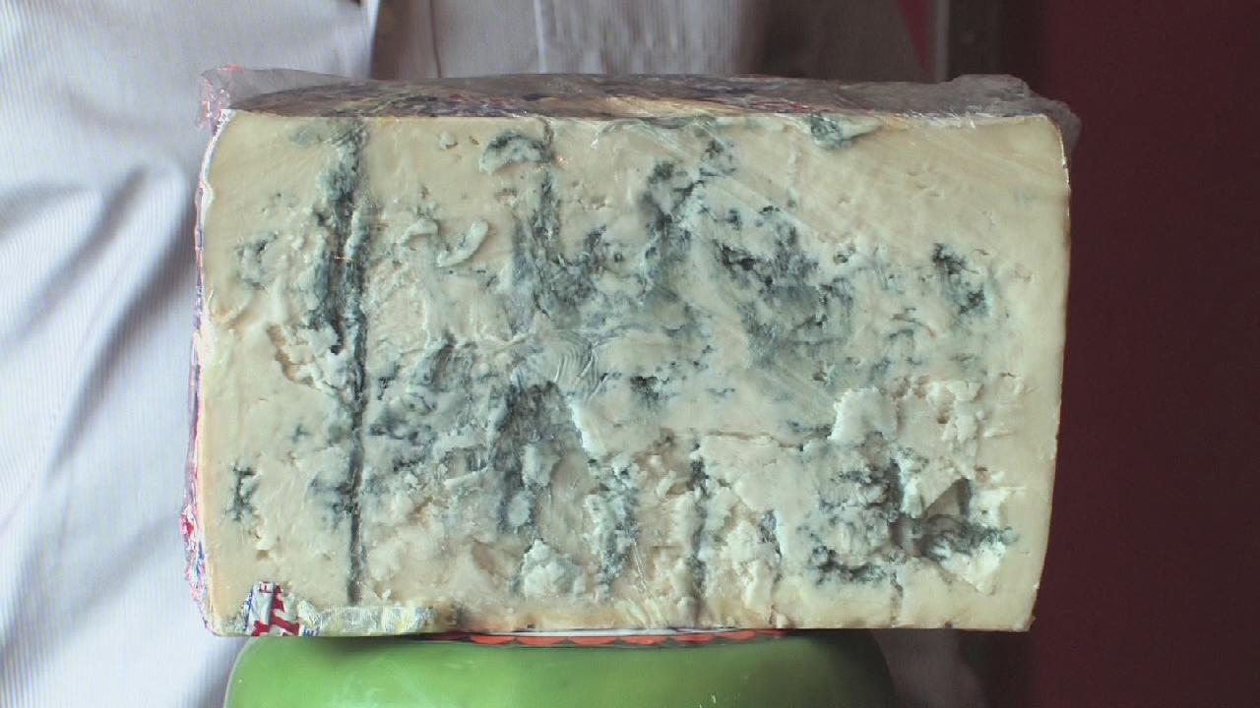
Molds
Molds are microscopic fungi that can form visible colonies.

Slide 11
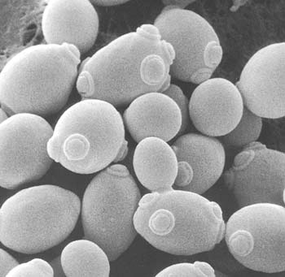
Yeasts
Yeasts are microscopic fungi but rarely grow on foods.

Slide 12
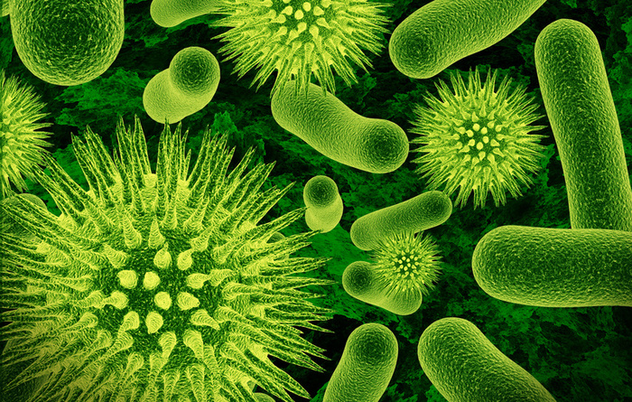
Bacteria
Bacteria are microscopic organisms that can both spoil food and produce toxins causing food-borne illness.

Slide 13

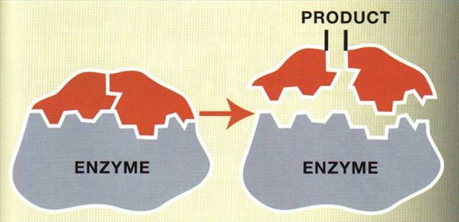
Enzymes & Chemical Reactions
Enzymes help facilitate chemical reactions that cause foods to spoil.
As chemicals in food are altered, the smell, appearance, texture and flavor can change.
For example; Oxidation of apples and potatoes when sliced: In apples, the specific enzyme that causes the brownish colour to appear is called polyphenol oxidase (PPO).

Slide 14
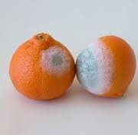
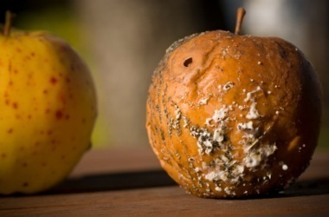
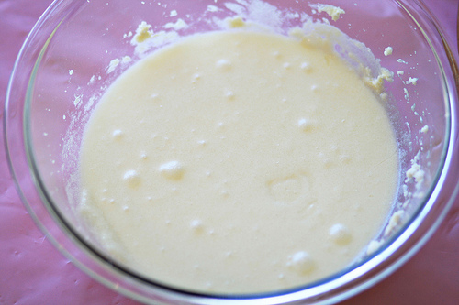
Signs of Spoilage
Off-odors
Brown meats
Sour milk
Mushy vegetables

Slide 15
SPOILAGE !!!!
Remember:
When in doubt, throw it out.

Slide 16
What is a food-borne illness?
A food-borne illness is derived from food. Majority of these illnesses are caused by micro-organisms which are called Pathogens.
Pathogens are bacteria that cause disease. (Example: Escherichia coli H7, Salmonella)

Slide 17
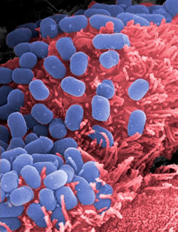
E.Coli H7
Causes diarrheal problems which can cause complications that sometimes lead to death.

Slide 18

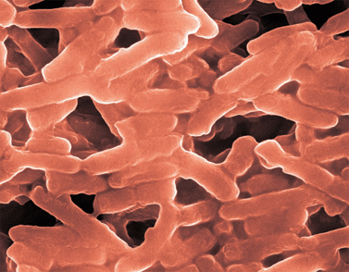
Salmonella
Causes gastroenteritis infections

Slide 19
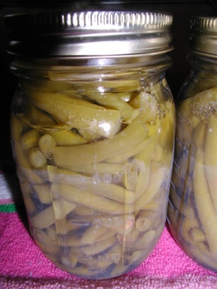
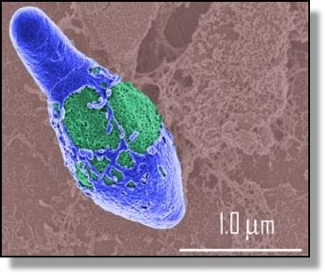
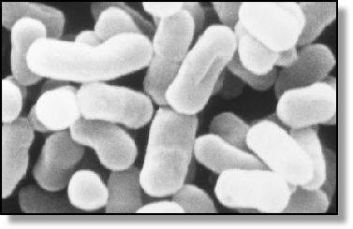
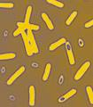
Clostridium botulinum
Clostridium botulinum is a Gram-positive, rod shaped bacterium that produces the neurotoxin botulin, which causes the flaccid muscular paralysis

Slide 20
Food preservation
So, how does food preservation work ?
All of the food preservation processes work by slowing down the activity and growth of disease causing bacteria, or by killing the bacteria all together. They also slow down or stop the action of enzymes which can degrade the quality of the food.
  Temperature
  Water Activity
  pH
Notes:
Water Activity a_{w} is a term used to describe the relative availability of water in a substance

Slide 21
How does food preservation help?
The goal of food preservation is to minimize the activity of micro-organisms (pathogens), enzymes and chemical reactions.
This will help keep the food free from spoilage and illness-causing micro-organisms.

Slide 22
Food processing
Food processing is the set of methods and techniques used to transform raw ingredients into food or to transform food into other forms for consumption by humans or animals either in the home or by the food processing industry.

Slide 23
Food processing methods
Removal of unwanted outer layers, such as potato peeling or the skinning of peaches.
Chopping or slicing e.g. diced carrots.
Mincing and macerating
Liquefaction, such as to produce fruit juice
Fermentation e.g. in beer breweries
Emulsification
Cooking, such as boiling, broiling, frying, steaming or grilling

Slide 24
Deep frying
Baking
Mixing
Addition of gas such as air entrainment for bread or gasification of soft drinks
Proofing
Spray drying
Pasteurization
Packaging

Slide 25
METHODS OF FOOD PRESERVATION
TRADITIONAL METHODS INDUSTRIAL MODERN METHODS
Drying Pasteurization
Cooling Vacuum packaging
Freezing Artificial food additives
Boiling Irradiation
Heating Pulsed electric field electroporation
Salting Modified atmosphere
Sugaring Nonthermal plasma
Smoking High-pressure food preservation
Pickling Biopreservation
Canning Hurdle technology
Jellying

Slide 26
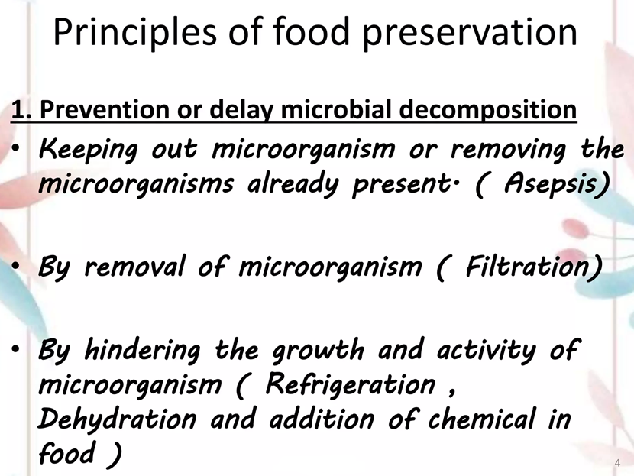

Slide 27
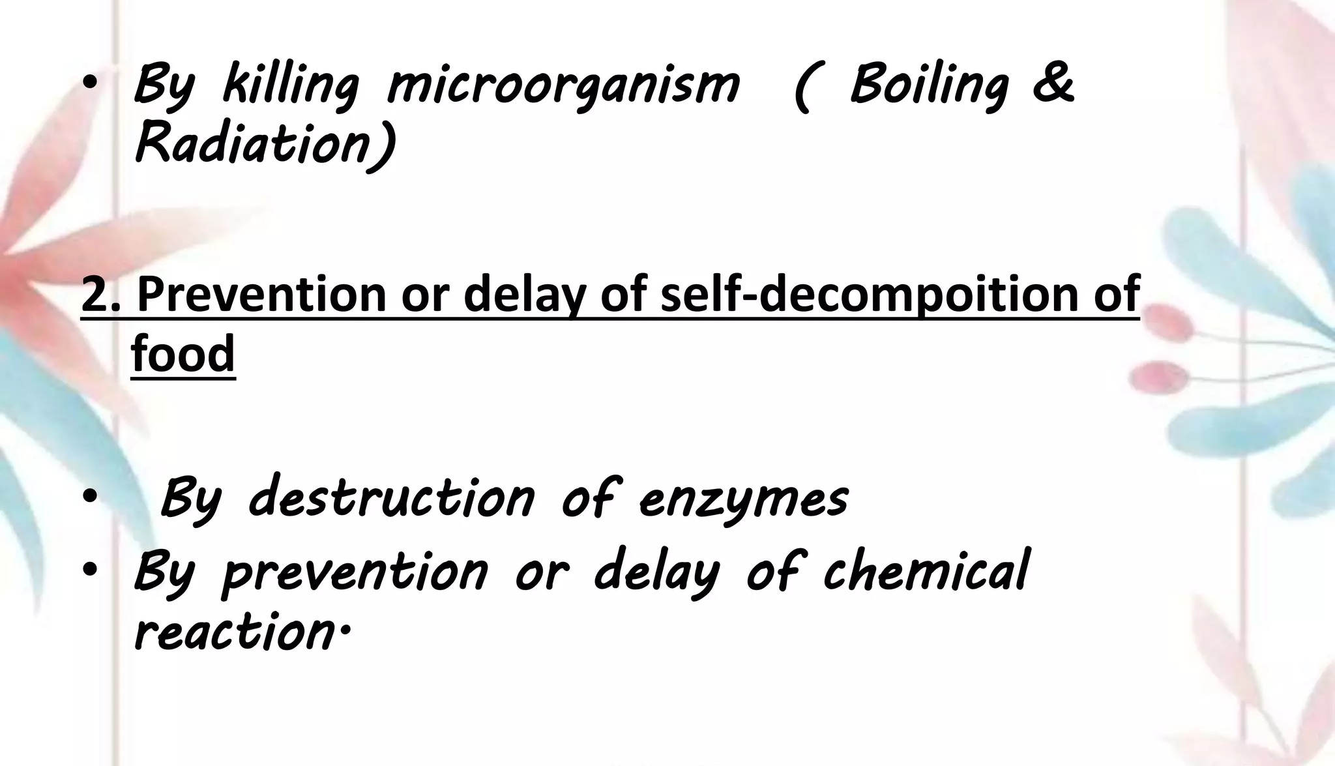

Slide 28
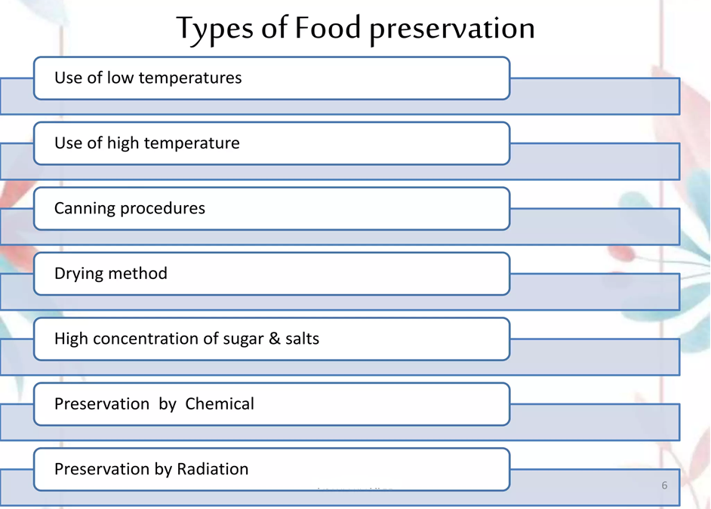
I.
II.
III.
IV.
V.
VI.
VII.

Slide 29
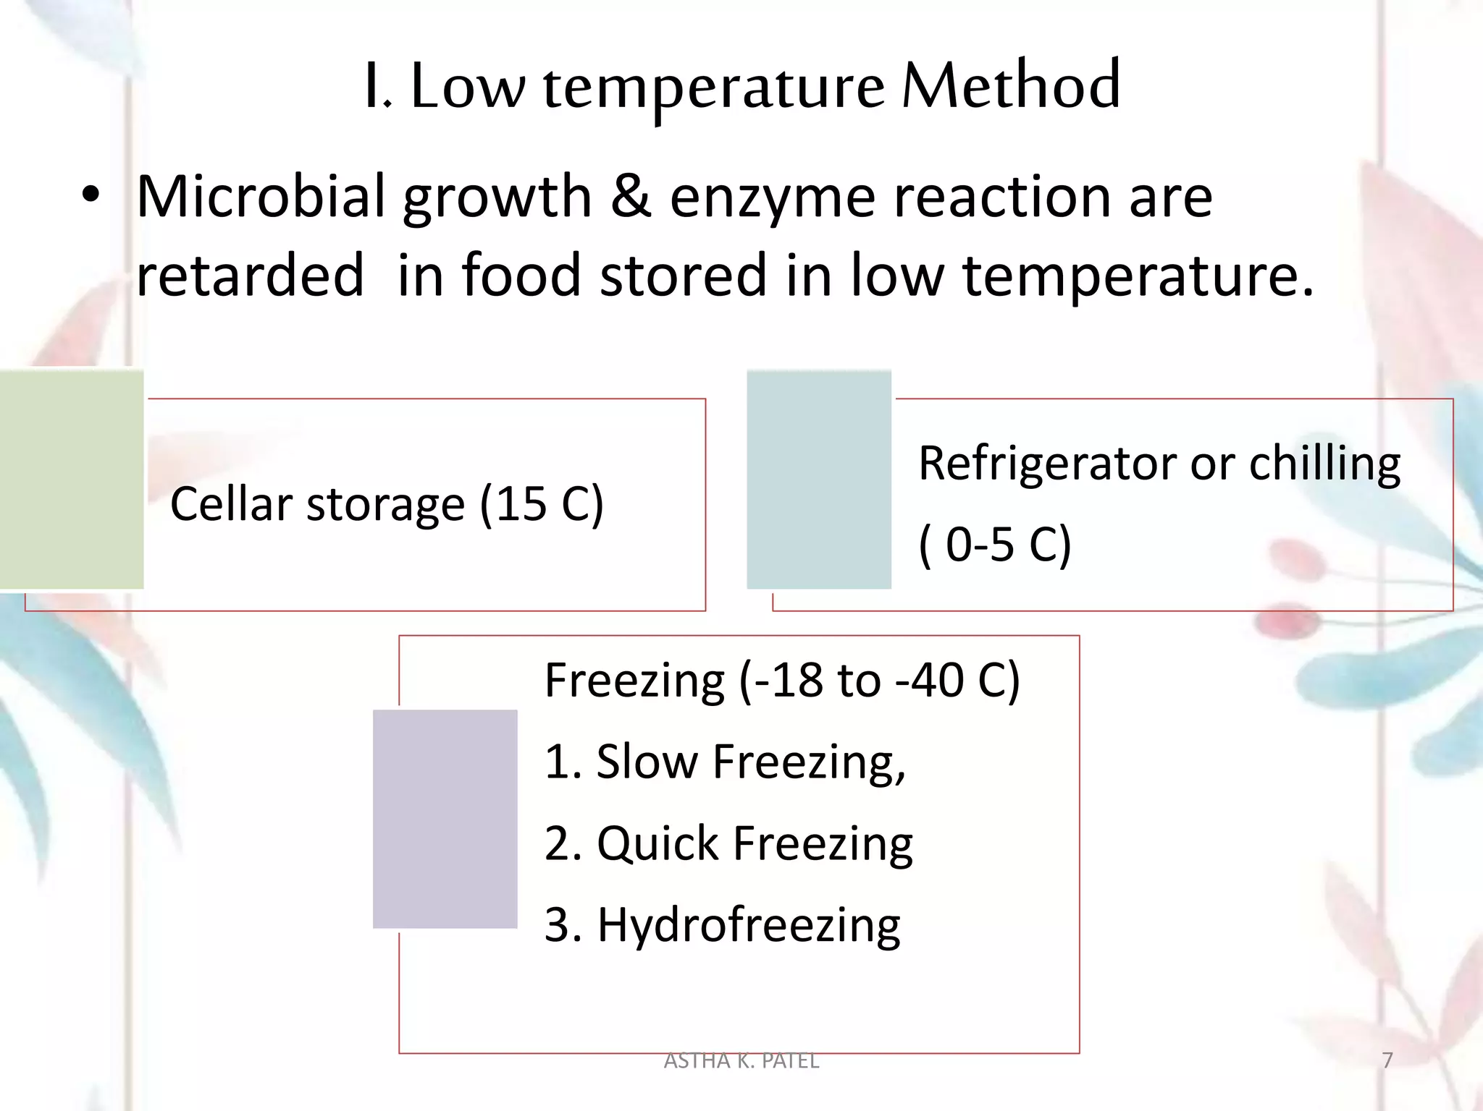
2.
1.
3.

Slide 30
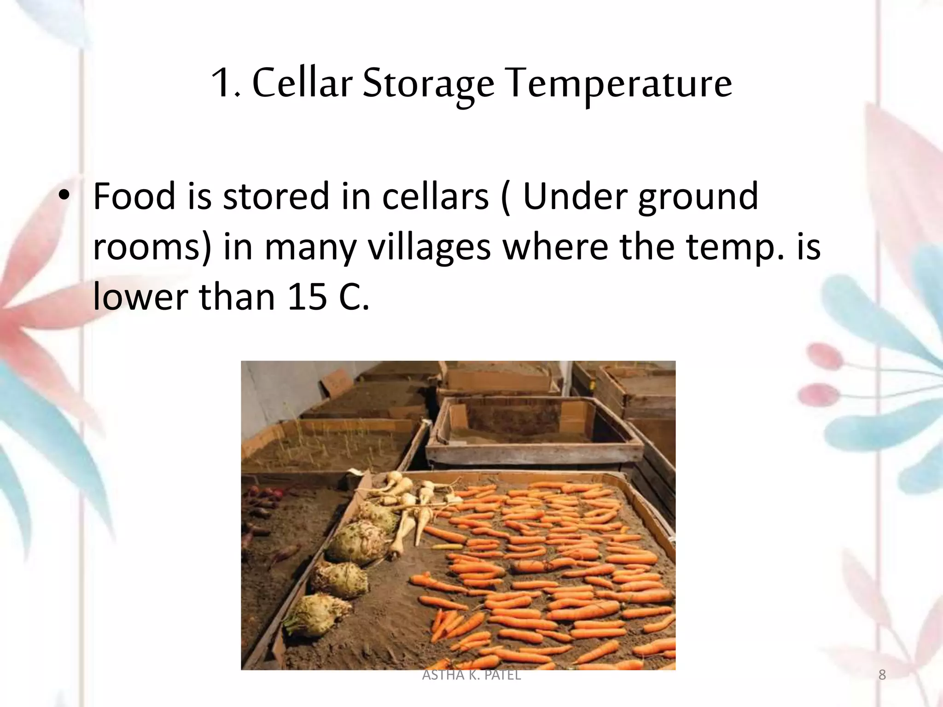

Slide 31
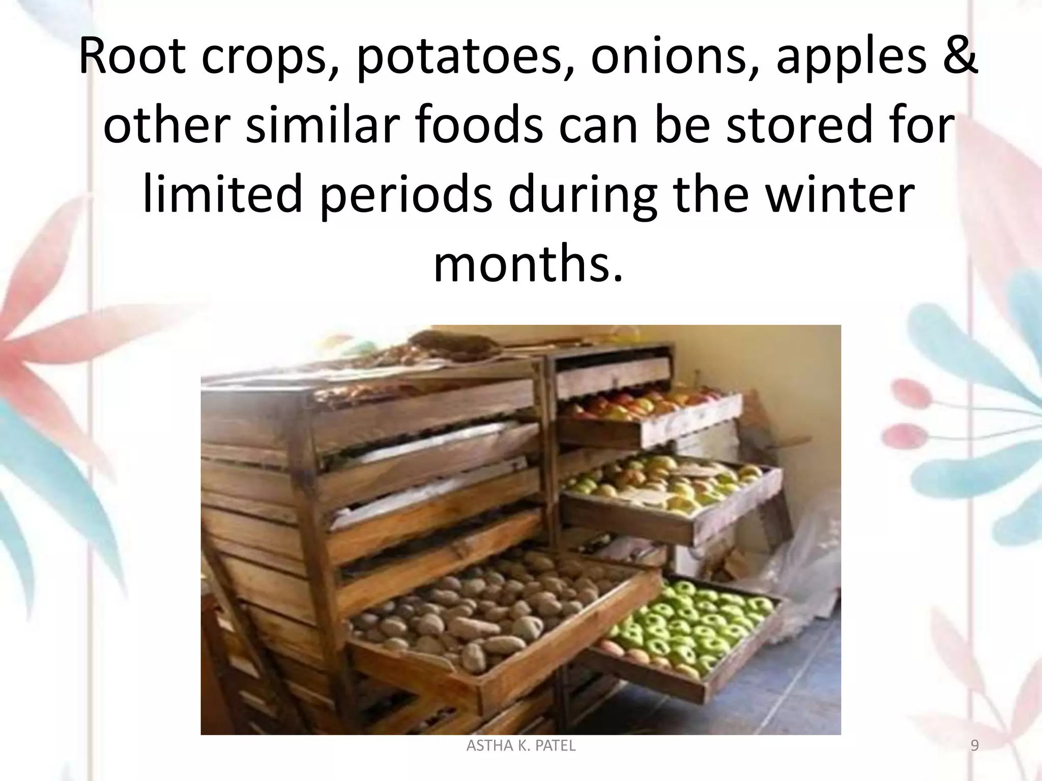

Slide 32
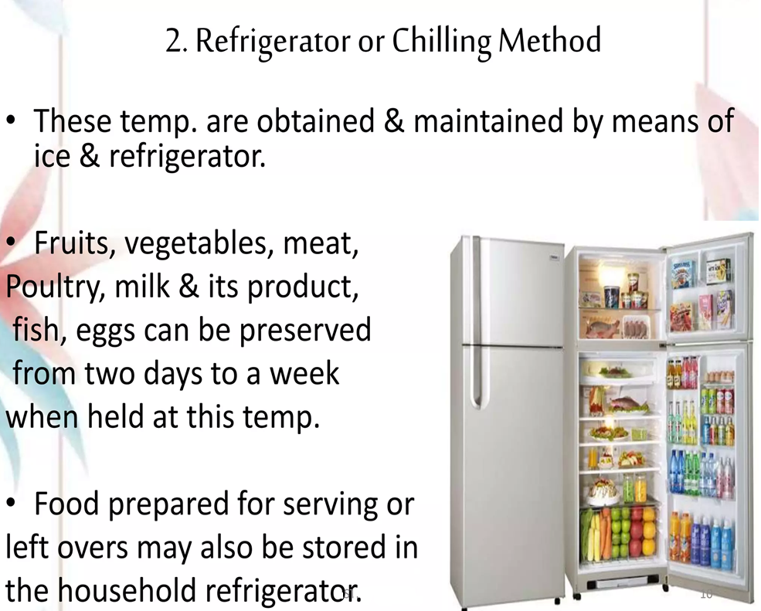
(0-5°C)

Slide 33
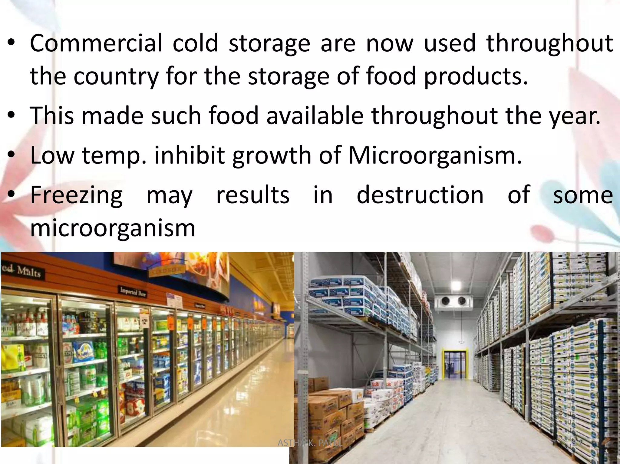

Slide 34
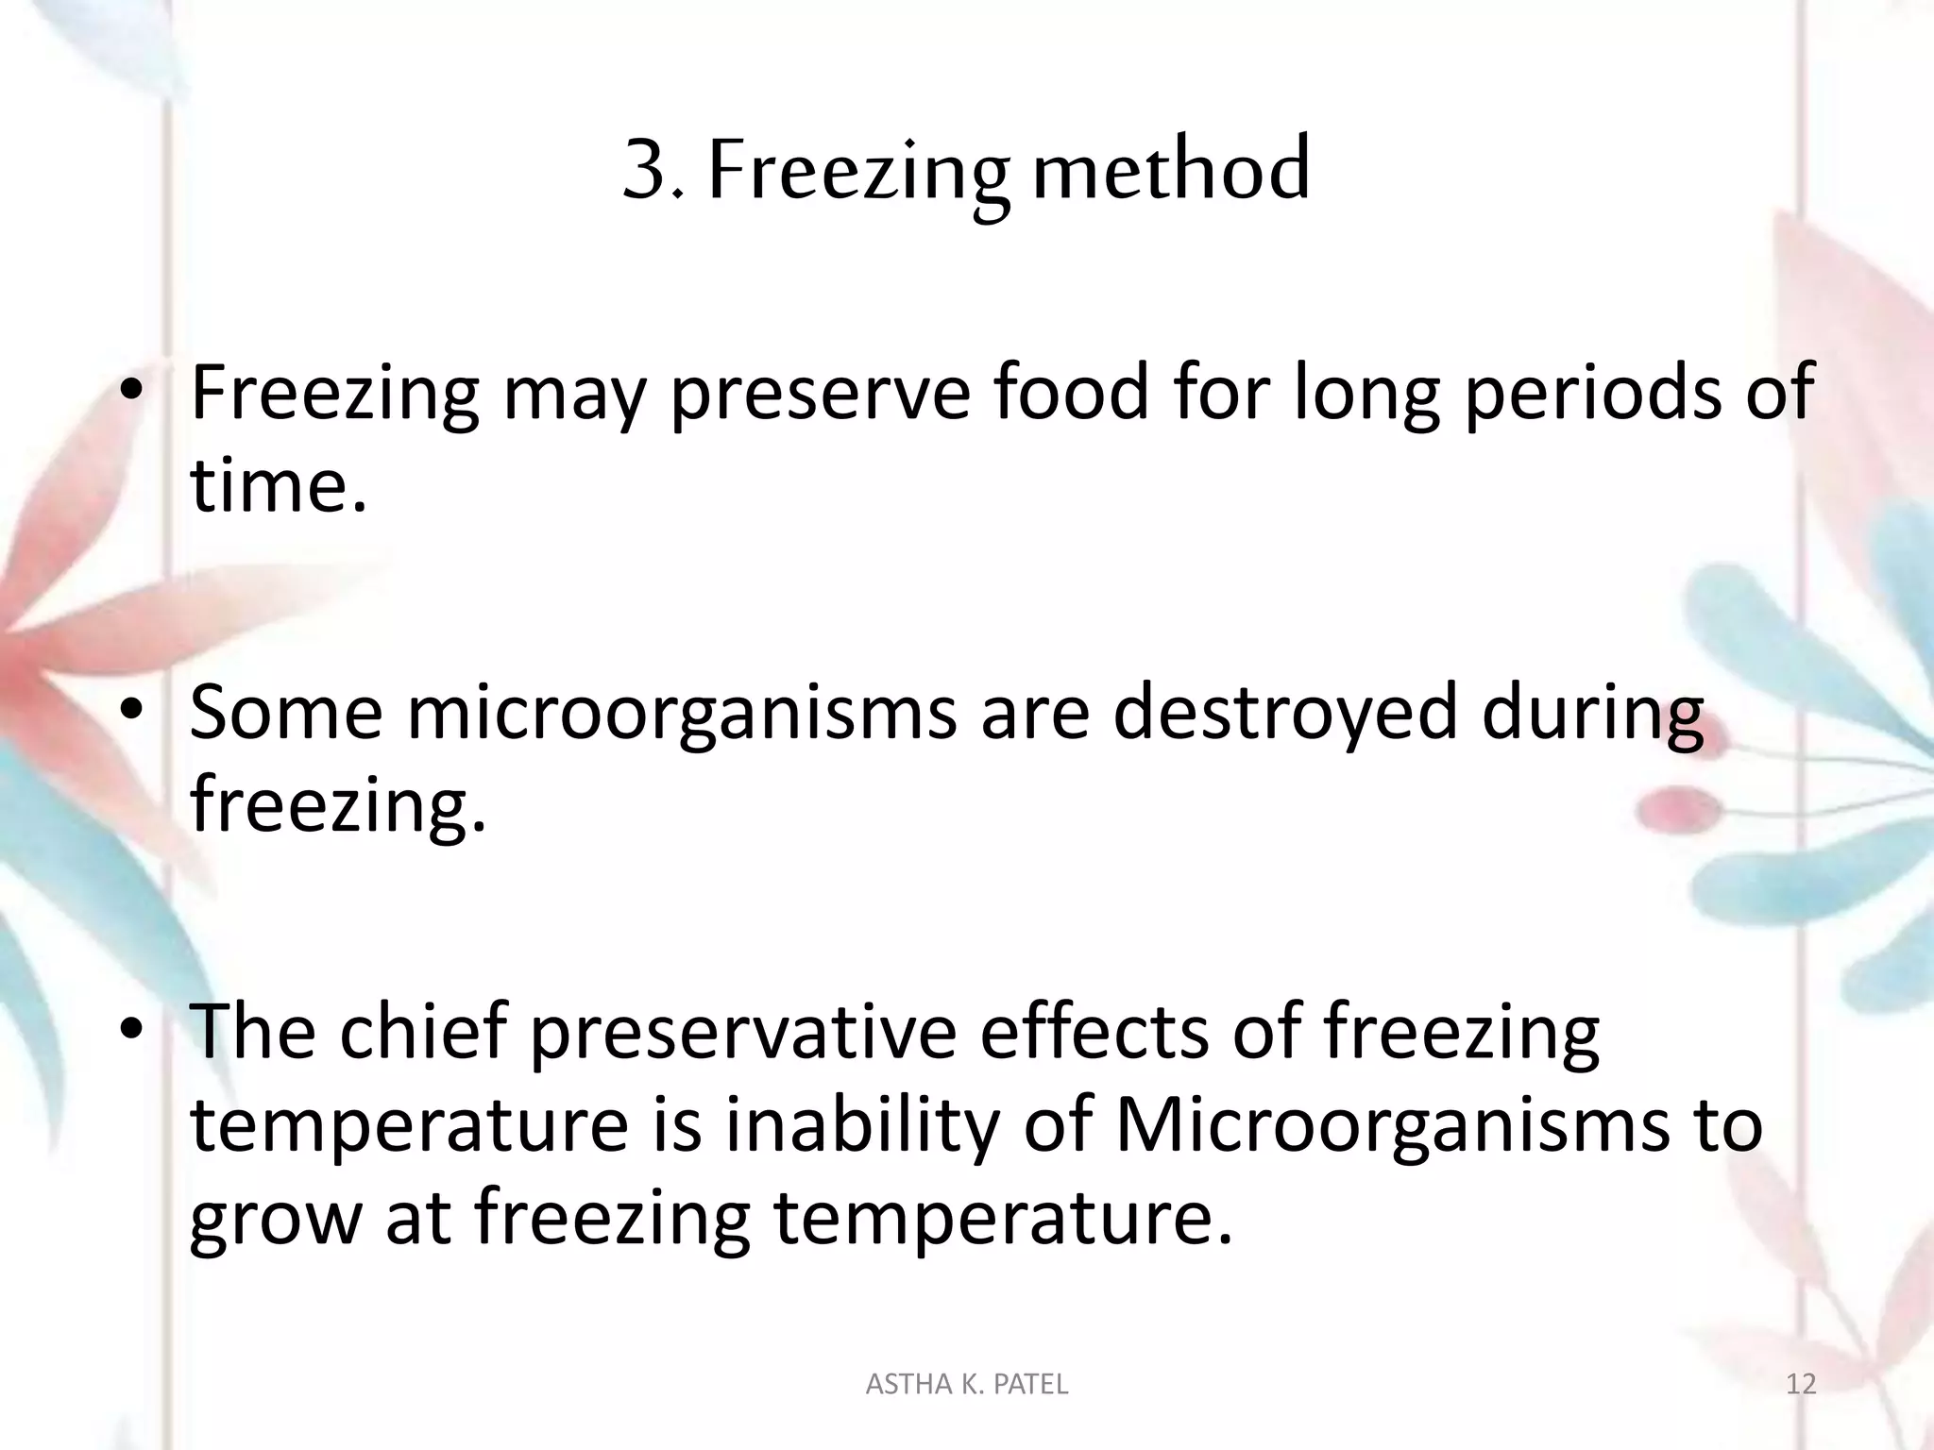

Slide 35
Freezing is the unit operation in which the temperature of a food is reduced below its freezing point and a proportion of the water undergoes a change in state to form ice crystals. The immobilization of water to ice and the resulting concentration of dissolved solutes in unfrozen water lower the water activity (a_{w}) of the food
Preservation is achieved by a combination of low temperatures, reduced water activity and, in some foods, pre-treatment by blanching

Slide 36
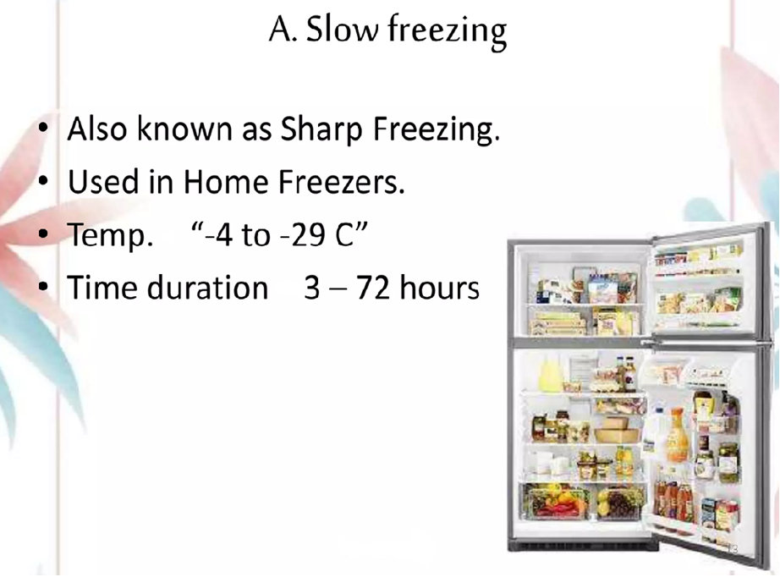

Slide 37
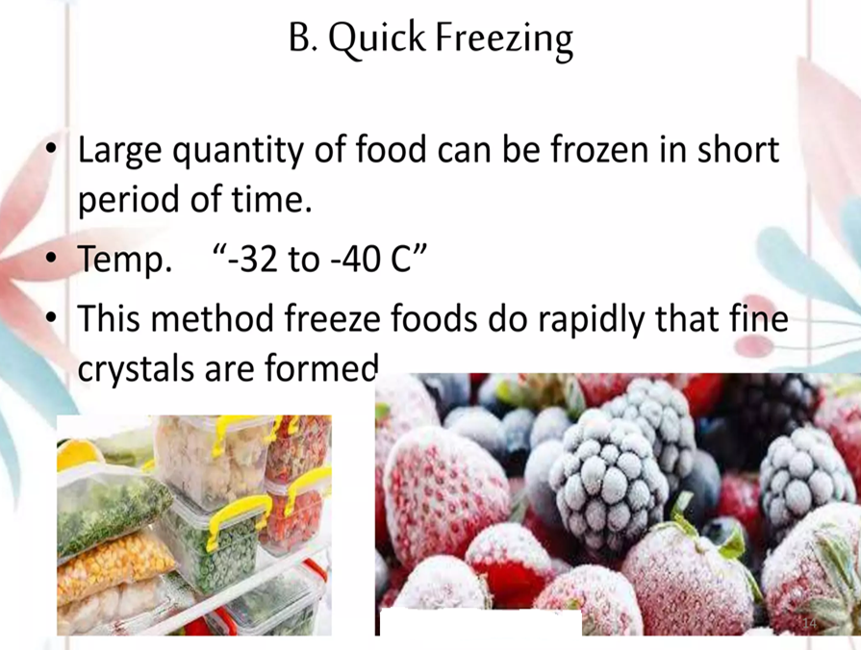

Slide 38
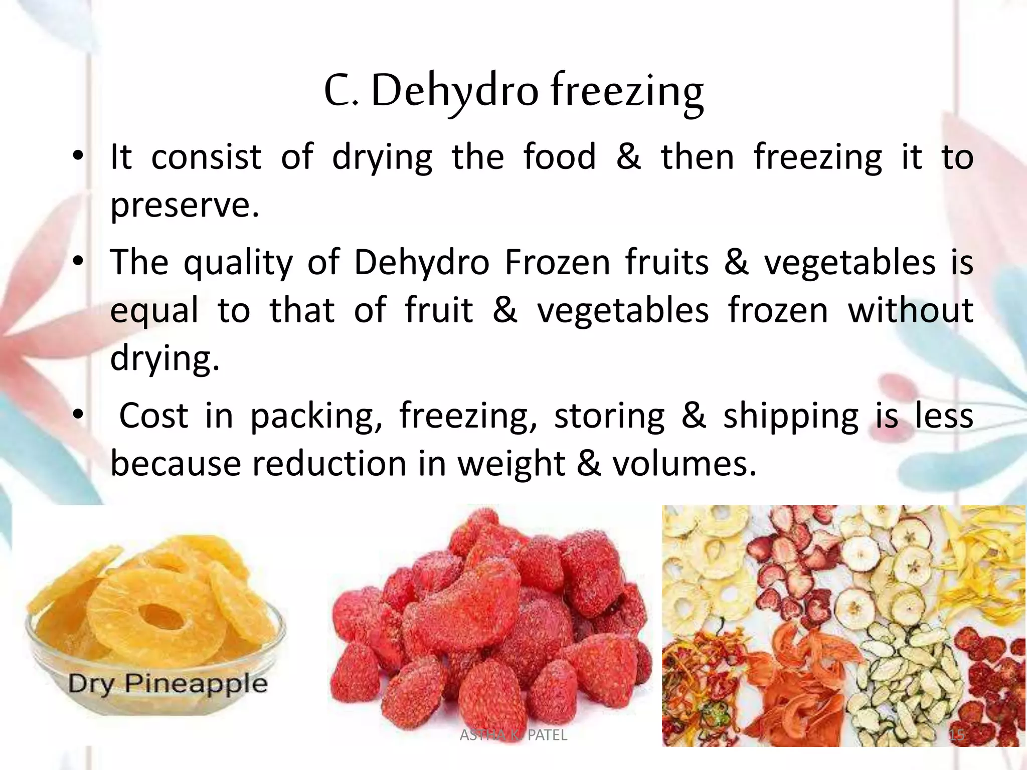

Slide 39
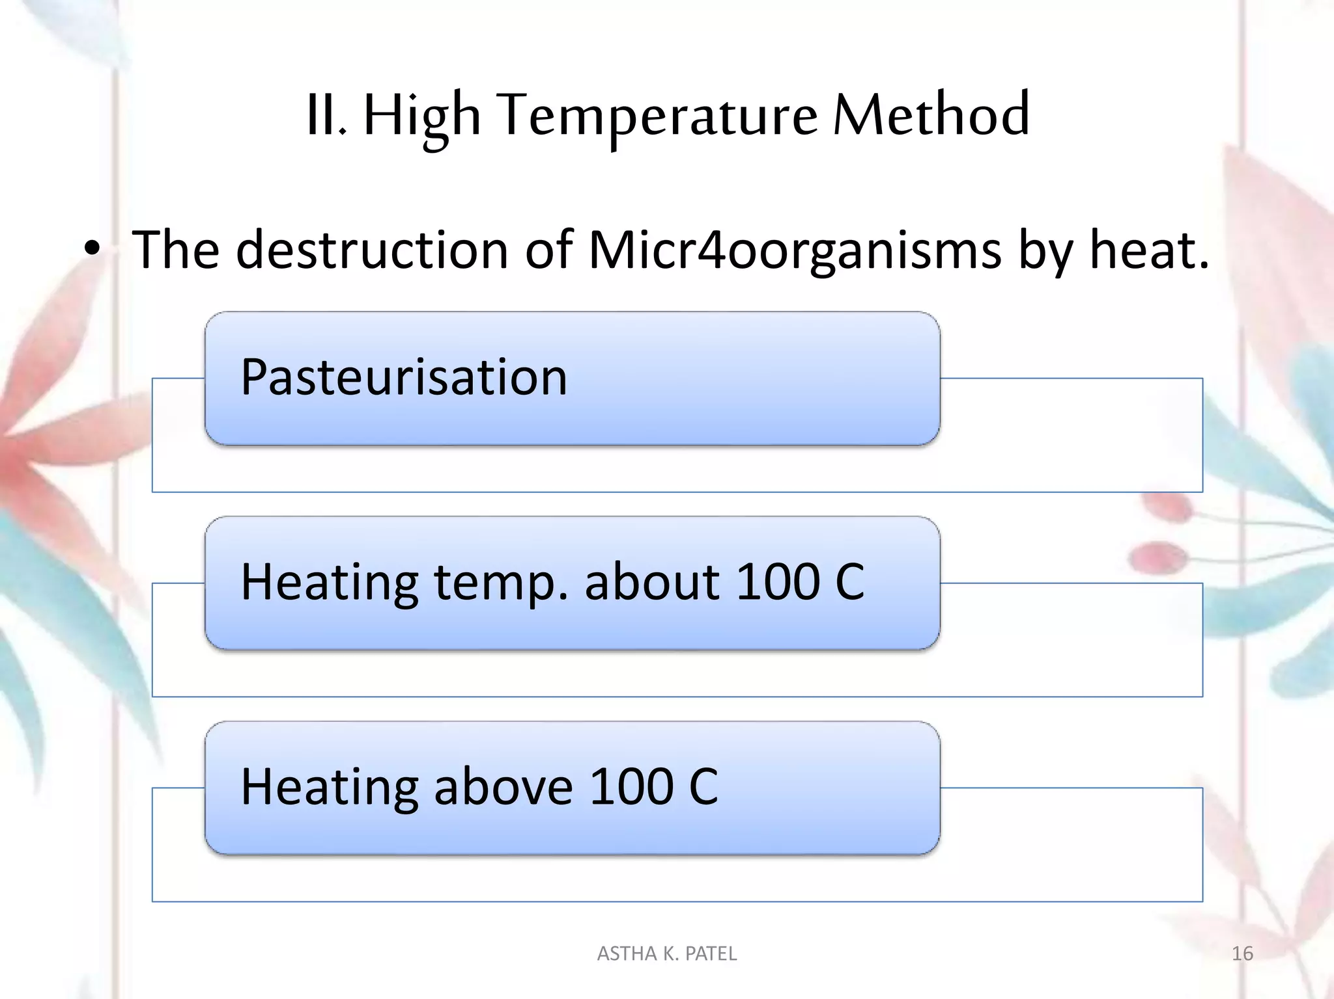
Micro-organisms
1.
2.
3.

Slide 40
Basically, two different food preservation categories are performed with heat application at high temperatures:
Pasteurisation
Sterilisation
Pasteurisation is able to destroy pathogenic life forms and the most part of those vegetative microorganisms in foods; moreover, enzymes are inactivated with pasteurisation treatments.
Sterilization is defined as the destruction of all microbial forms, including spores.

Slide 41
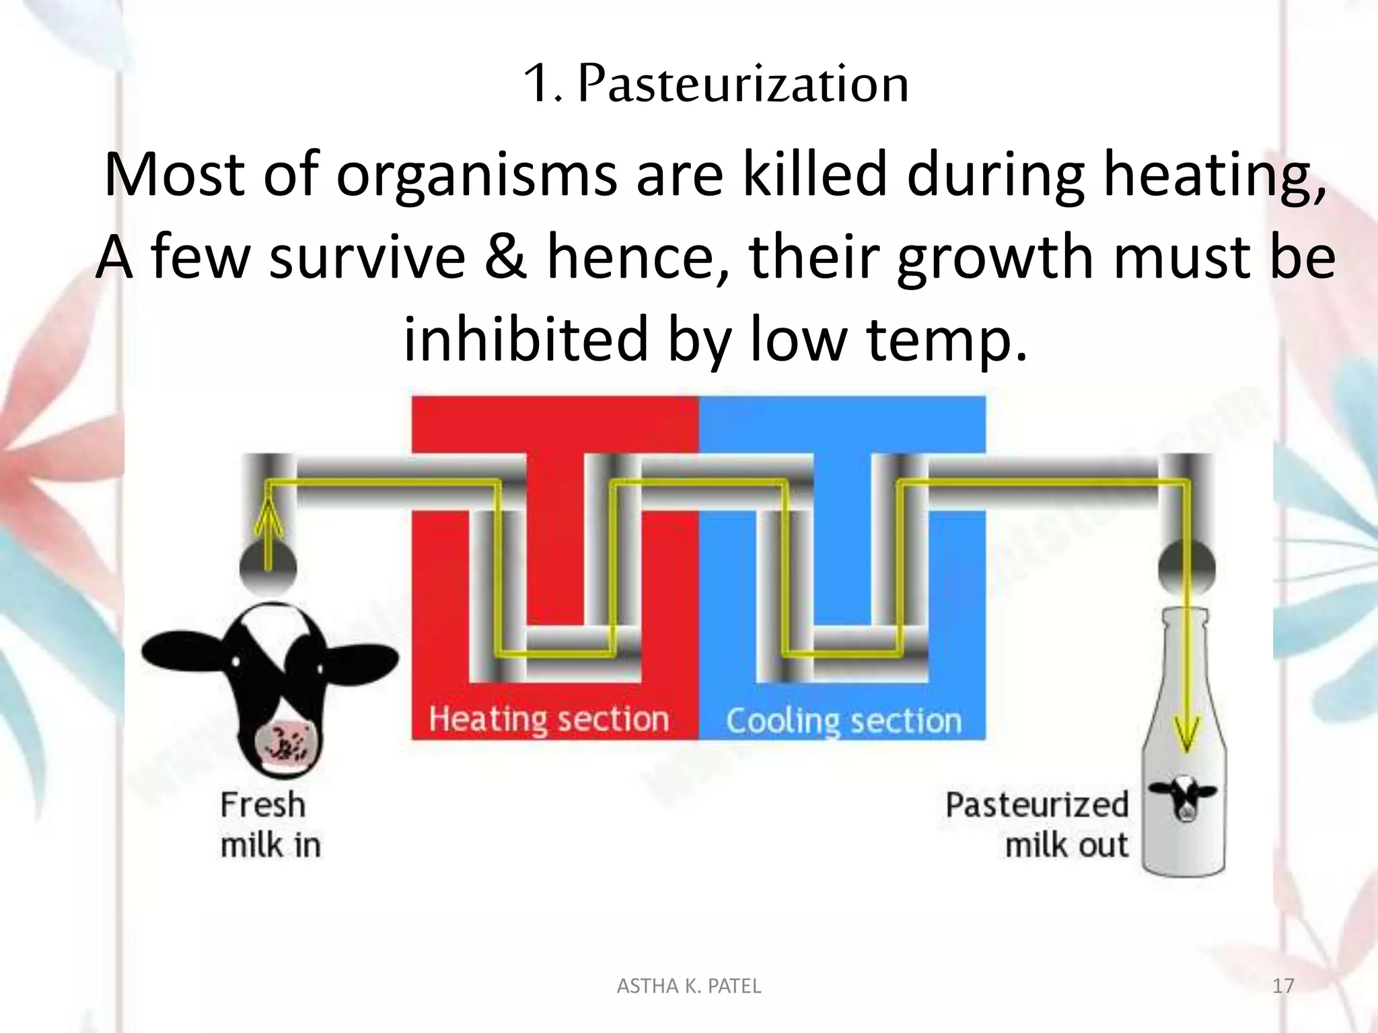

Slide 42
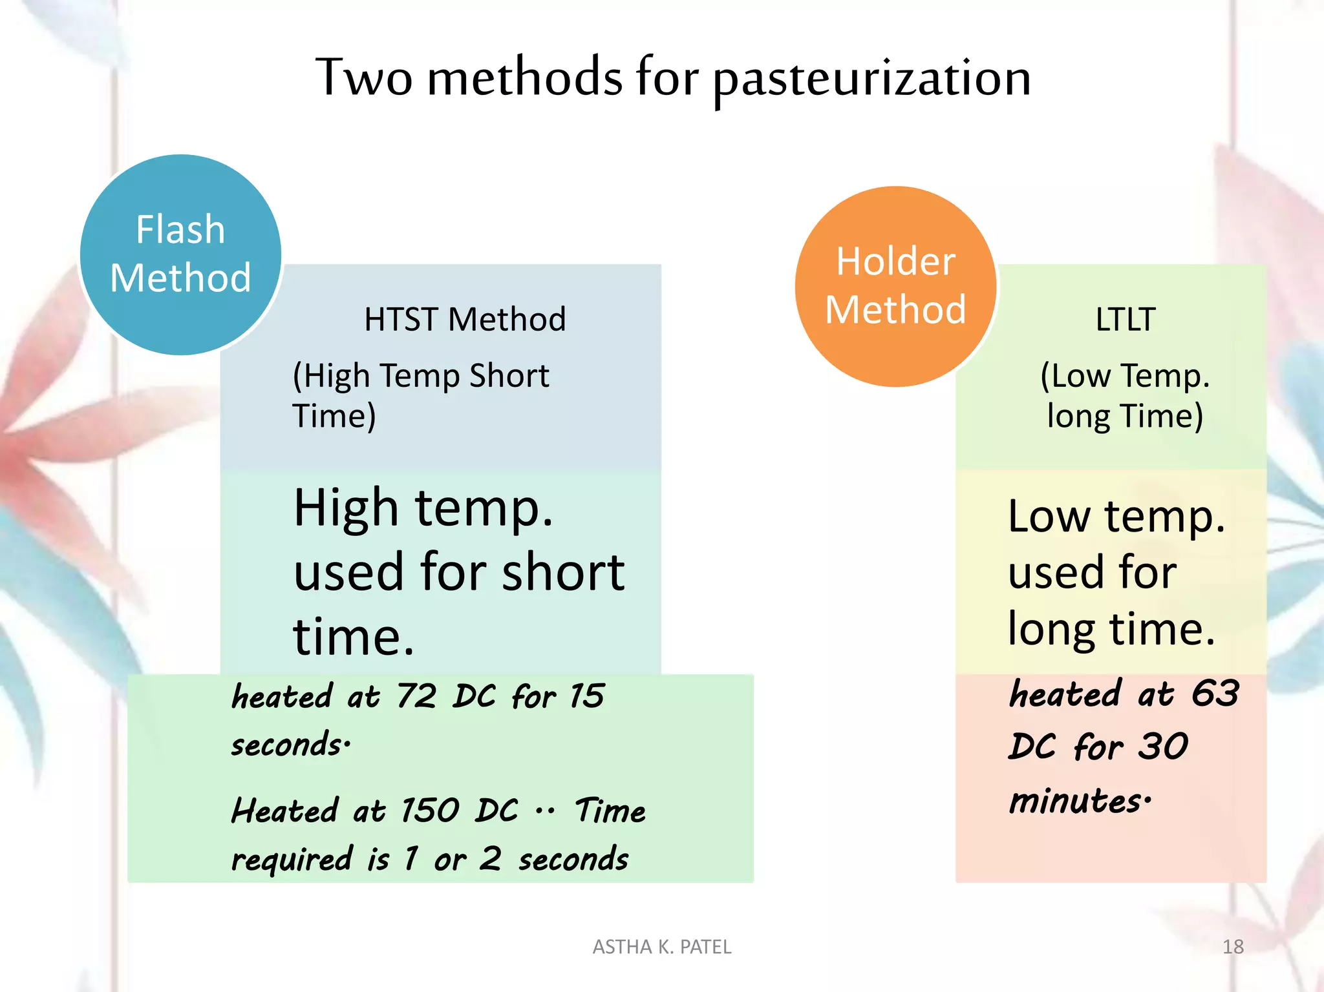
°C
°C
°C

Slide 43
