Slide 1
Freeze Drying or Lyophilization
Certain food stuff which can not be heated, even to moderate temperatures in ordinary drying, may be freeze dried. Freeze drying is also called as Lyophilization.
The process was first applied to food products after the Second World War.
Coffee was the first freeze dried food products to be produced, but now vegetables, fruits, meats, fish, dairy products, herbs and food flavorings can be freeze dried.
The substance to be dried is usually frozen by very cold air. In freeze drying the water is as a vapor by sublimation from the frozen material in a vacuum chamber.
After the moisture sublimes to a vapor, it is removed by mechanical vacuum pumps or steam jet ejector.

Slide 2
Since the vapor pressure of ice is very small, freeze drying requires very low pressure or very high vacuum.

Slide 10
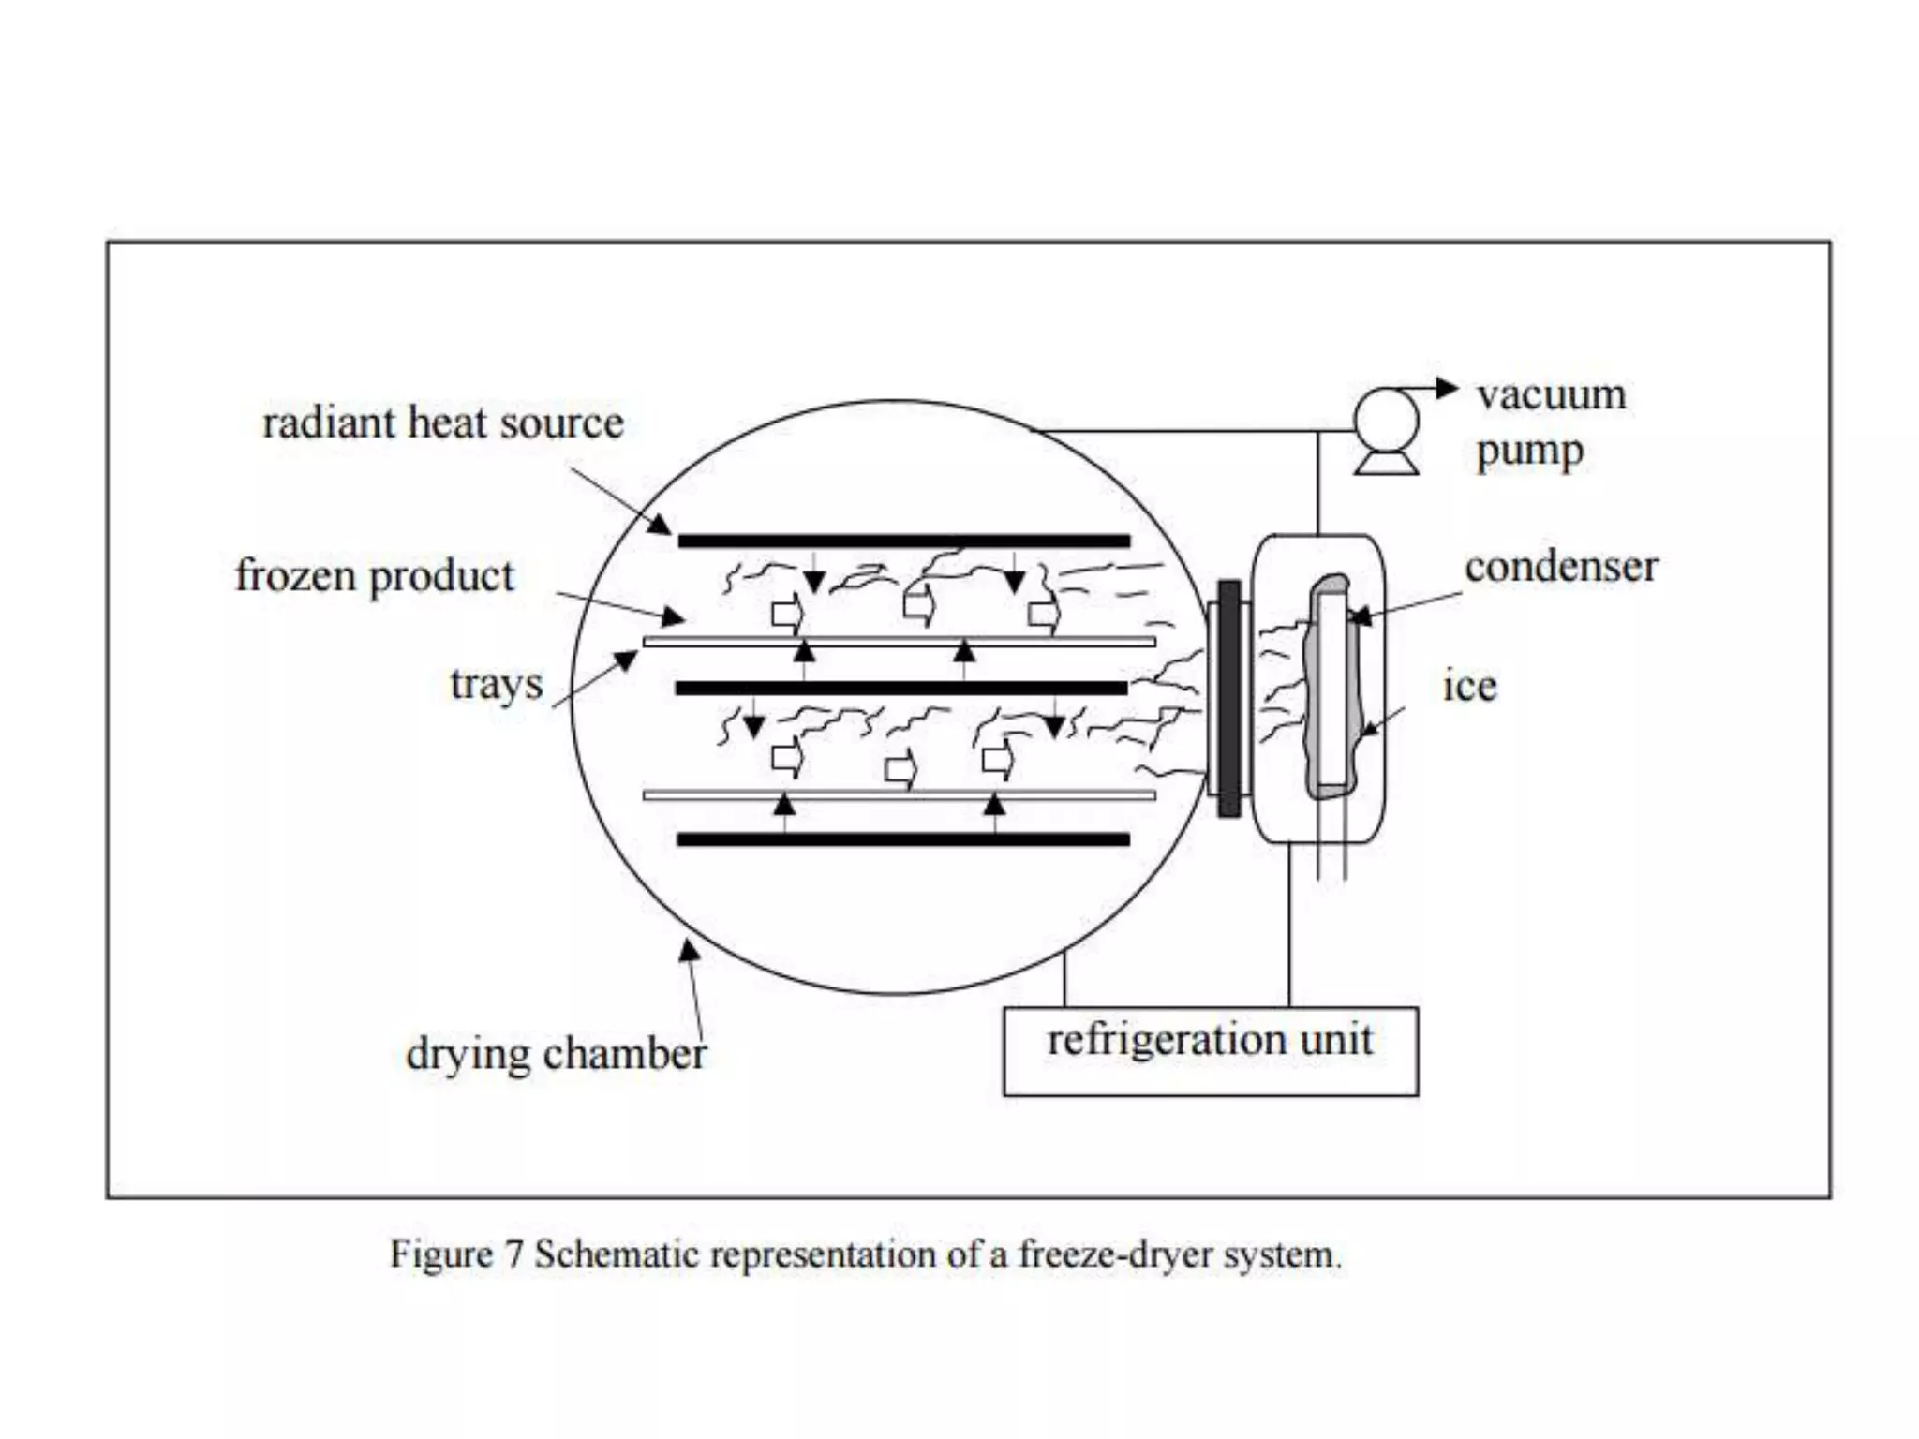

Slide 11
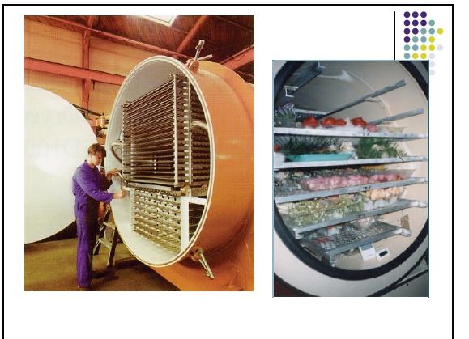
A commercial freeze dryer

Slide 13
The advantages of freeze-dried food
The process at low temperature and low pressure makes freeze drying an effective way to keep the color, shape, texture, smell, flavor and heat-sensitive nutrients of food and also eliminates the surface hardening of food. It is suitable for high value products.
Freeze-dried food is porous and easy to be rehydrated and instantly dissolved by adding water. It can be consumed directly or after rehydration.
Since freeze-dried food contains very low moisture content, it has relatively small density and is easy to be transported. i.e., it is lightweight, which reduces cost of shipping.
The freeze-dried food can be preserved at room temperature for a long time. It requires no refrigeration, hence, storage costs are reduced.
A freeze dried food has long shelf-life (more than 12 months) when packaged properly.

Slide 14
The disadvantages of freeze-dried food
If exposed directly to air, the open porous structure of the food may allow oxygen to enter and cause oxidative degradation of lipids and a series of chemical reactions will happen, resulting in the deterioration of food.
The freeze-dried products have to be vacuum-packaging or vacuum-nitrogen charged packaging. The packaging materials should be waterproof.
During transportation and sale process, freeze-dried food is easy to be powdered or cracked for its loose porous structure.
Freeze-drying is a time-consuming (Lengthy process time) and energy-consuming process, which lead to higher product costs of freeze-dried.
Freeze drying system includes vacuum and refrigeration equipments. The initial costs are relatively high.

Slide 15
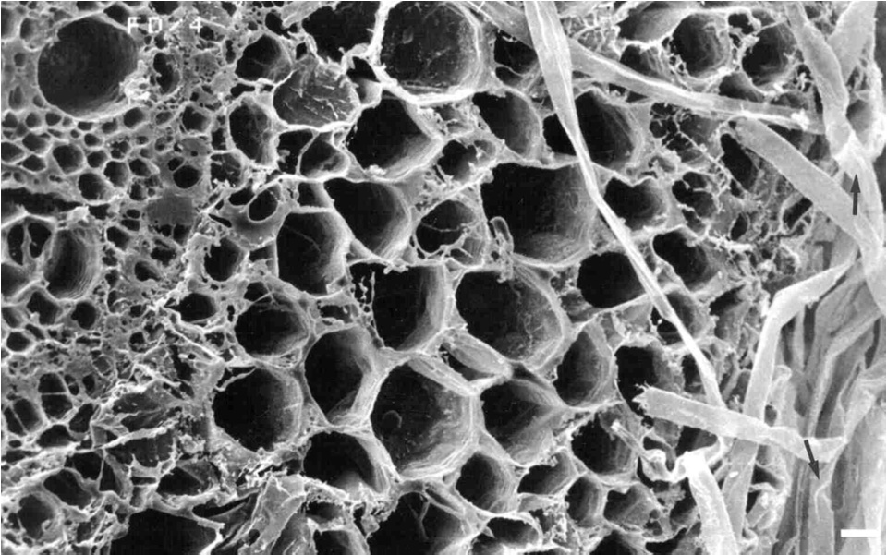
As a rule, freeze drying produces the highest quality food product obtainable by any drying method. During freeze drying the porous structure of the material do not collapse. When water is added later, the rehydrated product retains much of its original structural form.

Slide 16
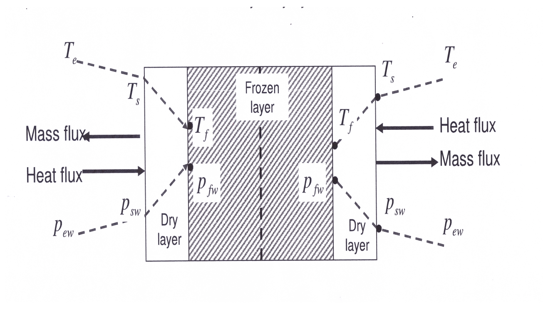
Heat-Mass Transfer and Drying Time Estimation
In the freeze drying process the original material is composed of a frozen core of material. As the ice sublimes, the plane of sublimation, which started at the outside surface, recedes and a porous shell of material already dried remains. The heat for the latent heat of sublimation of 2838 kJ/kg ice is usually conducted inward through the layer of dried material. In some cases it is also conducted through the frozen layer from the rear. The vaporized water vapor is transferred through the layer of dried material. Hence, heat and mass transfer are occurring simultaneously.

Slide 18
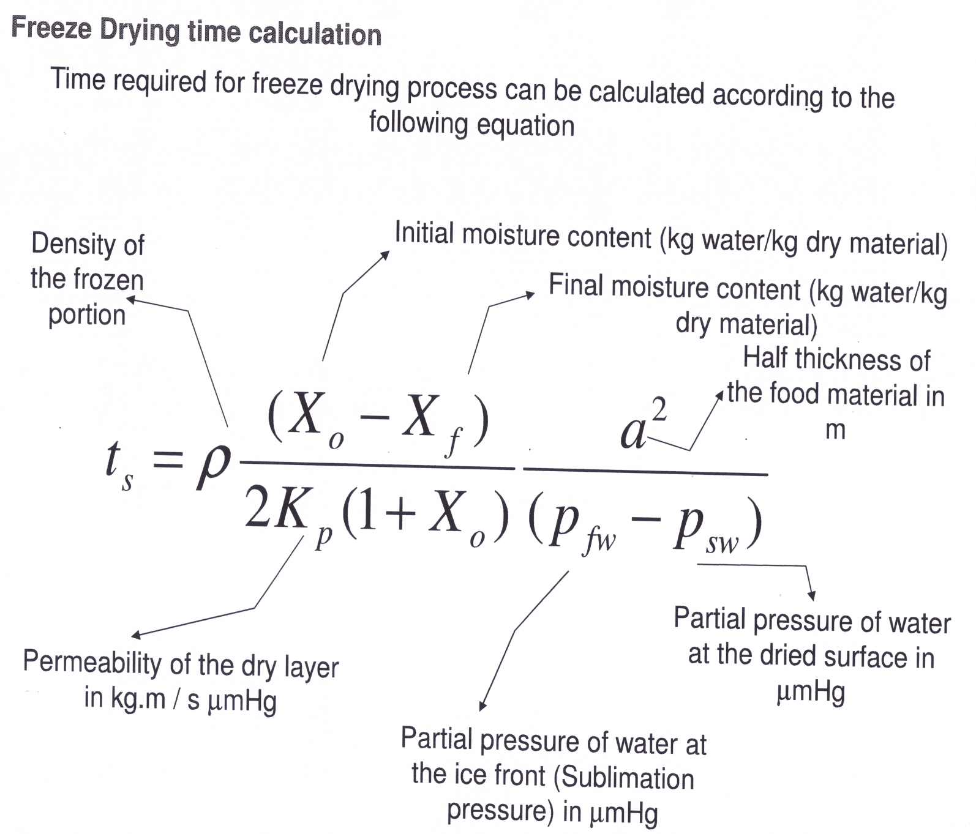
Freeze Drying Time Calculation

