Slide 1
Cold Storage Room Design

Slide 2
A cold storage room is used to store perishable products, such as fruit vegetables and meat to slow down their deterioration and preserve them as fresh as possible for as long as possible.
Heat is a factor that accelerates degradation of products. For this reason, the heat in the atmosphere in the cold rooms are removed and the products are cooled.
To remove the heat we use a refrigeration system as this allows accurate and automatic control of the temperature.
To remove the heat we need to know what the cooling load will be. The cooling load varies throughout the day so in most cases the average cooling load is calculated and the refrigeration capacity is calculated to suit this.

Slide 3
Refrigerated spaces are maintained below the temperature of their surroundings, and thus there is always a driving force for heat flow toward the refrigerated space from the surroundings.
As a result of this heat flow, the temperature of the refrigerated space will rise to the surrounding temperature unless the heat gained is promptly removed from the refrigerated space.
A refrigeration system should obviously be large enough to remove the entire heat gain in order to maintain the refrigerated space at the desired low temperature.
Therefore, the size of a refrigeration system for a specified refrigerated space is determined on the basis of the rate of heat gain of the refrigerated space.
In summary;
Cooling Load is calculated in 4 main groups:
1- Heat losses on the wall, floor, and ceiling surrounding the cooled volume
2- Hot air entering the cold storage while the cold room door is open
3- Heat load from stored products
4- Heat from the heat sources inside the cold storage (people, lighting, engine, fan, equipment such as fork lifts, trucks, defrosting machine etc.)

Slide 4
The total rate of heat gain of a refrigerated space through all mechanisms is called the refrigera­tion load, and it consists of
1) Transmission heat load, which is heat conducted into the refrigerated space through its walls, floor, and ceiling. Heat always flows from hot to cold and the interior of the cold room is obviously a lot colder than its surroundings, so heat is always trying to enter the space because of that difference in temperature. Typically 5-15% is through transmission loads.
2) Infiltration heat load, which is due to surrounding warm air entering the refrigerated space through the cracks and open doors. Infiltration adds 1-10% to the cooling load.
3) Product heat load, which is the heat removed from the food products as they are respire and/or cooled to refrigeration temperature. Product loads account for typically 55-75% of the cooling load.
a) Its the energy required to cool, freeze and further cool after freezing. If you’re just cooling the products then you only need to consider the sensible heat load. If you’re freezing the product then you need to account for the latent heat also as a phase change occurs.

Slide 5
b) The product respiration is the heat released (heat of respiration) by living products such as fruits and vegetables during the respiration process. These will generate heat as they are still alive, that’s why we’re cooling them to slow them down their deterioration and preserve them for longer.
To calculate this we’ll use the formula
Q = m x q / 3600
Q = kWh/day
q = heat of respiration of the product (1.9 kJ/kg)
a and b = are the constants,
T = storage temperature (ºC)
m = mass of product in storage (kg)
3600 = converts the kJ to kWh.
4) Internal heat load, which is heat generated by the lights, fans, electric motors, equipment such as fork lifts, trucks etc., and people in the refrigerated space. Internal loads account for around 10-20%.

Slide 6
5) Refrigeration equipment heat load, which is the heat generated by the refrigeration equipment as it performs certain tasks such as reheating and defrosting.
The refrigeration equipment in the room account for around 1-10% of the total cooling load. For this we want to know the rating of the fan motors and estimate how long they will run for each day, then we want to also account for any heat transferred into the space from defrosting the evaporator.
The first four segments of load constitute the net heat load for which a refrigeration system is to be provided; the fifth segment consists of all heat gains created by the refrigerating equipment. Thus, net heat load plus equipment heat load is the total refrigeration load for which a compressor must be selected.
The sum of all these heat sources is know as the heat gain (or heat load) of the building, and is expressed either in BTU (British Thermal Units) or kW (Kilowatts).
SAFETY FACTOR
Generally, the calculated load is increased by a factor of 5 %- 25 % to allow for possible discrepancies between the design criteria and actual operation.

Slide 7
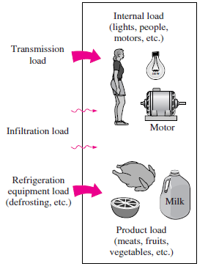
Transmission Heat Load
The transmission load depends on the materials and construction of the walls, floor, and ceiling of the refrigerated space, the surface area, the air motion or wind conditions inside or outside, and the temperature difference between the refrigerated space and the ambient air.
The rate of heat transfer through a particular wall, floor, or ceiling section can be determined from
Q_{transmission} = Heat gain = ${UA}_{0}$∆T
where, $A_{0}$ = outside surface area of the section,
∆T = temperature difference between the outside air and the air inside the refrigerated space,
U = overall heat transfer coefficient
Figure showing various mechanisms of heat gain that make up the total refrigeration load of a refrigerated space.

Slide 8
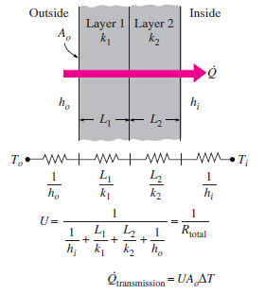
Noting that the thickness-to-thermal-conductivity ratio of a layer represents its unit thermal resistance, the overall heat transfer coefficient is determined from :
Single layer insulation
Multi-layer insulation
where h_{i} =heat transfer coefficient at the inner surface of the refrigerated space
h_{o} =heat transfer coefficient at the outer surface of the refrigerated space
ΣL/k = sum of the thickness-to-thermal-conductivity ratios of the layers that make up the section under consideration
Energy consumption (heat transfer) increases dramatically as thermal conductivity of wet insulation increased by 32 times.
Figure showing the determination of thermal resistance and the overall heat transfer coefficient for a two-layer wall section (multi-layer) for the calculation of transmission losses.

Slide 9
The thermal conductivity of several cold storage insulations are listed in Table 1. These values decrease with age.
Table 1. Thermal Conductivity of Cold Storage Insulation Insulation
- ------------------------------------------------------------------------------------------------
*Thermal Conductivity k, W/(m.K)
- ------------------------------------------------------------------------------------------------
Polyurethane board (R-11 expanded) 0.023 to 0.026 (Thickness: 170 mm)
Polyisocyanurate, cellular (R-141** expanded) 0.027 (Thickness: 170 mm)
Polystyrene, extruded (R-142**) 0.035 (Thickness: 220 mm)
Polystyrene, expanded (R-142**) 0.037 (Thickness: 220 mm)
Corkboard** 0.043
Foam glass*** 0.044 (Thickness: 200 mm)
- ------------------------------------------------------------------------------------------------
*Values are for a mean temperature of 75°F and insulation is aged 180 days.
**Seldom used insulation. Data is only for reference.
***Virtually no effects due to aging.

Slide 10
For still air, it is common practice to take 10 W/m² · º C for h_{i} and h_{o}. A value of 20 or 30 W/m² · ºC can be used for h_{o} for low or moderate wind conditions outside (about 24 km/h wind), respectively.
The walls, floor, and ceiling of typical refrigerated rooms are well insulated, and the unit thermal resistance L/k of the insulation layer is usually much larger than the L/k of other layers such as the sheet metals and the convective resistance 1/h_{i} and 1/h_{o}.
Therefore, the thermal resistances of sheet metal layers can always be ignored. Also, the convection resistances 1/hi and 1/ho are often negligible, and thus having very accurate values of hi and ho is usually not necessary.
When constructing refrigerated rooms, it is desirable to use effective insulation materials to minimize the refrigerated space for a fixed floor area.
Minimum insulation thicknesses for expanded polyurethane (k = 0.023 W/m ·ºC) recommended by the refrigeration industry are given in Table 1.
Note that the larger the temperature difference between the refrigerated space and the ambient air, the thicker the insulation required to reduce the transmission heat gain to reasonable levels.

Slide 11
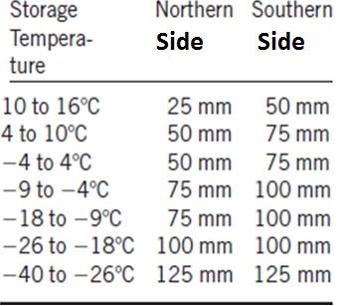
Table 2. Minimum recommended expanded polyurethane insulation thicknesses for refrigerated rooms.
Equivalent thicknesses for other insulating materials can be obtained by multiplying the values in this table by k_{ins}/k_{poly} where k_{ins} and k_{poly} are the thermal conductivities of the insulation material and the polyurethane, respectively.
Direct exposure to the sun increases the refrigeration load of a refrigerated room as a result of the solar energy absorbed by the outer surface being conducted into the refrigerated space. The effect of solar heating can conveniently be accounted for by adding a few degrees to the ambient temperature.
For example, the solar heating effect can be compensated for, by adding 4ºC to the ambient temperature for the east and west walls, 3ºC for the south walls, and 9ºC for flat rooms with medium-colored surfaces such as unpainted wood, brick, and dark cement.
For dark- (or light-) colored surfaces, we should add (or subtract) to 1ºC (or from) these values.

Slide 12
In most cases the temperature difference (ΔT) can be adjusted to compensate for solar effect on the heat load. The values given in Table 3 apply over a 24-h period and are added to the ambient temperature when calculating wall heat gain.
Table 3. Allowance for Sun Effect
-- ------------------------------------------------------------------------------------------------------------------------------
Typical Surface Types East South West Flat
Wall wall wall roof
°C °C °C °C
-- ------------------------------------------------------------------------------------------------------------------------------
Dark colored surfaces
Slate roofing 5 3 5 11
Tar roofing
Black paint
Medium colored surfaces
Unpainted wood 4 3 4 9
Brick
Red tile
Dark cement
Red, gray, or green paint
Light colored surfaces
White stone 3 2 3 5
Light colored cement
White paint
-- ---------------------------------------------------------------------------------------------------------------------------------

Slide 13
Infiltration Heat Load
The heat gain due to the surrounding warm air entering the refrigerated space through the cracks and the open doors continues the infiltration load of the refrigeration system.
The infiltration load changes with time. We should consider the maximum value to properly size the refrigeration system, and the average value to properly estimate the average energy consumption.
In installations that require the doors to remain open for long periods of time, such as distribution warehouses, the infiltration load may amount to more than half of the total refrigeration load.
In the absence of any winds, the infiltration is due to the density difference between the cold air in the refrigerated space and the surrounding warmer air.
A practical way of determining the infiltration load is to estimate the rate of air infiltration in terms of air changes per hour, which is the number of times entire air content of a room is replaced by the infiltrating air per hour.

Slide 14
The rate of infiltration heat gain can be determined from the following formula:
Q = V x E x C x (T₀ - T_{i}) / 3600
Q = kWh / day
C = Number of volume changes per day
V = Cold storage volume
E = Energy per cubic meter in degrees Celsius
T₀ = Outdoor air temperature
T_{i} = Cold room temperature
3600 = kJ to kWh.

Slide 15
Product Heat Load
The heat removed from the food products as they are cooled to refrigeration temperature and the heat released as the fresh fruits and vegetables respire in storage constitute the product load of the refrigeration system .
As we mentioned earlier, the refrigeration of foods involves cooling only, but the freezing of foods involves cooling to the freezing point (removing the sensible heat), freezing (removing the latent heat), and further cooling to the desired subfreezing temperature (removing the sensible heat of frozen food).
The three components of the product load can be determined from
Q_{cooling, fresh} = mc_{p}, _{fresh}(T₁ - T_{freeze}) (kJ)
Q_{freezing} = mh_{latent} (kJ)
Q_{cooling}, _{frozen} = mc_{p, frozen}(T_{freeze} - T₂) (kJ)
where, m =mass of the food product, c_{p}, _{fresh} = specificheat of the food before freezing, c_{p, frozen} = specific heat of the food after freezing h_{latent} = latent heat of fusion of the food, T_{freeze} =freezing temperature of the food , T₁ = initial temperature of the food (before refrigeration) T₂ = final temperature of the food (after freezing)

Slide 16
The rate of refrigeration needed to cool a product from T₁ to T₂ during a time interval Δt can be determined from:
Food products are usually refrigerated in their containers, and the product load also includes cooling the containers. The amount of heat that needs to be removed from the container as it is cooled from T₁ to T₂ can be determined from:
Q_{container} = mc_{p} _{container}(T₁ -T₂), (kJ)
where m is the mass of the container and c_{p, container} is the specific heat of the container, which is 0.50 kJ/kg ·ºC for stainless steel, 1.7 kJ/kg ·ºC for nylon, 1.9 kJ/kg ·ºC for polypropylene, and 2.3 kJ/kg ·ºC for polyethylene containers.
The contribution of Q _{container} to the refrigeration load is usually very small and can be neglected.

Slide 17
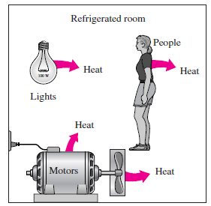
Internal Heat Load
The heat generated by the people, lights, fans, electric motors, and other heat-dissipating equipment in the refrigerated space constitutes the internal load of the refrigeration system (See Figure below)
The rate of heat dissipation by people depends on the size of the person, the temperature of the refrigerated space, the activity level, and the clothing, among other things.
A person must generate more heat at lower temperatures to compensate for the increased rate of heat transfer at higher temperature differences.

Slide 18
An average person, for example, will dissipate 210 W of heat in a space maintained at 10 º C and 360 W in a space at - 15 º C.
The rate of heat dissipation from lights is determined by simply adding the wattage of the light bulbs and the fluorescent tubes. For example, five 100-W incandescent light bulbs and eight 40-W fluorescent tubes contribute 820 W to the refrigeration load when they all are on.
The calculation of the heat dissipation from the motors is more complicated.
When the body of a motor-running a device is housed outside the refrigerated space, then the internal heat load of this motor is simply the power consumed by the device in the refrigerated space.
When the motor is housed inside the refrigerated space, then the heat dissipated by the motor also becomes part of the internal heat load since this heat now must be removed from the refrigeration system. Keeping the motors inside the refrigerated space may increase the internal load due to motors by 30 to 80 percent.

Slide 19
Refrigeration Equipment Heat Load
The refrigeration equipment load refers to the heat generated by the refrigeration equipment itself as it performs certain tasks such as circulating the cold air with a fan, electric reheating to prevent condensation on the surfaces of the refrigerator, and defrosting to prevent frost build-up and to evaporate moisture.
Equipment load can be as little as 5 percent of the total refrigeration load for simple refrigeration systems or it may exceed 15 percent for systems maintained at very low temperatures.

Slide 20
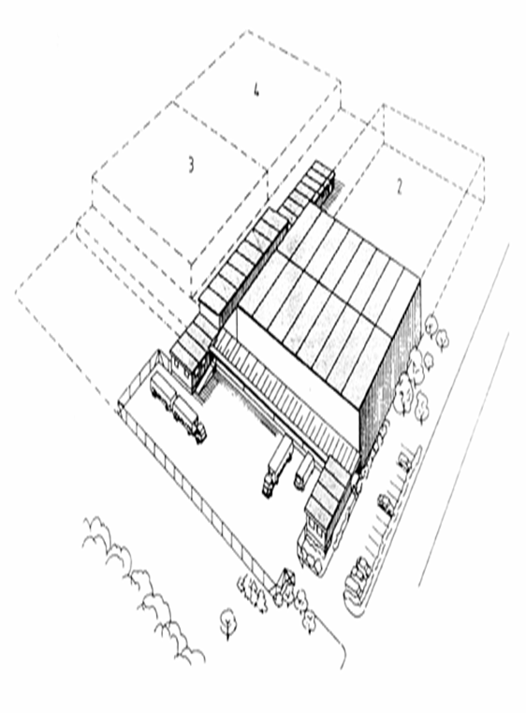
Selection of Direction of Cold Storage
N-S direction (N-S walls: long walls. Light color paint at south wall reduces 11°C compared with dark)
W-E walls should have good insulation and light color paint
N
W
S
E

Slide 21
Size of Cold Storage
V = v(C+S)
where,
V is the total volume needs in cubic feet.
v is the volume occupied by one product container in cubic feet.
C is the maximum number of containers to be cooled at any one time.
S is the maximum number of containers to be stored at any one time

Slide 22
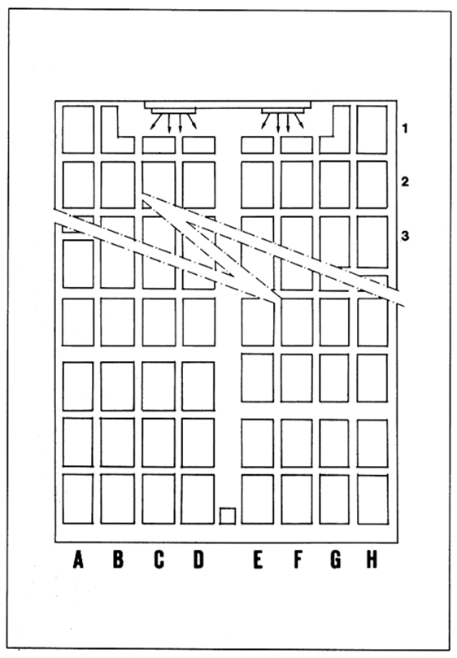
Space Requirement
Storage space 3.4 m³/ton suitable for stacking (istifleme) and circulation of cold air
Chamber height : 3 to 10 m
For loading and unloading, distance between;
Rack & rack : should not < 75cm
(Raftan rafa)
Rack & wall : at least 20-25 cm
Ceiling & product shelf top : 30 cm

Slide 23
Example: Given that volume of 1 product container is 8.75 ft³. Calculate the total volume of cold storage room if the maximum number of containers to be cooled at any one time is 25 and the maximum number of containers to be stored at any one time is 500.
Solution:
v = 8.75 ft³; C = 25; S = 100
V = v(C+S)
V = 8.75 ft³ (25 + 500) = 4593.75 ft³
Convert in to m³
V = 4593.75 ft³ x(1 m /3.28 ft)³ = 130.2 m³

Slide 24
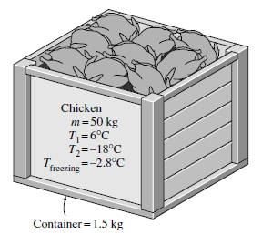
EXAMPLE : Freezing of Chicken
A supply of 50 kg of chicken at 6°C contained in a box is to be frozen to -18 ºC
in a freezer. Determine the amount of heat that needs to be removed. Neglect the product respiration load (Qresp = 0). The container box is 1.5 kg, and the specific heat of the box material is 1.4 kJ/kg ·ºC.
Assumption: The entire water content of chicken freezes during the process.
For chicken, the freezing temperature is -2.8ºC, the latent heat of fusion is 247 kJ/kg, the specific heat is 3.32 kJ/kg·ºC above freezing and 1.77 kJ/kg·ºC below freezing
The total amount of heat that needs to be removed (the cooling load of the freezer) is the sum of the latent heat and the sensible heats of the chicken before and after freezing as well as the sensible heat of the box, and is determined as follows:

Slide 25
1. Cooling fresh chicken from 6 ºC to -2.8 ºC
Q_{cooling, fresh} =(mcpΔT)_{fresh} =(50 kg)(3.32 kJ/kg ºC)[6 - (-2.8)]C =1461 kJ
2. Freezing chicken at - 2.8 ºC
Q_{freezing} =m Δ h_{latent} =(50 kg)(247 kJ/kg) =12,350 kJ
3. Cooling frozen chicken from -2.8 ºC to -18 ºC
Q_{cooling, frozen} =(mc_{p} Δ T)_{frozen}= (50 kg)(1.77 kJ/kg .ºC)[-2.8 (-18)]ºC =1345 kJ
4. Cooling the box from 6ºC to -18 º C
Q_{box} =(mc_{p} ΔT)_{box} =(1.5 kg)(1.4 kJ/kg ºC)[6 -(-18)]ºC = 50 kJ
5. Q_{res} = 0 (given)
Therefore, the total amount of cooling that needs to be done is:
Q_{total} = Q_{resp} + Q_{cooling, fresh} + Q_{freezing} + Q_{cooling, frozen Qbox}
0+1461+12,350 +1345 +50 =15,206 kJ
Q_{total} = 15,206x1.2 = 18,247 kJ (20 % safety factor)
DISCUSSION : Note that most of the cooling load (81 percent of it) is due to the removal of the latent heat during the phase change process. Also note that the cooling load due to the box is negligible (less than 1 percent), and can be ignored in calculations.

Slide 26
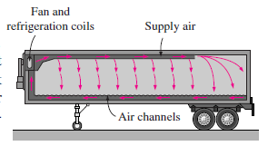
TRANSPORTATION OF REFRIGERATED FOODS
Perishable food products are transported by trucks and trailers, railroad cars, ships, airplanes, or a combination of them from production areas to distant markets.
Transporting some farm products to a nearby market by a small truck may not require any special handling, but transporting large quantities over long distances usually requires strict climate control by refrigeration and adequate ventilation. See Figure below.

Slide 27
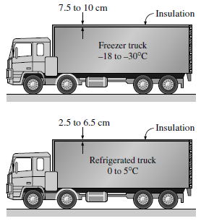
Using a thick insulation layer on walls reduces the rate heat gain into the refrigerated space, but it also reduces the available cargo space since the outer dimensions of the trucks and trailers are limited.
Urethane foam is commonly used as an insulating material because of its low thermal conductivity (k = 0.026 W/m · ºC).
The thickness of polyurethane insulation used is in the range of 7.5 to 10 cm for freezer trucks maintained at -18 º C or lower, and 2.5 to 6.5 cm for refrigerated trucks maintained above freezing temperatures as shown below.
The outer surface of the truck must be vapor proof to prevent water vapor from entering the insulation and condensing within the insulation.
Air entering inside the refrigerated space of the truck through cracks represents a significant heat gain since the moisture in the air will be cooled inside and condensed, releasing its latent heat.

Slide 28
The cargo space must be maintained at - 18 ºC for most frozen products and - 29 ºC for other deep-frozen products such as ice cream.
The rate of heat gain can also increase significantly as a result of the product cooling load, air infiltration, and opening of the door during loading and unloading.
The interior of refrigerated trucks should be precooled to the desired temperature before loading.
The fruits and vegetables should also be cooled to the proper storage temperature before they are loaded into the refrigerated railcars or trucks. This is because the refrigerated cars or trucks do not have the additional refrigeration capacity to cool the products fast enough.

Slide 29
DESIRED Environmental conditions

