Slide 1
FE 322 FOOD PRODUCTION MANAGEMENT
4. ISO 9000 Quality Management System Standards

Slide 2
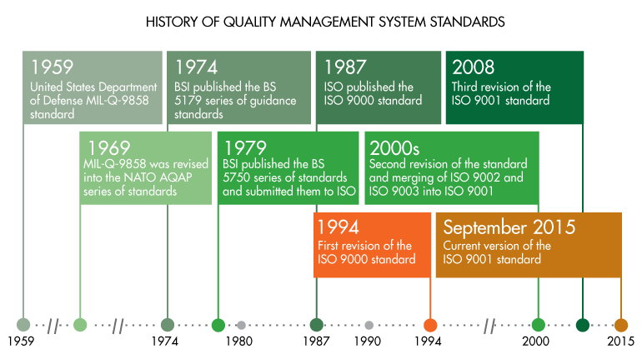
Role, origins and application of ISO 9000

Slide 3
Role, origins and application of ISO 9000
What is ISO 9000?
ISO 9000:2000 is a series of three International Standards for Quality Management Systems. They specify requirements and recommendations for the design and assessment of management systems. ISO 9000 is not a product standard. None of the standards in the family contain requirements with which a product or service can comply. There are no product acceptance criteria in ISO 9000 so you can’t inspect a product against the standard.

Slide 4
Role, origins and application of ISO 9000
What is the purpose of ISO 9000?
The purpose of these standards is to assist organizations of all types to implement and operate effective quality management systems. These standards provide a vehicle for consolidating and communicating concepts in the field of quality management that have been approved by an international committee of representatives from national standards bodies. It is not their purpose to fuel the certification, consulting, training and publishing industries. The primary users of the standards are intended to be organizations acting as either customers or suppliers.

Slide 5
Role, origins and application of ISO 9000
What is the ISO 9000 family of standards?
The three standards in the family are
ISO 9000 Quality management systems – Fundamentals and vocabulary
ISO 9001 Quality management systems – Requirements
ISO 9004 Quality management systems – Guidelines for performance improvements

Slide 6
Role, origins and application of ISO 9000
What is the purpose of these standards?
Each standard fulfils a different purpose.
The purpose of ISO 9000 is to provide an appreciation of the fundamental principles of quality management systems and an explanation of the terminology used in the family of standards.
The purpose of ISO 9001 is to provide requirements which if met will enable organizations to demonstrate they have the capability to consistently provide product that meets customer and applicable regulatory requirements. ISO 9001 states that the standard can be used to assess the organization’s ability to meet customer, regulatory and the organization’s own requirements.
The purpose of ISO 9004 is to provide guidance for improving the efficiency, effectiveness and overall performance of an organization.

Slide 7
Model of a process based quality management system

